Slide 1


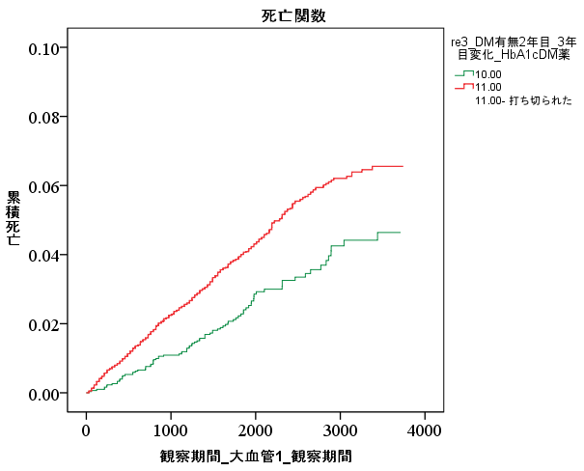


Impact of Diabetes Remission on the Incidence of Cardiovascular Disease
POPULATION
RESULTS
Incidence of CVD
Age | <50 years
 | ≥50 years
BMI | <25 kg/m²
 | ≥25 kg/m²
Change in BMI | ≤0 %
 | >0 %
Adjusted HR (95% CI)
 | Adjusted HR (95% CI)
No remission | Reference
Remission | 0.71 (0·57–0·89)
Nationwide claims database
with multiple health checkups
No remission
Remission
Log rank P < 0.0001
Cumulative incidence
299,967 individuals
aged 20–72 years
without prior CVD
Time (days)
Ref: no remission
FINDINGS
Diabetes remission decreased the risk of CVD by approximately 30%.
Younger and higher BMI were more likely to decrease CVD risk upon diabetes remission.
Weight loss did not always essential for reducing CVD risk following diabetes remission.
Median follow-up
5.0 years

