Slide 1
PCR-based amplification is required for the detection of circulating cell-free DNA from serum.
ICGEC-O-18
Venkatesh Madegowda¹*, Manohar M V¹, Medha Karnik¹, Nithin E A¹, Prathima T C¹, Sadiya M R¹, Devananda Devegowda¹, SubbaRao V Madhunapantula^{1#}
*Presenting Author
Venkatesha
Ph.D. Scholar
Center of Excellence in Molecular Biology & Regenerative Medicine
JSS Medical College, Mysuru
email:venkatesh@jssuni.edu.in Mobile: +91-903-549-8255
#Corresponding Author:
Dr. M.V.S.S.T. SubbaRao
Professor of Cellular and Molecular Biology
CEMR Laboratory,
Department of Biochemistry, JSS Medical College,
JSS Academy of Higher Education & Research,
Mysuru-570015.

Slide 2
Background and Need for the Study
Cancer-related deaths are expected to increase dramatically by the year 2030¹.
Early detection of cancer is crucial for achieving better treatment, and for decreasing mortality. But, only very few biomarkers are available for early diagnosis and prognosis ². Moreover, the existing biomarkers require tissue excision or invasive procedures, limiting their utility in routine diagnosis.
Therefore, the need for a specific early detection marker still persists.
Circulating cell-free DNA (ccf-DNA) is a newly reported biomarker, known to identify individuals suffering from cancer. Accurate detection of ccf-DNA from blood is crucial for the early diagnosis of diseases³.
But, isolation of ccf-DNA is challenging and requires magnification approaches for effective detection.
In this study, we report the standardization of an in-house protocol for ccf-DNA isolation from human serum samples.

Slide 3
Existing methods of ccf-DNA detection in serum
1. Circulating cell-free DNA in Serum as a Marker for the Early Detection of Tumor Recurrence in Breast Cancer Patients by QIAamp DNA Mini Kit from QIAGEN kit-based method.
2. Optimisation of robust singleplex and multiplex droplet digital PCR assays for high-confidence mutation detection in circulating tumour DNA by Maxwell, Promega, KingFisher Flex, Omega BioTek, QIAamp Circulating Nucleic Acid Kit according to the manufacturer’s protocols.
3. A simple silica-based DNA isolation method for cell-free DNA analysis from liquid biopsy.
4. A Comparison of Cell-Free DNA Isolation Kits: Isolation and Quantification of Cell-Free DNA in Plasma

Slide 4
Drawbacks of Existing methods
Commercial DNA isolation kits have been preferred because of their application simplicity and requiring shorter time for achieving high purity and high yield of DNA. However, the usage of these commercial kits for screening is expensive and requires expert technical staff.
Additionally, there is always a risk of discontinuation of the product.
Numerous, high-throughput cost-effective, and in-house methods have been developed for the isolation of ccf-DNA from serum samples for PCR applications.
For this reason, it is very important to develop new in-house ccf-DNA isolation methods with high yield and low cost, especially for middle-income countries.
Our protocol competes with the commercial isolation kit DNA in terms of yield concentration.
High isolation efficiency, minimal and easy workflow, which are the minimum requirements of a kit and not considered in the previous kits, have been achieved in our protocol

Slide 5
Strategies to overcome the challenges
Certain modifications are work-out with the isolation process.
a. Using certain chaotropic reagents
Constant changes in the Incubation time while cell disintegration
Changes in the centrifugation protocol
Additional cell washing steps
DNA precipitation time and the introduction of incubation at -20⁰C.

Slide 6
Introduction
The quality assessment and suitability of unusually low ccf-DNA concentrations introduce inconsistencies in preanalytical stages and impact various downstream applications remain challenging⁴.
2. Addressing this challenge, we have developed a PCR-based protocol for detecting a very small amount of ccf-DNA in the serum⁵.
3. ccf-DNA has the potential to depict the entire molecular and (epi)genetic landscape, irrespective of intratumor heterogenicity, aiding in precision treatment and monitoring relapse after early detection⁶.

Slide 7
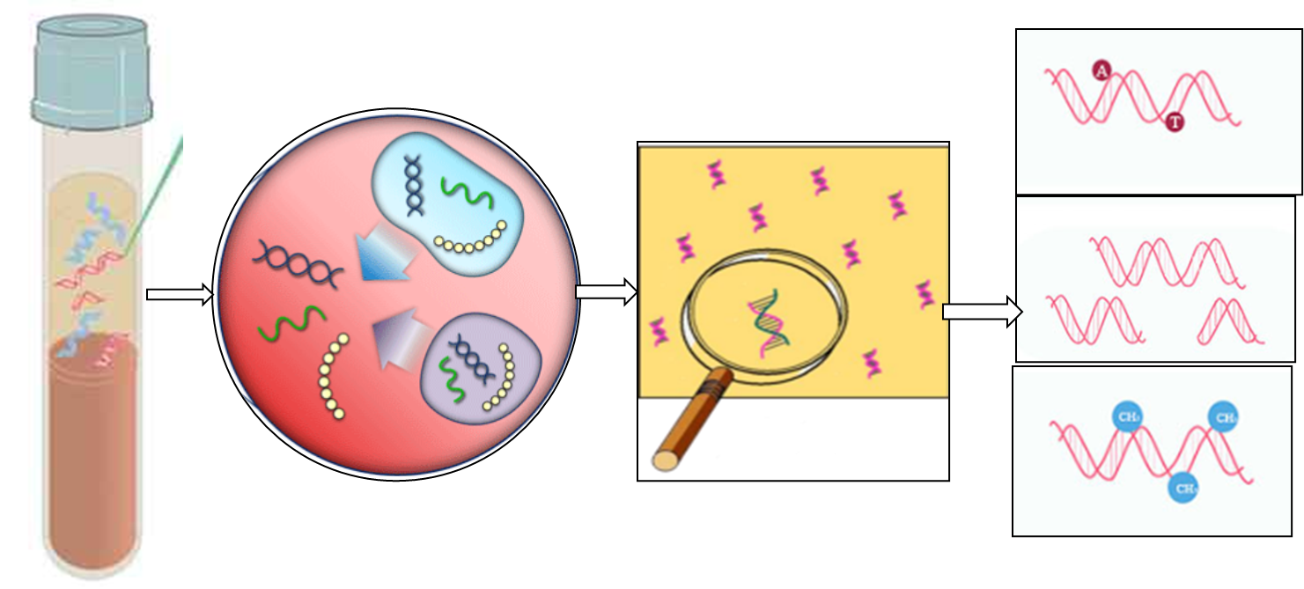
The presence of small fragments of ccf-DNA can detect early Cancer in Serum.
ccf-DNA in blood
Diagnose of ccf-DNA
Amplification of ccf-DNA
Serum/Blood

Slide 8
Aim & Objectives
Aim:
The study is aimed to optimize a suitable protocol for effectively detecting circulating cell-free DNA (ccf-DNA) from serum.
Objectives:
1. To isolate ccf-DNA from the serum
2. Optimize a PCR-based protocol to detect very low ccf-DNA, which is isolated from serum
3. Test whether the isolated ccf-DNA is suitable for various downstream applications such as RT-PCR.

Slide 9
Methodology
The study was conducted upon the approval of the Institutional Ethics Committee of JSS Medical College, Reg-JSSMC/IEC/240323/2022-23, JSS AHER Mysuru.
A total of 74 samples were collected from JSS & NK Hospital Mysuru.
Serum (500µL) was separated from the blood by centrifugation, and the ccf-DNA was isolated using Phenol Chloroform and Isoamylalcohol (PCI) protocol.
The obtained ccf-DNA was used for optimizing the PCR-based protocol to detect the presence of GAPDH & β-Globin, the most widely used endogenous controls.

Slide 10
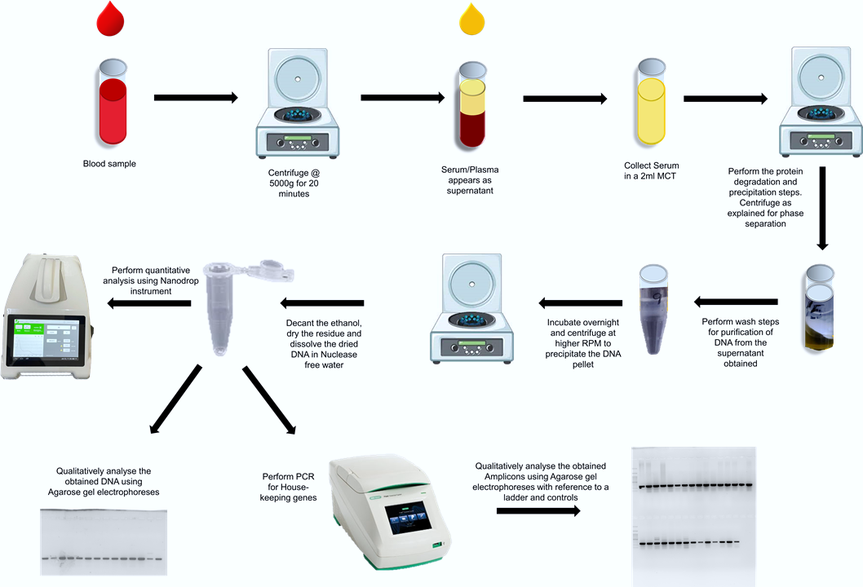
Schematic representation isolation process of ccf-DNA

Slide 11
Results Analysis:
The PCI protocol yielded ccf-DNA in varied amounts ranging from 4ng/µL to 740 ng/µL (quantity determined using a Nanodrop spectrophotometer).
Quality assessment by conventional agarose gel electrophoresis failed to detect this low quantity of ccf-DNA.
Therefore, we have adopted a PCR-based target-amplification method to determine the quality of isolated ccf-DNA.
Data analysis showed a prominent GAPDH & β-Globin band, indicating that PCR-based target amplification is a viable strategy for checking the quality of ccf-DNA.

Slide 12
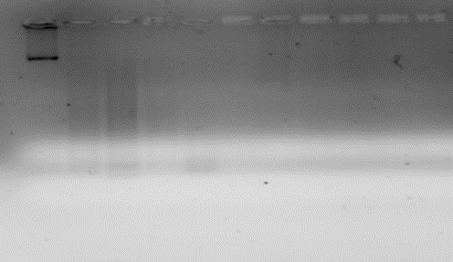
PCI protocol for improving ccf-DNA yield from serum
1
2
7
8
10
13
16
11
14
17
20
3
4
5
6
9
12
15
18
19
21
22
26
28
29
30
32
32
33
35
36
37
23
24
25
27
31
34
50
52
53
55
46
51
54
56
58
44
45
47
48
49
57
38
39
40
41
42
43
Concentration of ccf-DNA Yield
0.8% Agarose Gel Electrophoresis

Slide 13
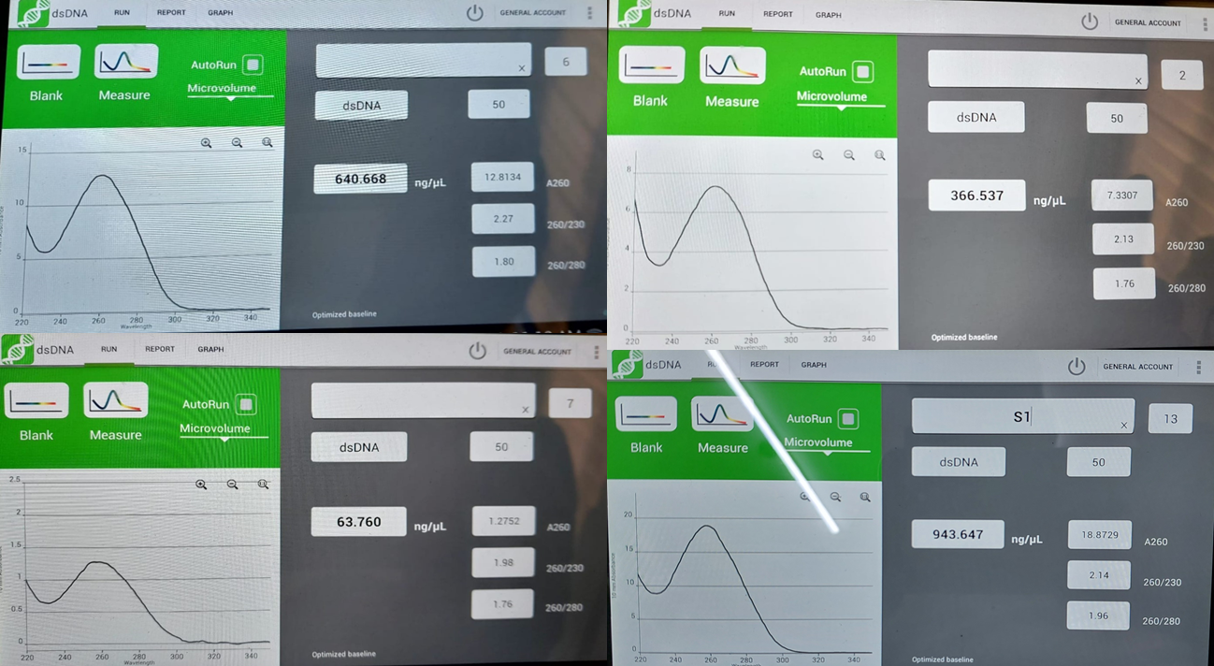
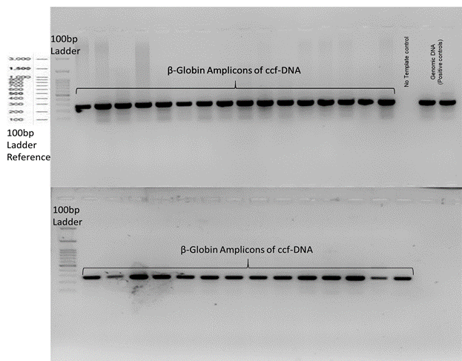
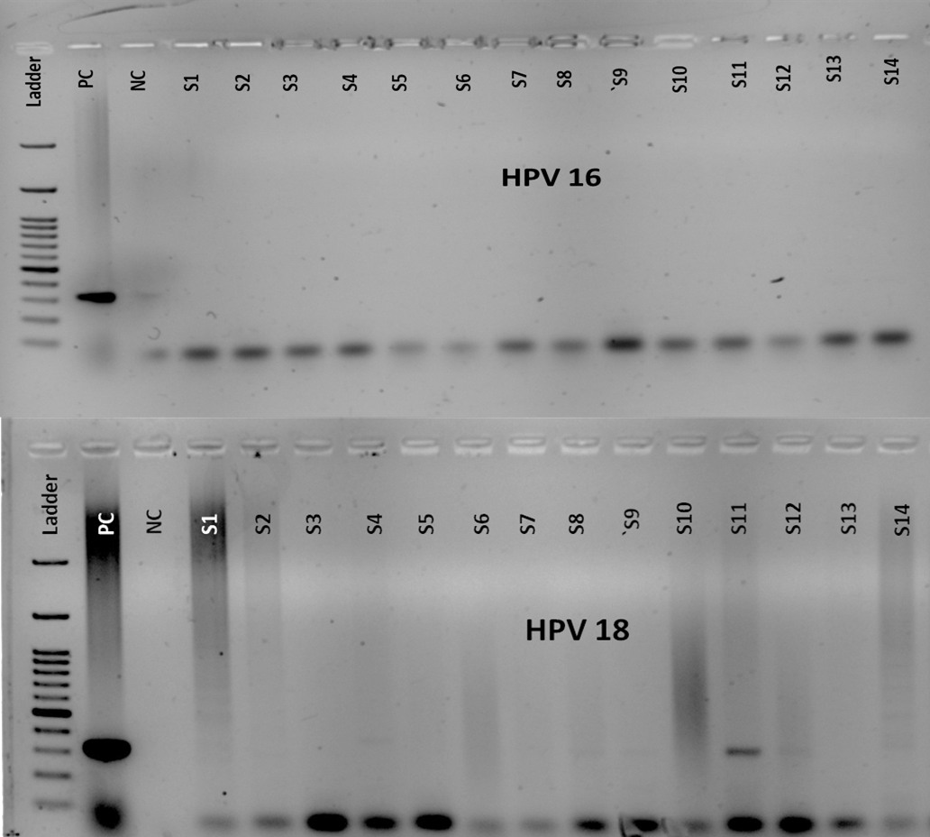
Analysis of quality and quantity of ccf-DNA
Nanodrop measurement of ccf-DNA by 260/280
The quality of DNA is confirmed by β-Globin as an internal control.
Detection of HPV-16&18

Slide 14
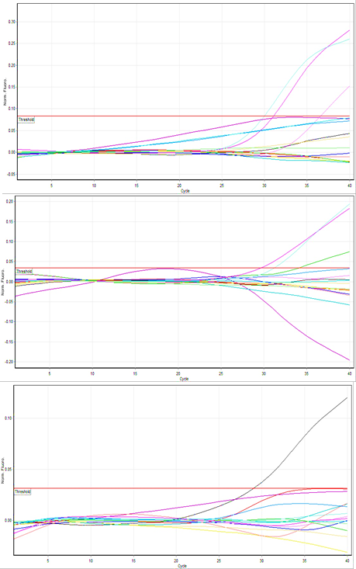
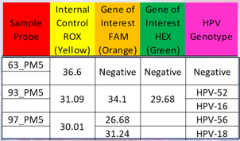
ccf-DNA can be used to genotype HPV
Real-time PCR Results based on ct-values at 37cycles.
Real-time PCR genotyping of ccf-DNA

Slide 15
Outcomes of research
The outcomes of this research help in avoiding biopsy-based testing while providing a wide range of opportunities to analyze the prognosis of the prevailing disease condition.
We report a standardized PCR-based protocol to detect ccf-DNA.
Early Diagnosis
LAMP based detection
GeneXpert TAT testing
Point of Care Testing
Loop-mediated isothermal amplification
Expert HPV Assay

Slide 16
Conclusion:
circulating cell-free DNA (ccf-DNA) testing is the core of most blood-based assays.
In particular, ccf-DNA fragmentation features could facilitate non-invasive cancer detection due to their interconnection with tumor-specific epigenetic alterations.
However, the final ccf-DNA fragmentation profile in a purified sample is the result of a complex interplay between informative biological and artificial technical factors.
We report the utilization of PCR-based target amplification as a method of choice to determine the quality of ccf-DNA

Slide 17
ccf-DNA promises for several applications in cancer management
1
Minimal residual disease monitoring
2
Assessing treatment response
3
Tracing the tissue origin of ctDNA
4
5
Molecular profiling or prognostication
Cancer detection screening or earlier diagnosis
6
Non-Invasive
7
8
9
predicting recurrence
assessing tumor burden
later-disease staging

Slide 18
References:
Corina K, Zeinab Barekati RR, XYZ. Alterations of ccf-DNA and their potential for use as cancer biomarkers. Anticancer Res 2011;31:2623–8.
A simple silica based DNA isolation method for cell-free DNA analysis from liquid biopsy Turkish Journal of Biochemistry. 2020 Oct 28;45(6):701-5.
Jain KK, Jain KK. Biomarkers of cancer. The handbook of biomarkers. 2017:273-462.
Han Y, Li J. Sample types applied for molecular diagnosis of therapeutic management of advanced non-small cell lung cancer in the precision medicine. Clinical Chemistry and Laboratory Medicine (CCLM). 2017 Oct 26;55(12):1817-33.
Gao Q, Zeng Q, Wang Z, Li C, Xu Y, Cui P, Zhu X, Lu H, Wang G, Cai S, Wang J. Circulating cell-free DNA for cancer early detection. The Innovation. 2022 Jul 12;3(4).
Nunes SP, Moreira-Barbosa C, Salta S, Palma de Sousa S, Pousa I, Oliveira J, Soares M, Rego L, Dias T, Rodrigues J, Antunes L. Cell-free DNA methylation of selected genes allows for early detection of the major cancers in women. Cancers. 2018 Sep 26;10(10):357.

Slide 19

Acknowledgement
Department of Biochemistry, JSS Medical College, JSS Academy of Higher Education & Research, Mysuru.
Centre of Excellence in Molecular Biology and Regenerative Medicine, JSS AHER.

