Slide 1
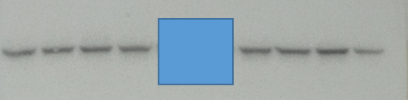
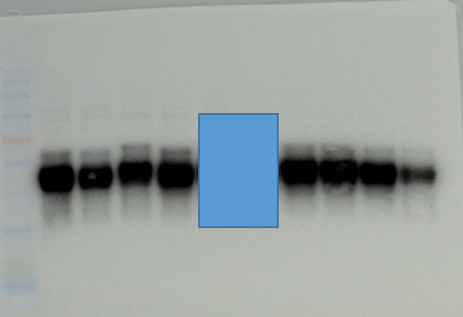
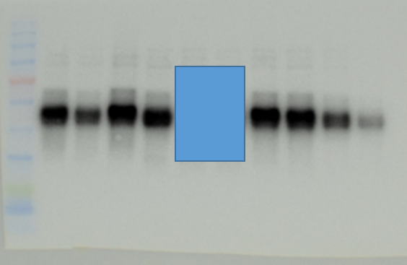
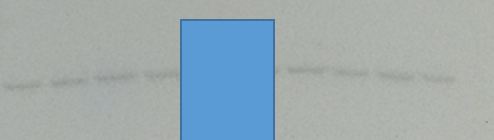
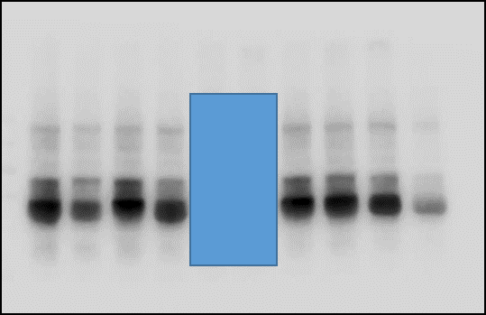
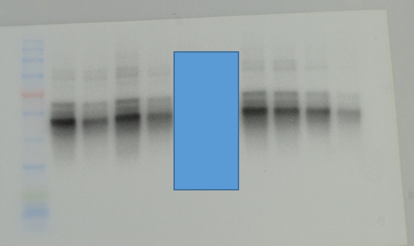
β actin
Tau5
pTau(T231)
Control
CE9A215
Control
CE9A215
Control
CE9A215
1234
1234
1234
1234
1234
1234
43kDa
59kDa
59kDa
Samples from other experiment
pTau(S396)
pTau(T181)
pTau(T205)
Control
CE9A215
Control
CE9A215
Control
CE9A215
1234
1234
1234
1234
1234
1234
59kDa
59kDa
59kDa

Slide 2
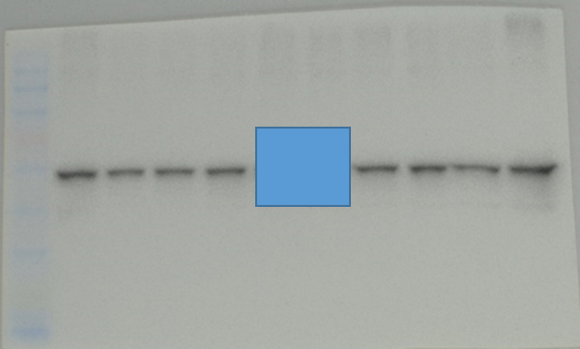
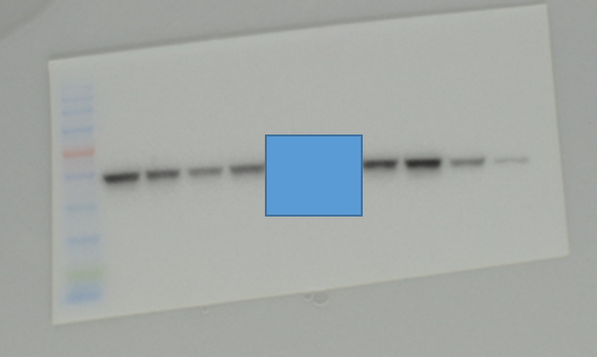
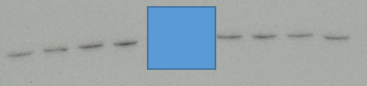
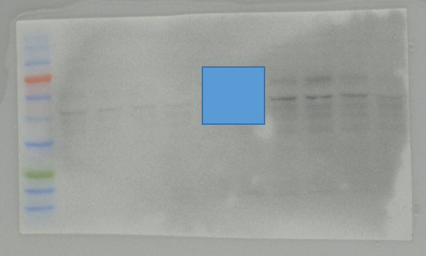
ΑΚΤ
pAKT
Control
CE9A215
Control
CE9A215
1234
1234
1234
1234
60kDa
60kDa
GSK3β
pGSK3β
Control
CE9A215
Control
CE9A215
1234
1234
1234
1234
47kDa
47kDa

