Slide 1
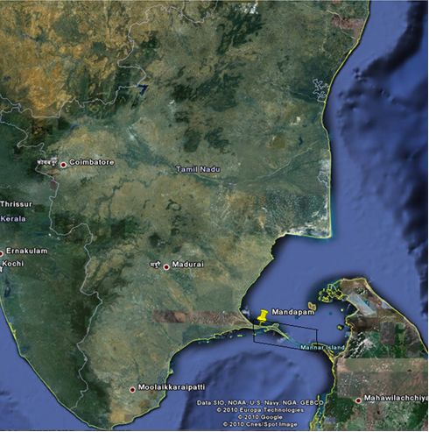
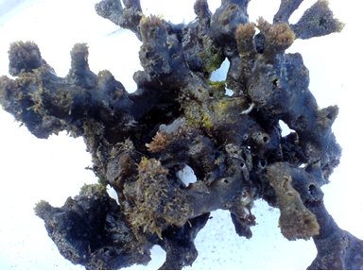
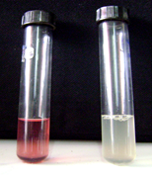
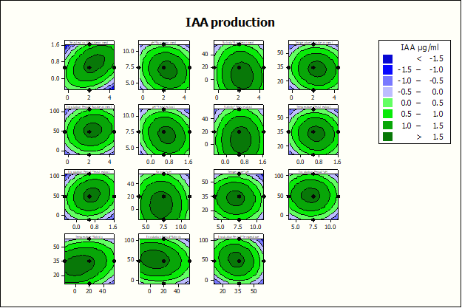
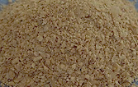

Callyspongia diffusa
Gulf of Mannar, Southeast coast of India(Study area)
Mass scale production of IAA
Isolation of P.fluorescens BCPBMS-1
.
Soya bean husk
B
A
Screening of IAA production(A-positive ,B-control)

