Slide 1
Graphical Abstract

Slide 2
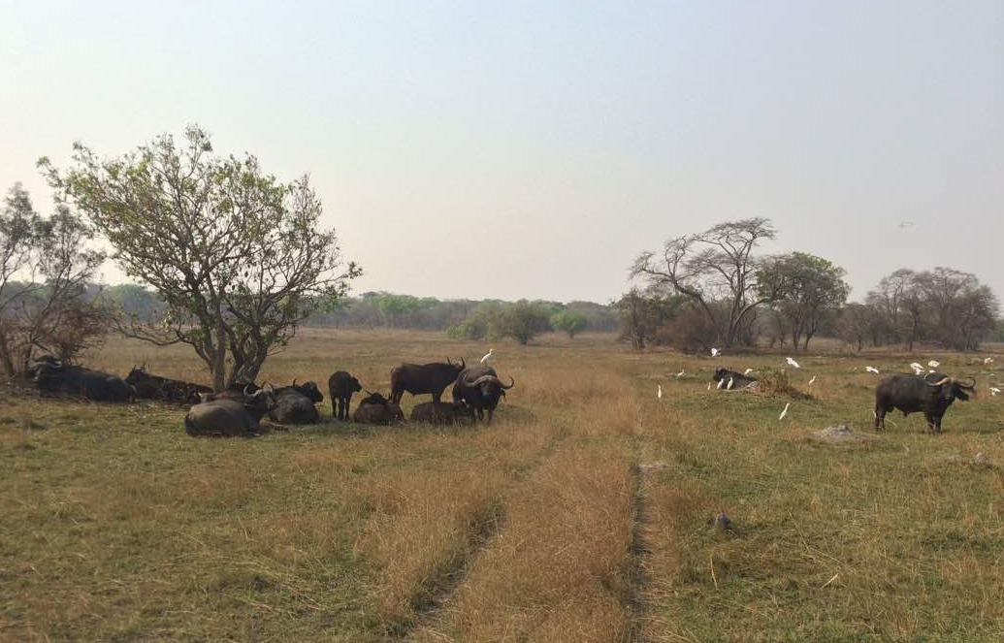
Herd of buffalo in the wildlife-livestock interface of the Kafue ecosystem

