Slide 1
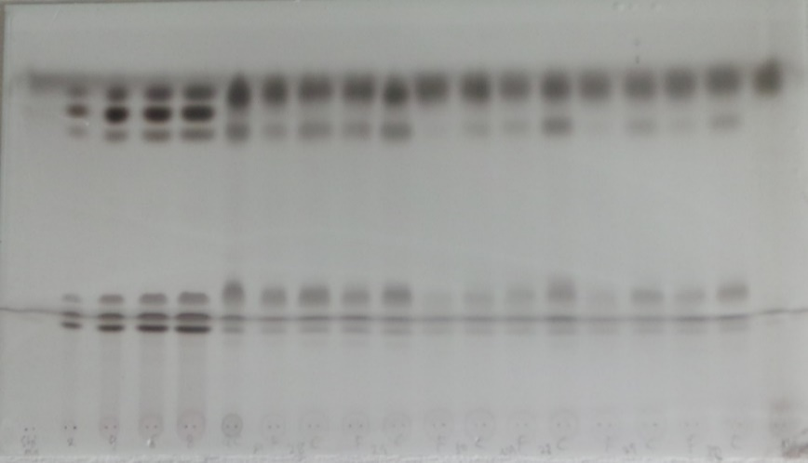
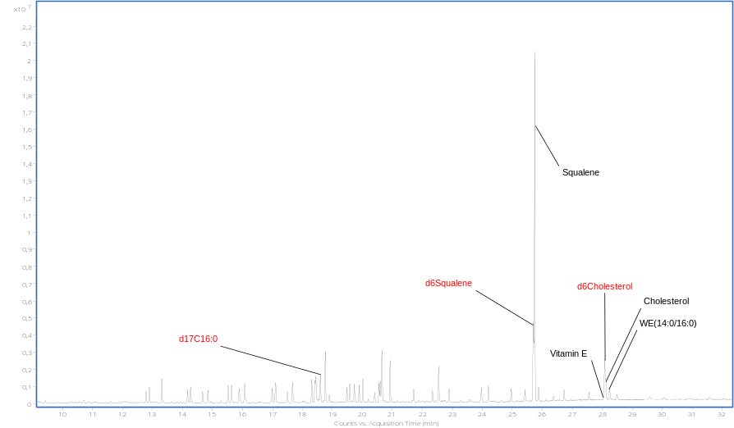
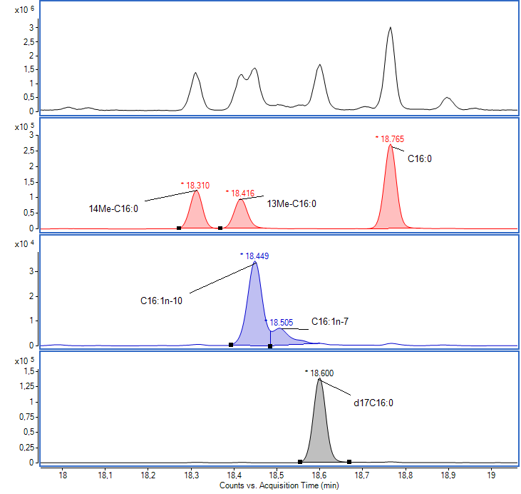
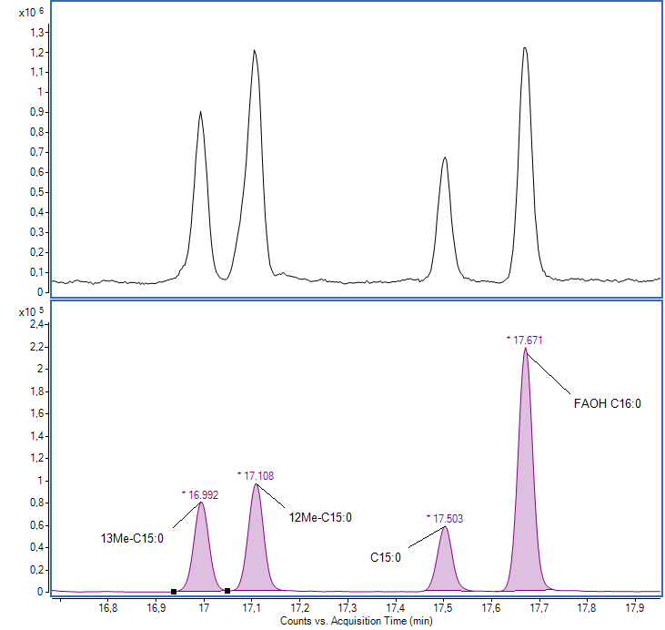
CE
Squalene
(a)
WE
FFA
TG
Cholesterol
Blank extract
QC
Blank tape
Standard mixtures
Pair-wise sebum extracts from foreheads and cheeks of six donors (NA, A)
(b1)
TIC
FFAs
C≥22
FFAs
18≤C≤21
FFAs
12≤C≤17
FOHs
14≤C≤18
FOHs
20≤C≤24
TIC
TIC
(b2)
(b3)
EIC 313
EIC 311
EIC 299
EIC 330

