Slide 1
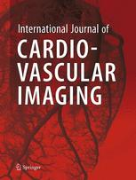
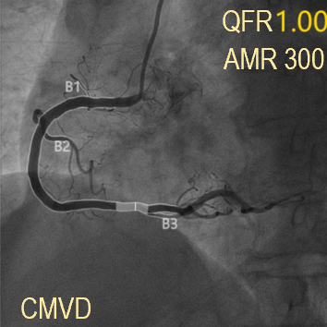
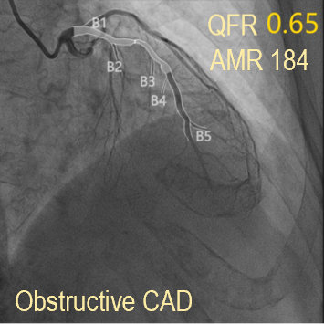
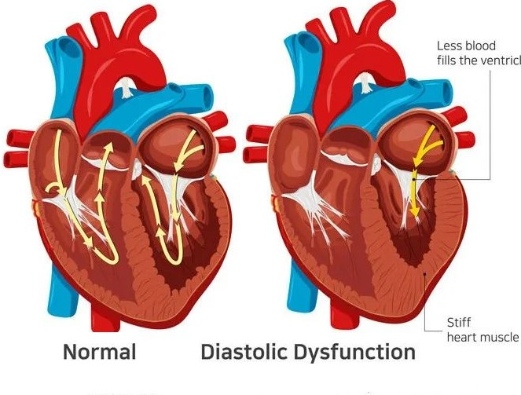
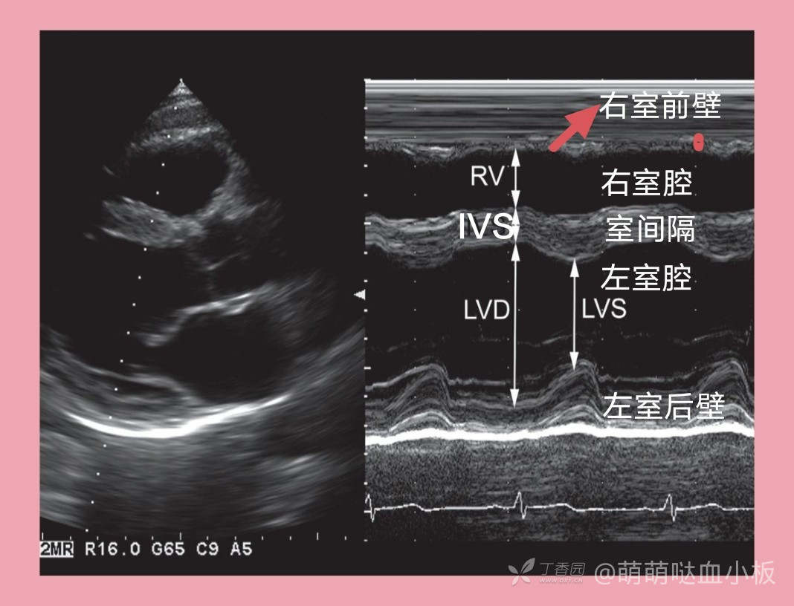
CMVD as a risk factor for LVDD
Key Findings
Coronary microvascular disease (CMVD) cuasing left ventricular diastolic dysfunction (LVDD)
Angiography-derived index of microcirculatory (AMR) linearly correlated with indicators of LVDD

