Slide 1
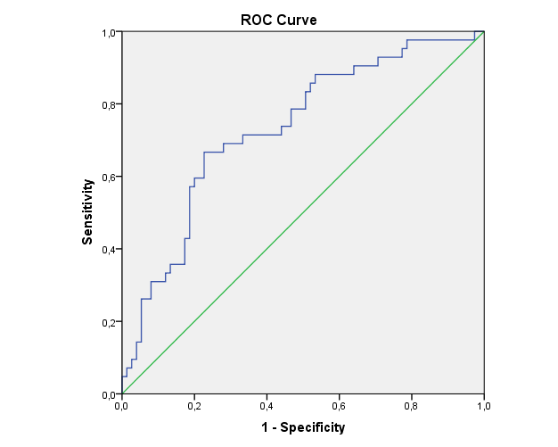
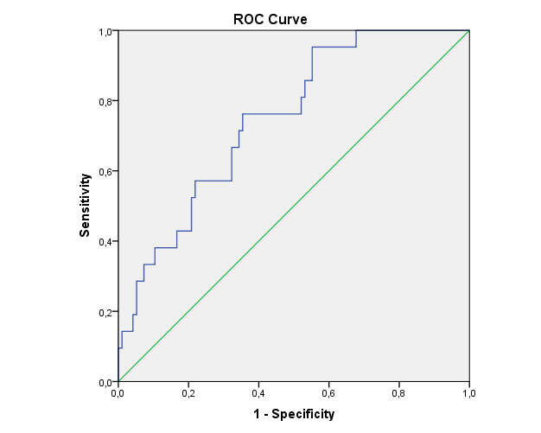




The role of urinary Dickkopf-3/creatinine ratio in diagnosis of acute kidney injury before creatinine elevation in pediatric intensive care unit
AIM: to investigate the possible role of urinary DKK3 in detecting AKI before creatinine elevation in PICU and whether elevated urinary DKK3 is associated with worse patient outcomes
Prospective Study
DESIGN & OUTCOMES:
AKI %35.8 (n:42)
AOR 3.619 95% CI 1.478-8.876
↑ UDKK3/Cr risk for AKI ↑ 5.547 times
Mortality %33.3 (n:39)
AOR 3.914 95% CI 1.397-10.961
↑ UDKK3/Cr risk for mortality ↑ 5.569 times
PICU
117 patients
10 days
follow-up
The area under curve is 0.73 (95% CI 0.638-0.827) for the diagnosis of AKI (left) and is 0.75 (95% CI 0.642-0.852) for the mortality (right).
Urinary
Dickkopf-3/creatinine
CONCLUSION: Urine DKK3 is a clinically useful biomarker in predicting the development of AKI according to KDIGO SCr in patients hospitalized in PICU. A high level of urine DKK3 is a risk factor for both AKI and mortality.
Gökçeli et al. 2024

