Slide 1
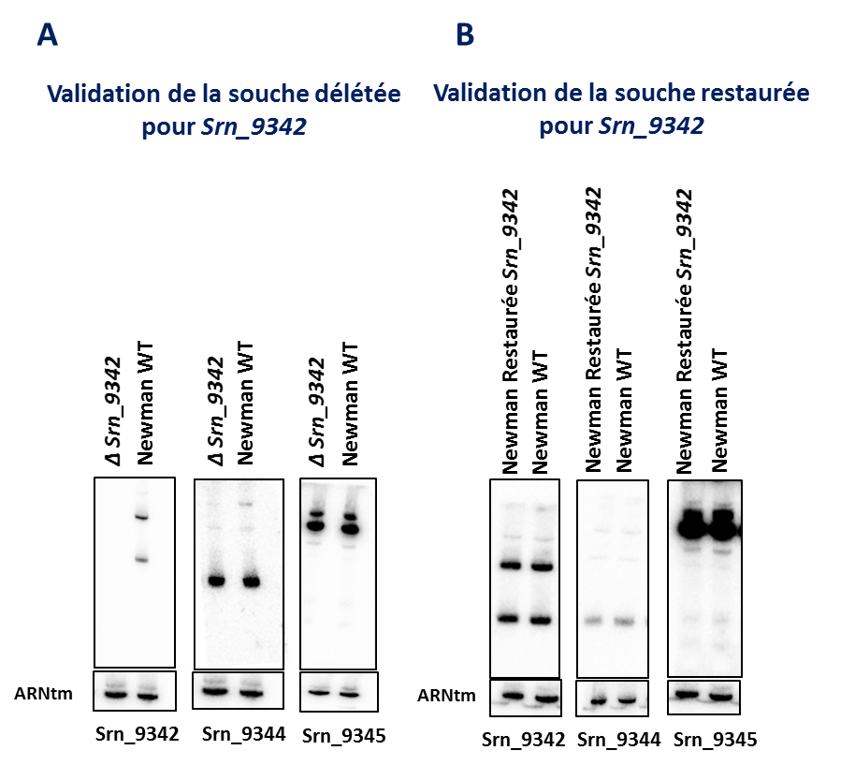
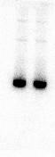
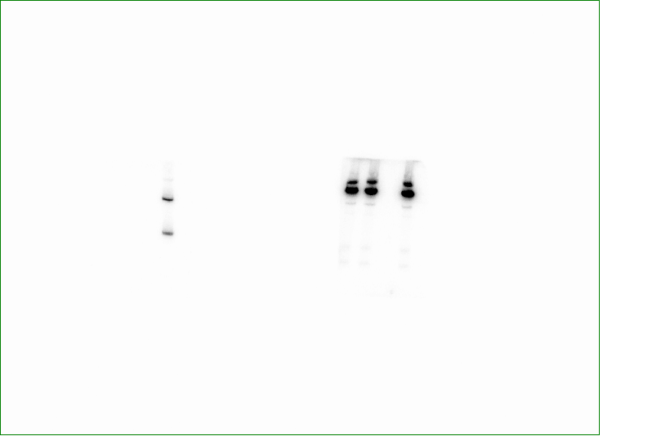
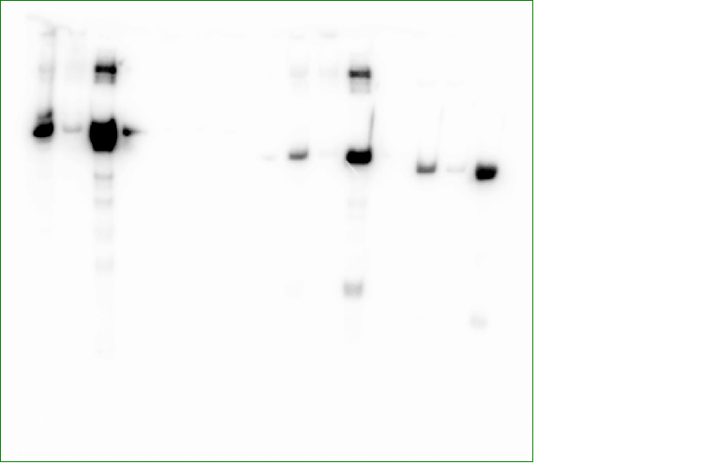
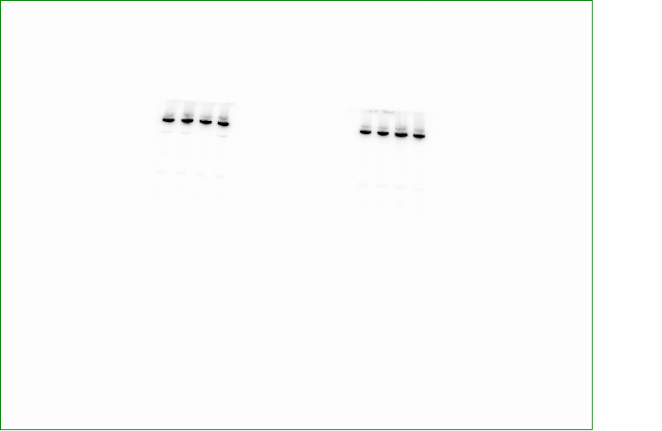
Δsrn_9342_{compl.}
Δsrn_9342
Δsrn_9342
Δsrn_9342
Newman
A
Newman
B
Newman
Newman
C
D
CE FL EL
Srn_9342_{L}
Srn_9342_{L}
Srn_9342_{S}
Srn_9342_{S}
tmRNA
tmRNA
tmRNA
Srn_9344
Srn_9345
Figure S1 : Implementation of MAPS to identify the RNA partners of Srn_9342_{L} and Srn_9342_{S}. (A) Verification of Srn_9342 expression in ∆srn_9342 (lane 1) and in parental strain (lane 2). (B) The deletion of srn_9342 has no polar effect on the expression of Srn_9344 and Srn_9345. (C) Northern blot targeting MS2-MS2_Srn_9342_{S} during purification on MS2 chromatography affinity. RNAs were extracted from a same volume of crude extract (CE), flow-through (FT) and elution (EL), and loaded on urea polyacrylamide gel. (D) Restoration of srn_9342 at the endogenous locus complements the expression of Srn_9342_{S/L}.

Slide 2
A
B
Figure S2 : Differential repartition of RNA classes enriched by MAPS with Srn_9342_{S} or Srn_9342_{L}.

Slide 3
A
B
Srn_9342_{S}
Srn_9342_{L}
Figure S3 : Differential repartition of functions enriched by MAPS with Srn_9342_{S} or Srn_9342_{L}. Functions were assigned using the COG database for all mRNAs identified by MAPS.

Slide 4
Figure S4 : Sequence alignment of Srn_9342 and SprY RNA sequences. The alignment was performed using Clustal Omega. The stars refer to nucleotide conservation between the RNAs.

