Slide 1
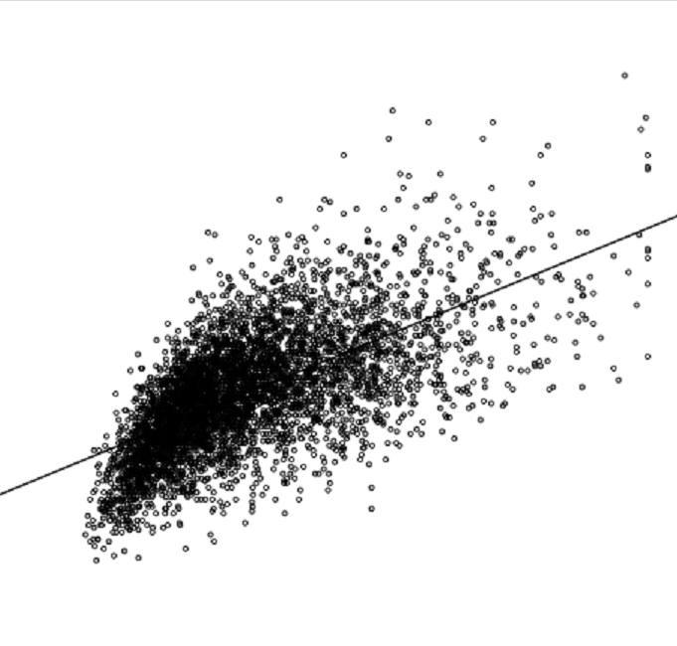
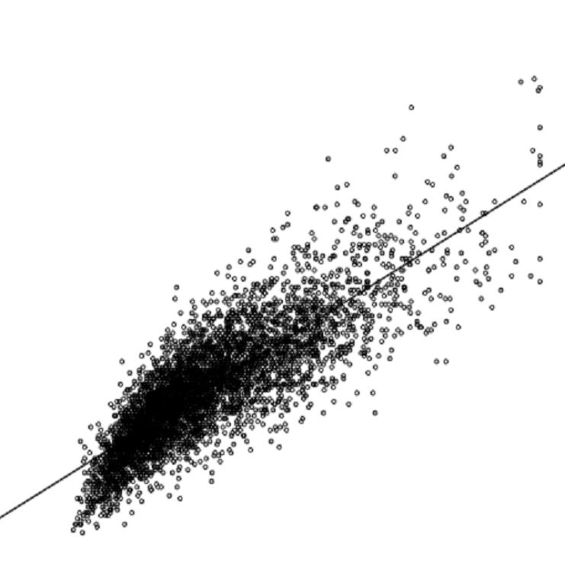
A
B
200
250
200
150
150
LDL-C (mg/dl)
Apo B (mg/dl)
100
100
50
50
R=0.64, P<0.001
Y=1.09x+71.12
R=0.83, P<0.001
Y=1.13x+52.94
0
0
0
20
40
60
80
100
0
20
40
60
80
100
sd LDL-C (mg/dl)
sd LDL-C (mg/dl)
Supplemental Figure 1. Correlation between sdLDL-C and LDL-C or Apo B.
A: The scatter diagrams of the correlation between LDL-C and sdLDL-C. B: The scatter diagrams of the correlation between Apo B and sdLDL-C. LDL-C: low-density lipoprotein cholesterol, sdLDL-C: small dense low-density lipoprotein cholesterol, Apo B: apolipoprotein B.

Slide 2
P=0.32
P=0.008
The rate of CV events (%)
(≦29 mg/dl)
(>29 mg/dl)
TG lower half
(≦113 mg/dl)
TG upper half
(>113 mg/dl)
Supplemental Figure 2. The rate of CV events according to TG and sdLDL-C levels.
The study population was divided into 2 subgroups, lower and upper halves of TG levels. The rates of CV events during the follow-up periods were compared between the lower and upper halves of sdLDL-C levels in each subgroup by the chi squared test. CV: cardiovascular, TG: triglyceride, sdLDL-C: small dense low-density lipoprotein cholesterol.

