Slide 1
Supplementary files
Efficient predictive diagnosis for endoscopic remission in Crohn’s diseases by the combination of three non-invasive markers
Kensuke Takei, Toshihiro Inokuchi, Sakiko Hiraoka, Mikako Ishiguro, Junki Toyosawa, Yuki Aoyama, Shoko Igawa, Keiko Takeuchi, Yasushi Yamasaki, Hideaki Kinugasa, Masahiro Takahara, Seiji Kawano, and Motoyuki Otsuka
Department of Gastroenterology and Hepatology, Okayama University Graduate School of Medicine, Dentistry and Pharmaceutical Sciences, Okayama, Japan

Slide 2
Supplementary Figure Legends
Supplementary Figure .
Correlation between the values of the single use of non-invasive markers and the mSES-CD in CD patients with ileal lesions
The values of each marker (A, LRG, B, CRP, and C, Fcal) and mSES-CD in CD patients with ileal lesions. LRG, leucine-rich alpha- glycoprotein; CRP, C-reactive protein; Fcal, fecal calprotectin; mSES-CD, modified simple endoscopic score for Crohn’s disease.
Supplementary Figure .
Correlation between the values of the single use of non-invasive markers and the mSES-CD in CD patients with colonic lesions
The values of each marker (A, LRG, B, CRP, and C, Fcal) and mSES-CD in CD patients with colonic lesions. LRG, leucine-rich alpha- glycoprotein; CRP, C-reactive protein; Fcal, fecal calprotectin; mSES-CD, modified simple endoscopic score for Crohn’s disease.
Supplementary Figure 3.
Correlation between the values of the single use of non-invasive markers and the mSES-CD in CD patients with ileocolonic lesions
The values of each marker (A, LRG, B, CRP, and C, Fcal) and mSES-CD in CD patients with ileocolonic lesions. LRG, leucine-rich alpha- glycoprotein; CRP, C-reactive protein; Fcal, fecal calprotectin; mSES-CD, modified simple endoscopic score for Crohn’s disease.

Slide 3
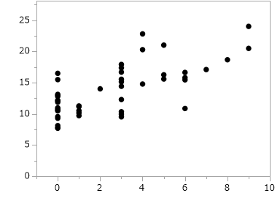
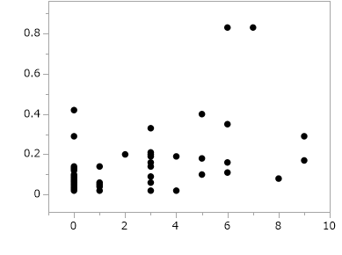
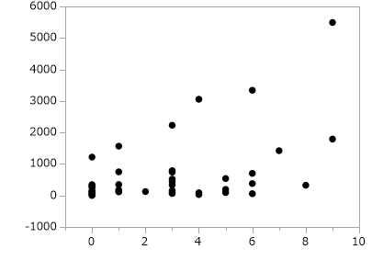
Supplementary Figure 1
LRG
A
(µg/mL)
r = 0.63
P < 0.000
mSES-CD
CRP
B
(mg/dL)
r = 0.48
P = 0.009
mSES-CD
C
Fcal
(μg/g)
r = 0.493
P = 0.0003
mSES-CD

Slide 4
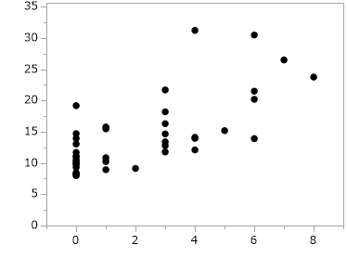
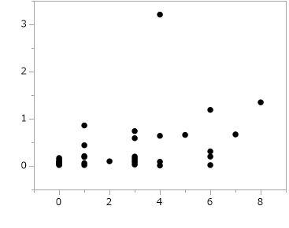
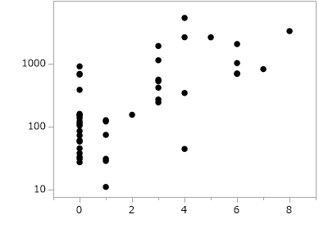
Supplementary Figure 2
LRG
A
(µg/mL)
r = 0.6874
P < 0.000
mSES-CD
CRP
B
(mg/dL)
r = 0.533
P = 0.000
mSES-CD
C
Fcal
(μg/g)
r = 0.6058
P < 0.000
mSES-CD

Slide 5
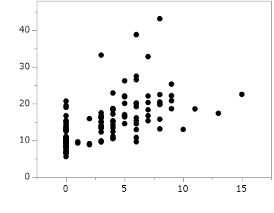
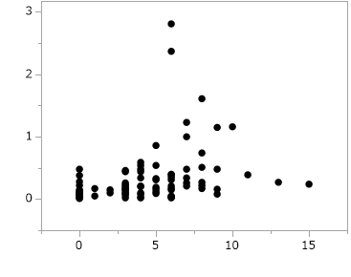
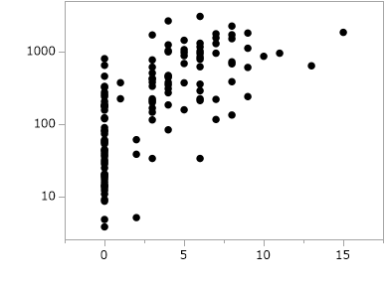
Supplementary Figure 3
LRG
A
(µg/mL)
r = 0.6954
P < 0.000
mSES-CD
CRP
B
(mg/dL)
r = 0.6646
P < 0.000
mSES-CD
C
Fcal
(μg/g)
r = 0.795
P < 0.000
mSES-CD

