Slide 1
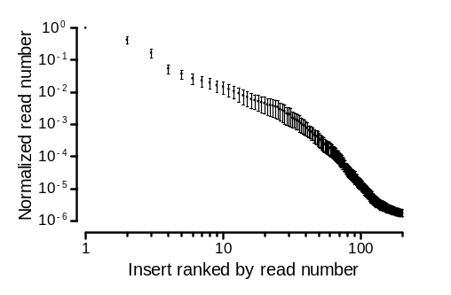
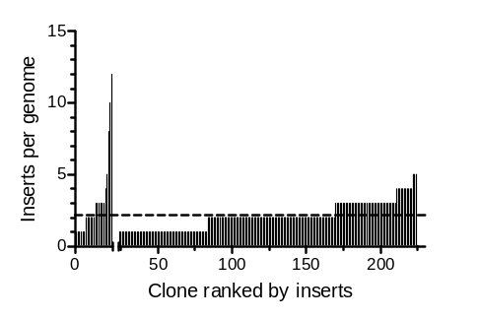
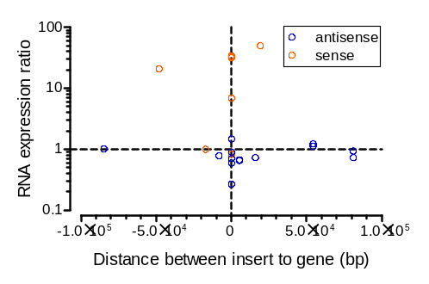
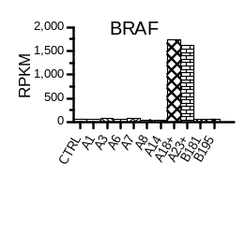
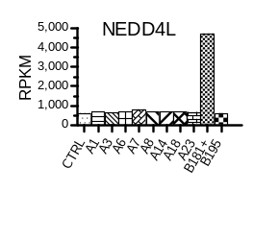
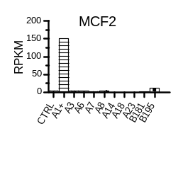
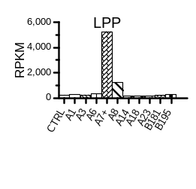
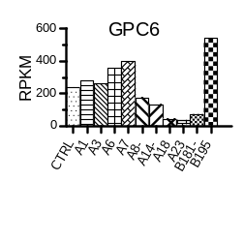
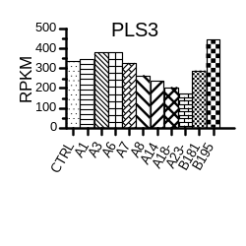
A
B
C
D
Figure S1. Characterization of transposon inserts.
(A) Consistent sequencing read signal decay across the ten resistant pools. x-axis, inserts ranked in each pool by read number; y-axis, read number normalized to first insert of each pool. Error bars denote standard error of mean.
(B) Number of inserts per clone. A dash line indicates the mean. Primary and limiting-dilution clones are separated by a gap in the x-axis.
(C) Gene expression relative to insertion position. Expression is affected by distance and direction of PB inserts to the gene body. Negative distance values indicate inserts are upstream of the gene while positive values for downstream, and zero for intragenic inserts.
(D) Gene expression detected by RNA-seq in ten clones and a control sample (CTRL). Clones with the corresponding gene perturbed by transposon are labeled with a “+” for activation or “-” for disruption. RPKM, reads per kilobase million.

Slide 2
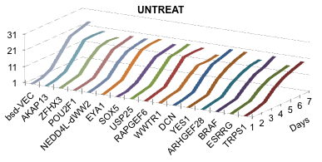
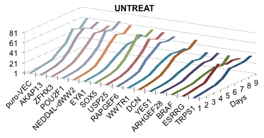
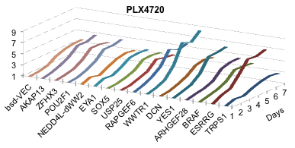
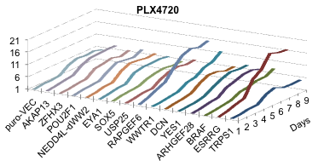
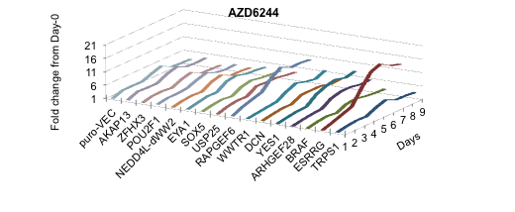
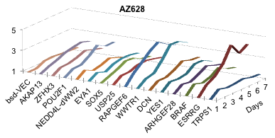
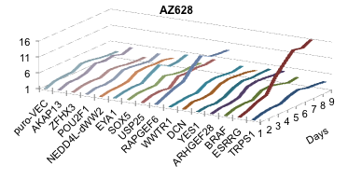
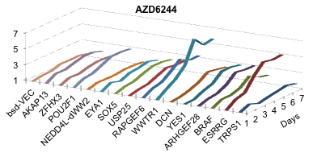
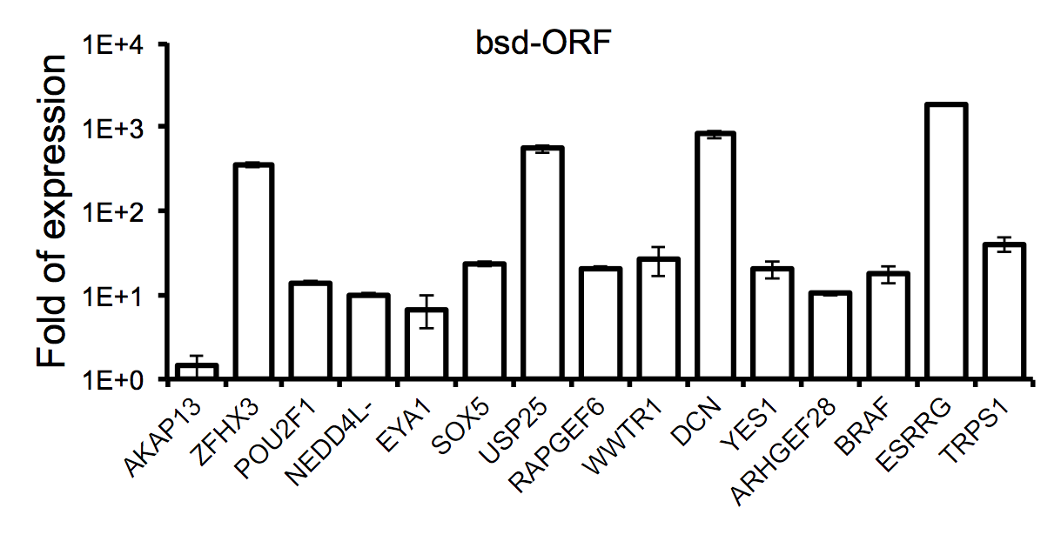
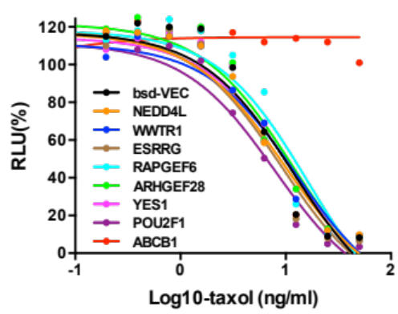
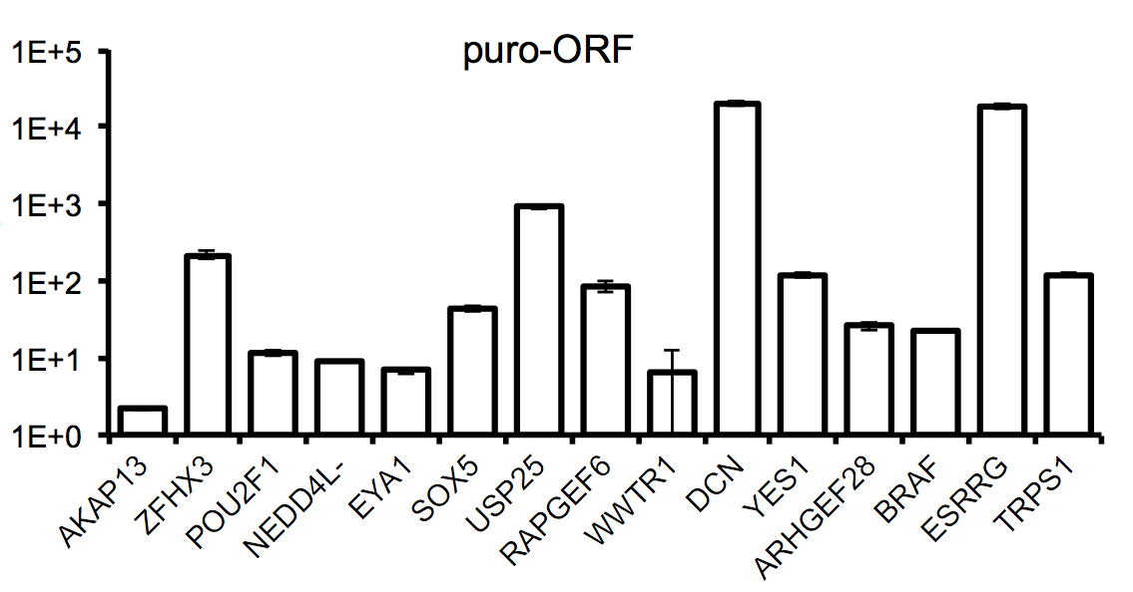
A
bsd-ORF
puro-ORF
B
C
Figure S2, Effect of candidate resistance genes on proliferation evaluated by cDNA overexpression.
(A) Proliferation of A375 cells infected with lentiviral cDNA constructs across 7 or 9 days. Cells were either untreated, or treated with PLX4720, AZ628, or AZD6244 and normalized to Day-0. Each cDNA construct was subcloned into two lentivirus vectors (bsd-ORF and puro-ORF) for independent experiments.
(B) Dose responses of cells to paclitaxel (taxol). The taxol resistance gene ABCB1 was used as a control.
(C) Quantitative PCR for the indicated genes normalized to vector control cells. Error bars denote SEM, n=3. NEDD4L-dWW2 or NEDD4L- represents a WW2-domain-deletion isoform.

Slide 3
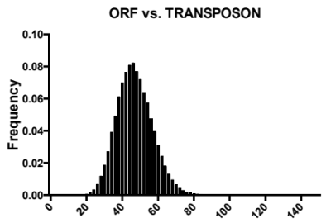
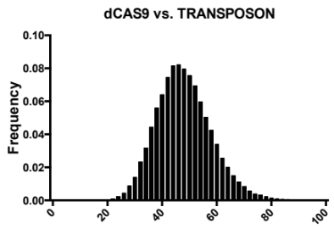
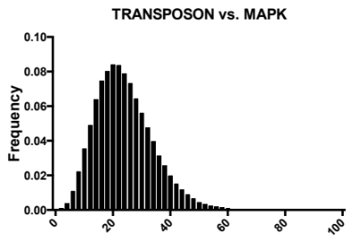
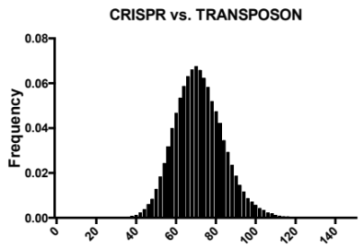
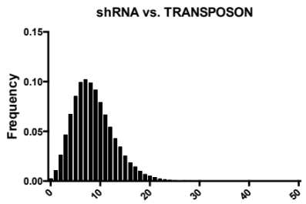
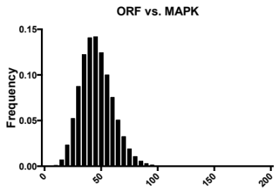
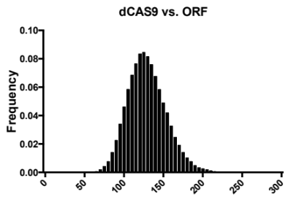
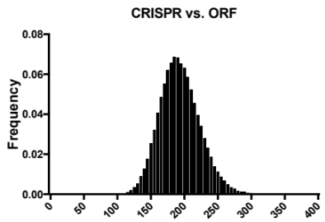
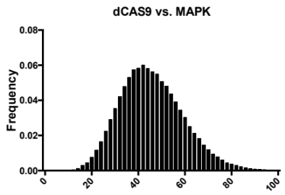
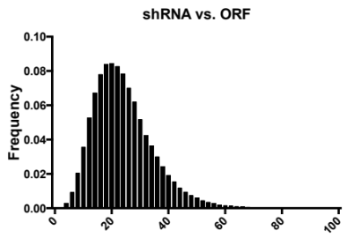
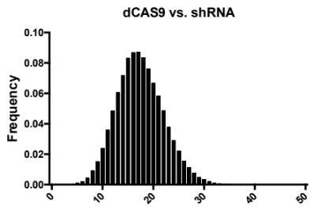
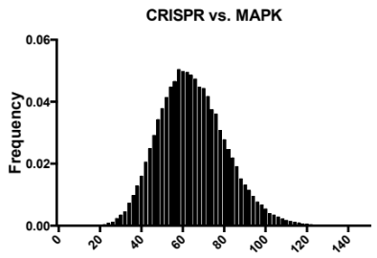
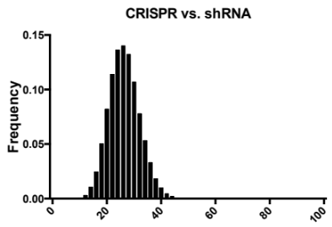
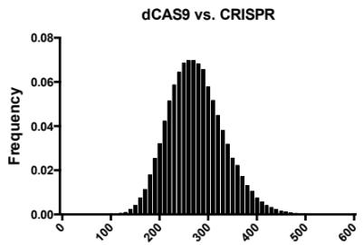
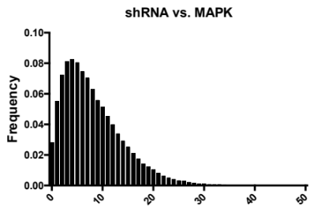
A
B
p<10⁻⁶
p=0.046
p=7.3x10⁻⁴
p=0.048
p=0.29
p<10⁻⁵
p=0.023
p=3x10⁻⁴
p=0.01
p=0.053
p=0.56
p=0.07
p<10⁻⁵
p=0.99
p=0.20
Figure Statistical test for gene list connectivity based on STRING across multiple screens.
(A) Distributions of STRING connections between genetic screens using genes across 10^6 (for ORF vs. TRANSPOSON) or 10^5 (for others) random picks from corresponding backgrounds. Red dots indicate the observed number of connections between two genesets.
(B) Distributions of STRING connections between transposon and MAPK components.

Slide 4
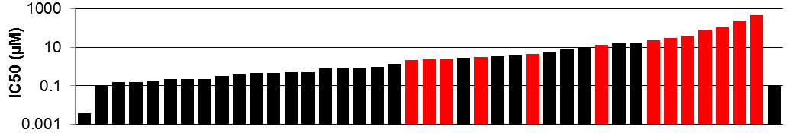
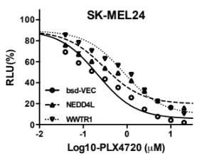
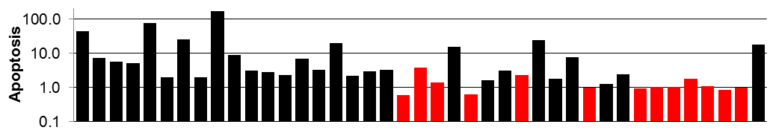
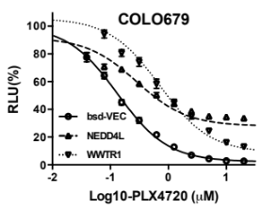

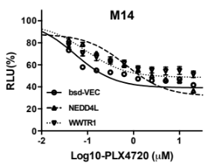

A
B
WM278 | WM35 | MMAC-SF | UACC-62 | COLO-858 | IGR-37 | K2 | MEL-HO | C32 | COLO-849 | RVH-421 | COLO 853 | A101D | UACC-257 | M-14 | HT-144 | MZ7-mel | IST-MEL1 | WM1552C | IPC-298
LB2518-MEL | MZ2-MEL | COLO-679 | CHL-1 | LOXIMVI | A2058 | CP66-MEL | WM902B | IGR-1 | WM-115 | SK-MEL-119 | SK-MEL-28 | VMRC-MELG | MEWO | MGH-PO-1 | MEL-JUSO | LB373-MEL-D | K19 | GAK | SK-MEL-30 | A375 | Markers
220kD
NEDD4L
120kD
100kD
80kD
60kD
WWTR1
50kD
40kD
pMEK
50kD
40kD
tMEK
50kD
pERK
40kD
tERK
40kD
BRAF
40kD
80kD
GAPDH
40kD
Figure S4. WWTR1 and NEDD4L expression versus sensitivity in melanoma cell lines.
(A) NEDD4L and WWTR1 expression and MAPK signaling across melanoma cell lines. Expression of the indicated proteins by western blot performed across lysates of melanoma cells lines. Lysates were loaded from left to right according to sensitivity to PLX4720 in two gels processed in the same experiment. The corresponding IC50s measured by CellTiter-Glo and apoptosis induction determined using Caspase-Glo normalized to total cell number are shown in the top and middle histograms. BRAF V600E or V600D mutants are denoted as black columns while BRAF wildtypes are in red.
(B) PLX4720 dose response of different melanoma cell lines with NEDD4L or WWTR1 lentiviral overexpression. Error bars denote SEM, n=4.

Slide 5
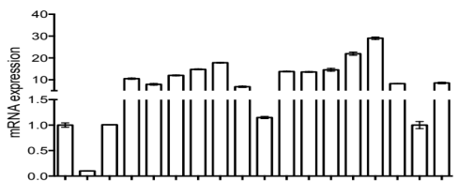
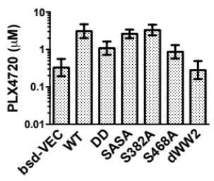
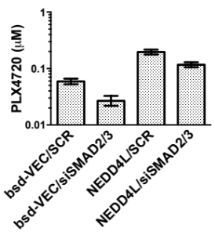
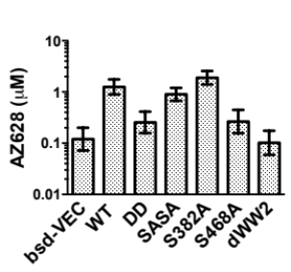
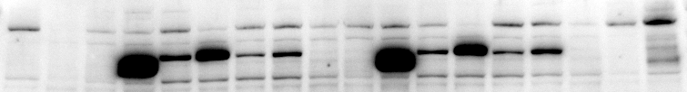
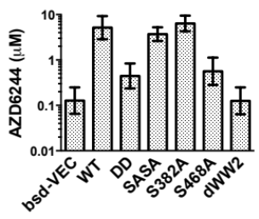
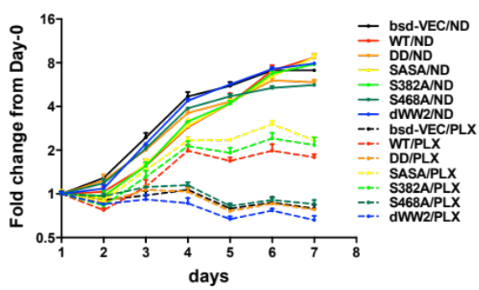
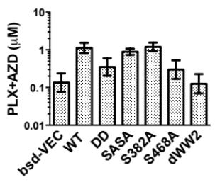
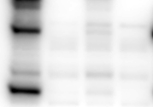



A
C
D
A375/scramble | A375/siNEDD4L | bsd-VEC | bsd-dWW2 | bsd-WT | bsd-DD | bsd-SASA | bsd-S382A | bsd-S468A | puro-VEC | puro-dWW2 | puro-WT | puro-DD | puro-SASA | puro-S382A | puro-S468A | A375 | Clone B181
Scramble | siSMAD2 | siSMAD3 | siSMAD2/3
NEDD4L
E
GAPDH
pSMAD2/3
B
SMAD2/3
GAPDH
F
siRNA | Scramble | siNEDD4L | Scramble | siNEDD4L
PLX4720 | - | - | + | +
NEDD4L
SMAD2/3
pSMAD2/3
GAPDH
Figure S5. NEDD4L mutation activities.
(A) NEDD4L mutants expressed in two sets of vectors (bsd- and puro-). mRNA levels are shown as column graph on the top (mean ± SEM, n=2), and proteins are shown at the bottom. A transposon clone (B181) with insert in NEDD4L gene is also included in the assay.
(B) Proliferation of mutants either in the absence of drug (ND, solid lines) or presence of 0.5 µM PLX4720 (PLX, dash lines). Error bars denote SEM, n=3.
(C) IC50 of NEDD4L-mutant-expressing A375 cell lines treated with PLX4720, AZ628, AZD6244, and combination of PLX4720 and AZD6244. In the combinatorial treatment, PLX4720 and AZD6244 concentrations were fixed at 5:1 and the y-axis indicated PLX4720 concentrations. Error bars denote 95% CI.
(D) IC50 of PLX4720 of vector control and NEDD4L-overexpressing cells with SMAD2/3 knockdown. Values are shown as mean ± 95% CI, n=3.
(E) SMAD2/3 knockdown reduces both phospho- and total SMAD2/3.
(F) NEDD4L knockdown does not increase total or phospho-SMAD2/3.

Slide 6
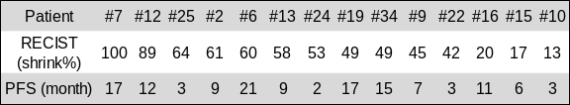



A
B
Figure S6. WWTR1 and NEDD4L expression versus treatment outcome.
(A) Response Evaluation Criteria In Solid Tumor (RECIST) and Progression Free Survival (PFS) are indicated for each patient.
(B) NEDD4L, WWTR1, and a melanoma biomaker MLANA mRNA expression in patient samples sorted by RECIST scores. Y-Values indicated reads per kilobase million (RPKM) of RNA-Seq.

Slide 7




























































































A
bsd-VEC
NEDD4L
WWTR1
ESRRG
RAPGEF6
ARHGEF28
YES1
POU2F1
COT
EKB569
(nM)
-
125
-
BMS754807
(nM)
125
-
125
B
PLX4720 (nM)
C
Figure S7. EGFR and IGF1R inhibitions broadly resensitize resistant cells.
(A) Resensitization measured by clonogenic assays after 12-day drug treatments.
(B) And (C) Responsiveness of resistance-gene-overexpressing A375 cells to 150nM PLX4720, 250nM EKB569, 250nM BMS754807, or combinations, in 5-day viability assays measured by CellTiter-Glo. Bars denote mean ± SEM, n=3. Note the two panels were prepared from different experiments and the baselines should only be compared within each panel.

Slide 8

Figure S8. Plasmid map of a PB-SB dual-LTR plasmid.
Full sequence can be found in the Supplementary Text. Plasmid map is drawn using SnapGene.

