Slide 1
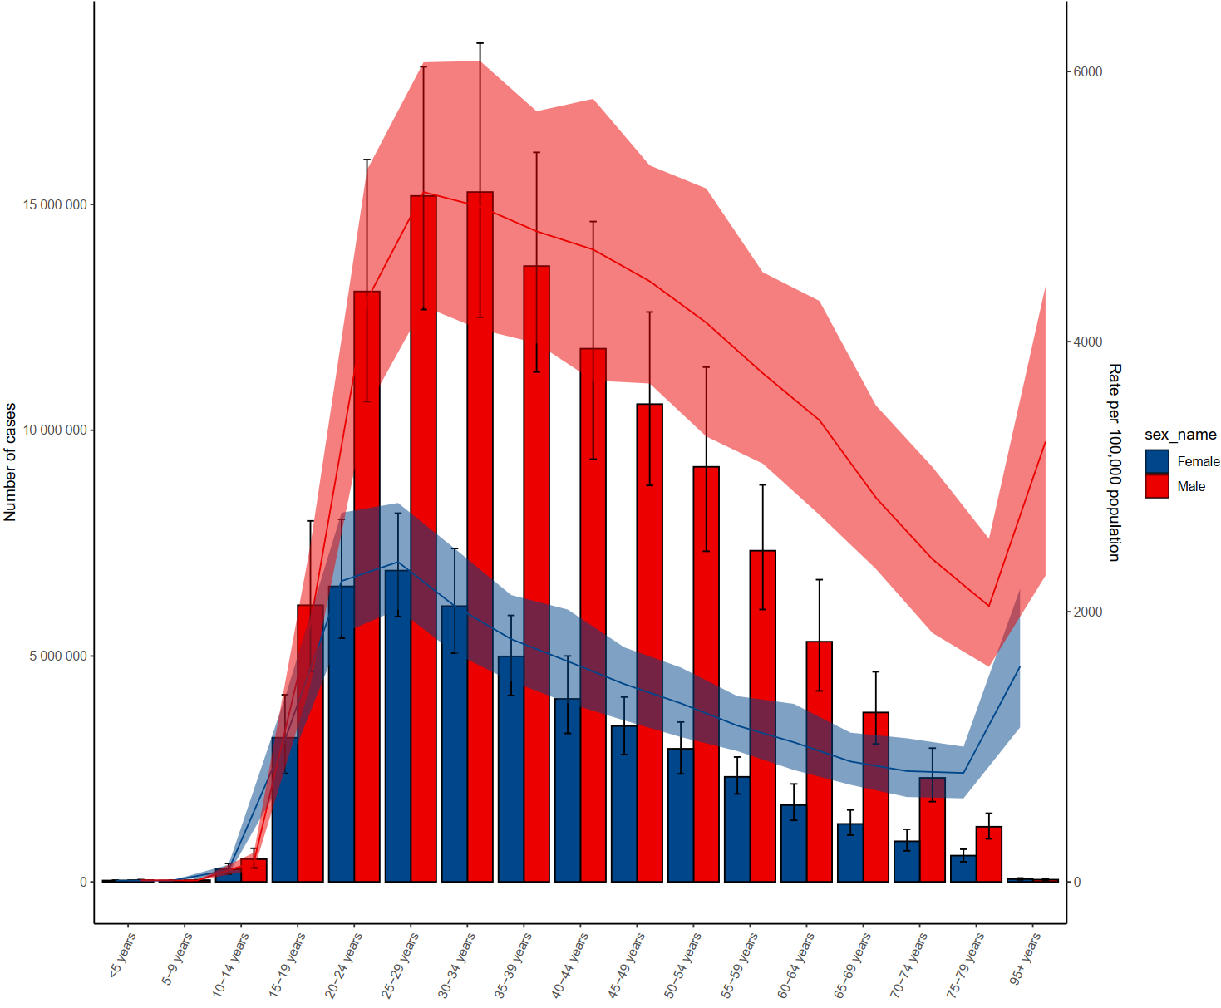
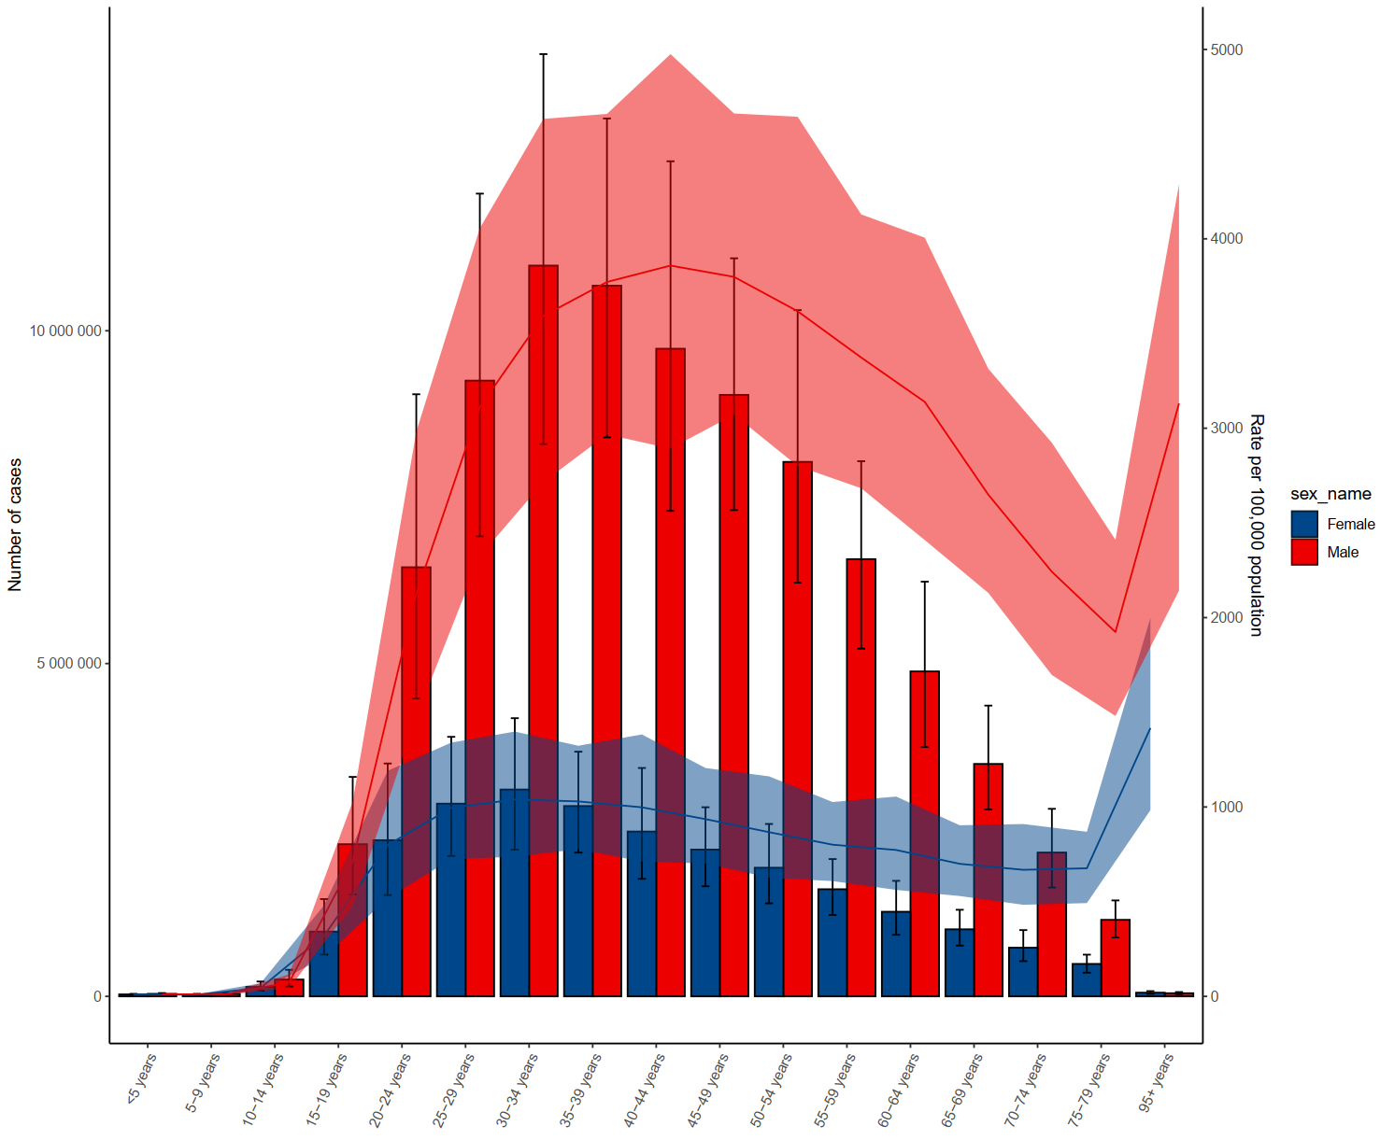
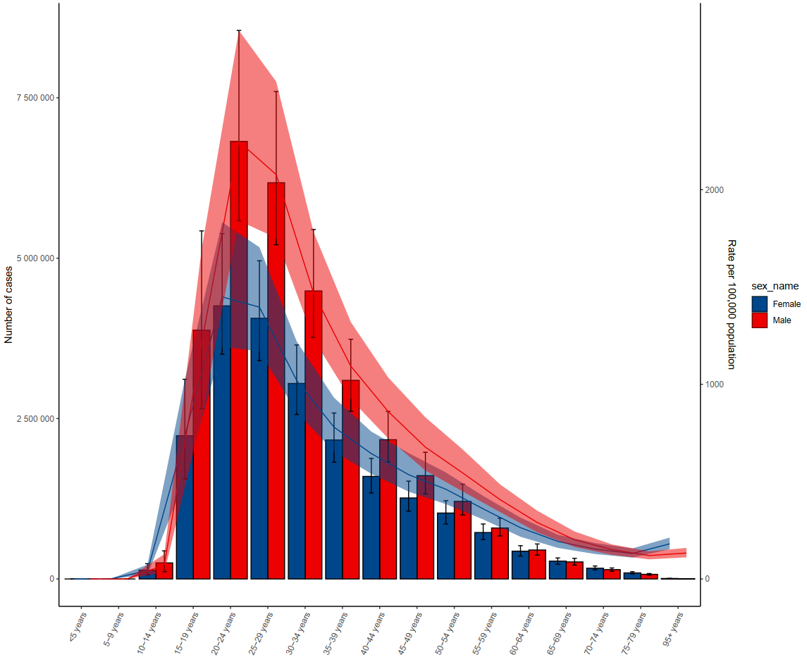
Supplement Figure1
D
A. Prevalence of SUD in 2021 by age group
E
B. Prevalence of AUD in 2021 by age group
F
C. Prevalence of DUD in 2021 by age group

Slide 2
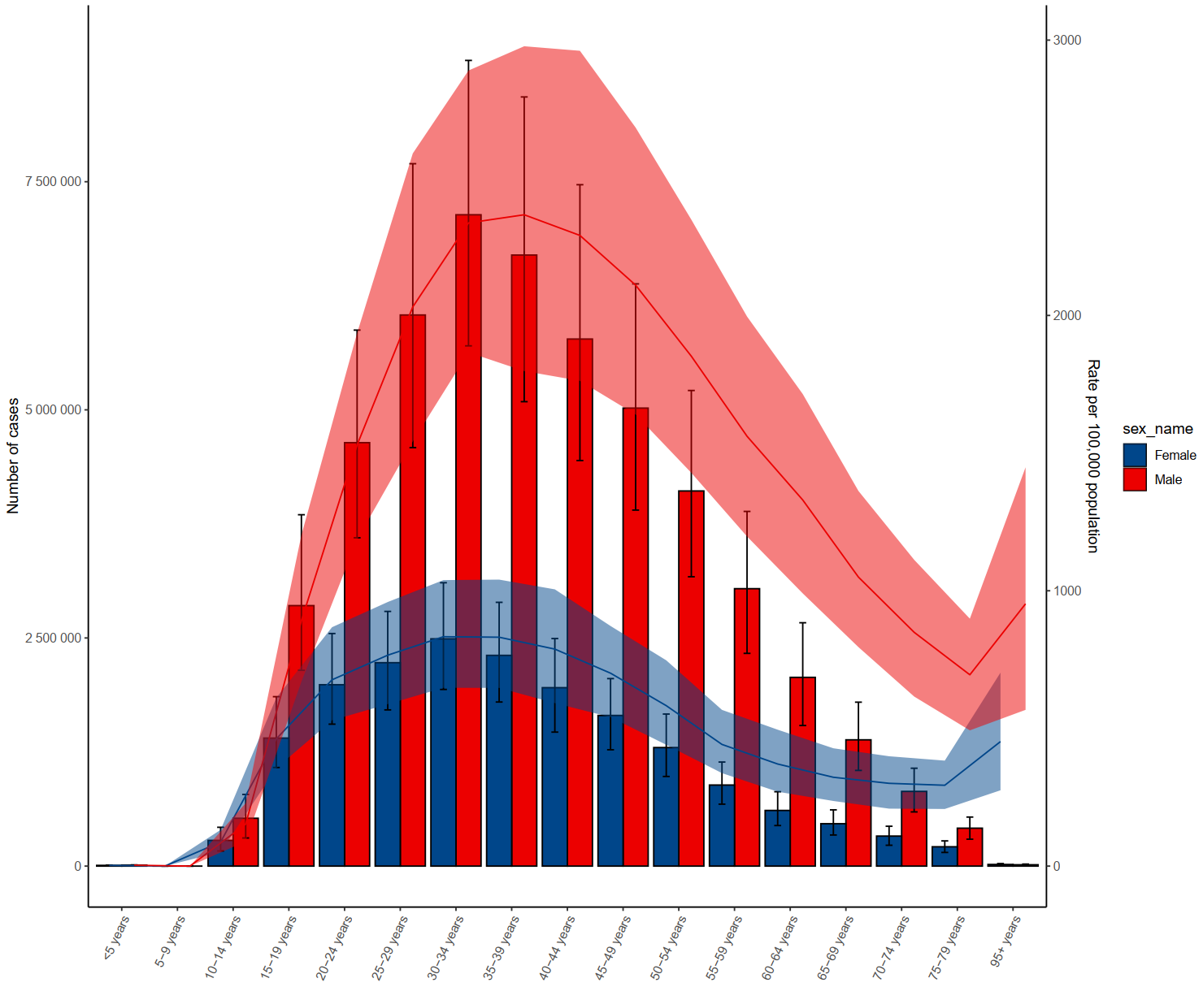
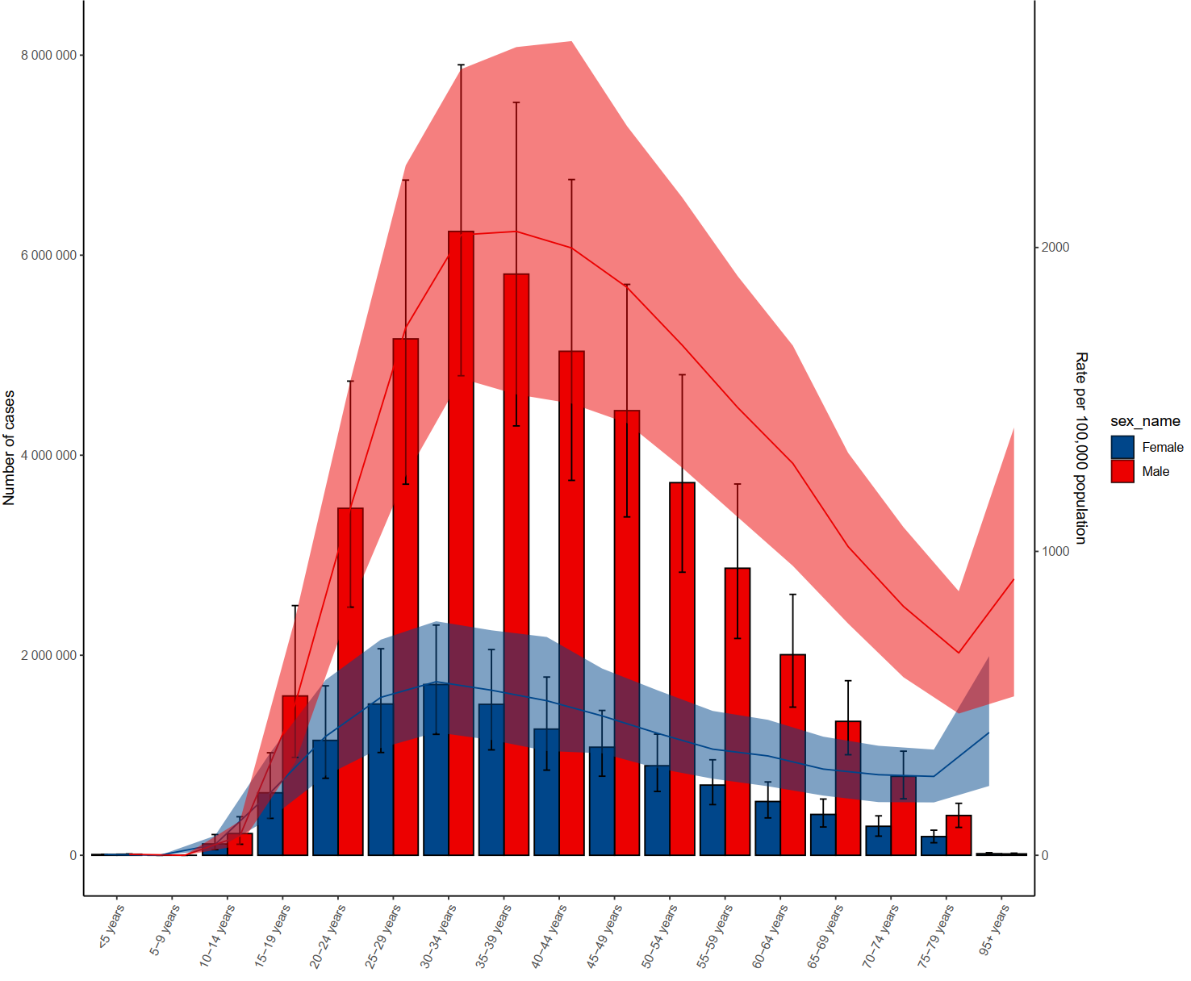
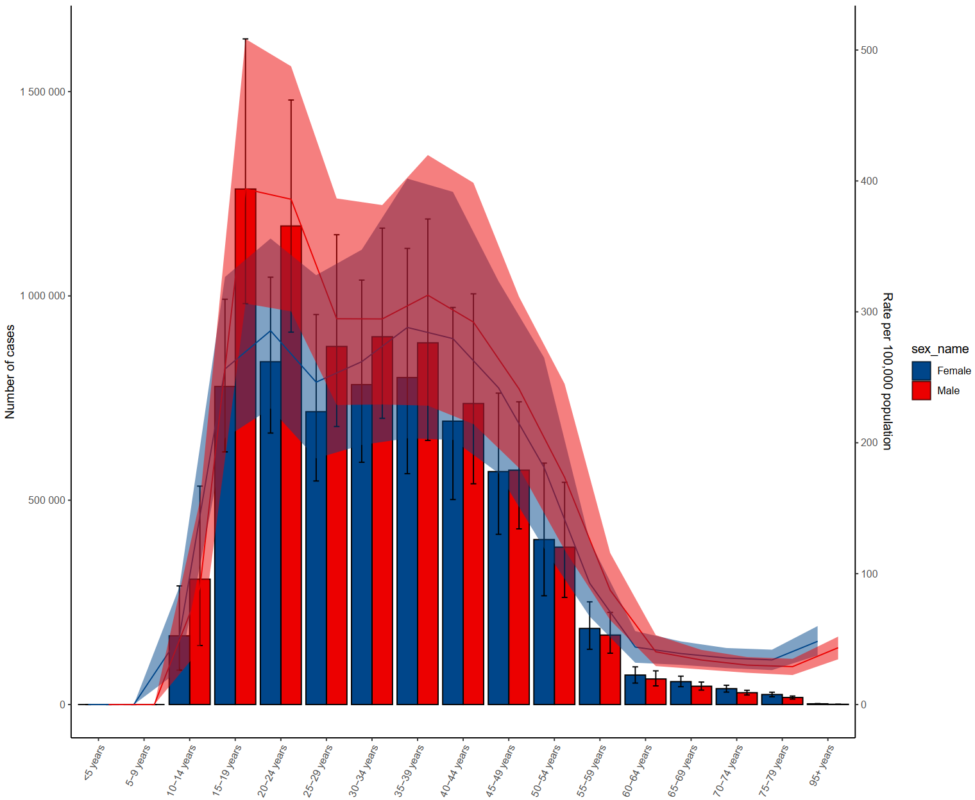
D. Incidence of SUD in 2021 by age group
E. Incidence of SUD in 2021 by age group
F. Incidence of SUD in 2021 by age group

Slide 3
Supplement Figure2. Trend of SUD incidence rate among 21 regions and 204 countries

Slide 4
Supplement Figure3. Trend of SUD(A), AUD(B), DUD(C) DALYs rate among 21 regions and 204 countries
A
B
C

Slide 5
Supplement Figure3. Trend of SUD(A), AUD(B), DUD(C) prevalence rate among 21 regions and 204 countries
A
B
C

