Slide 1
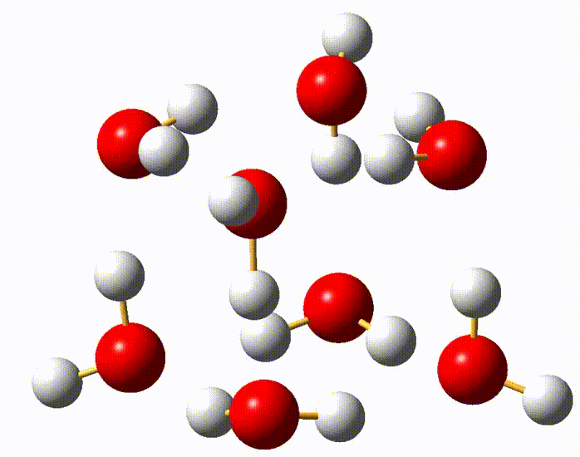
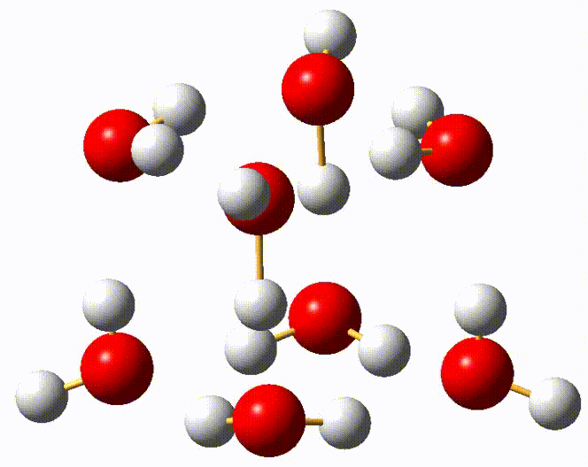
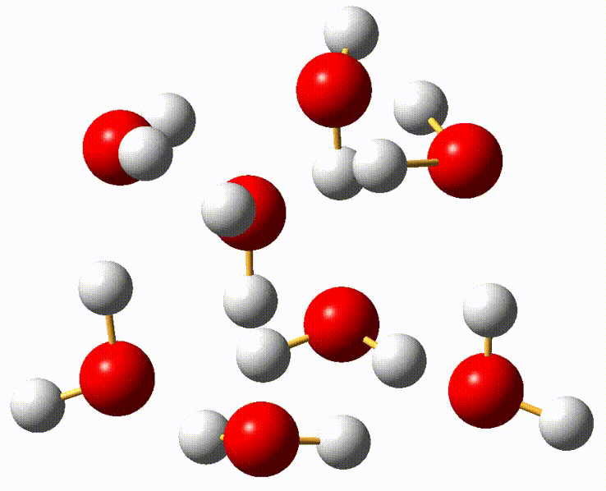
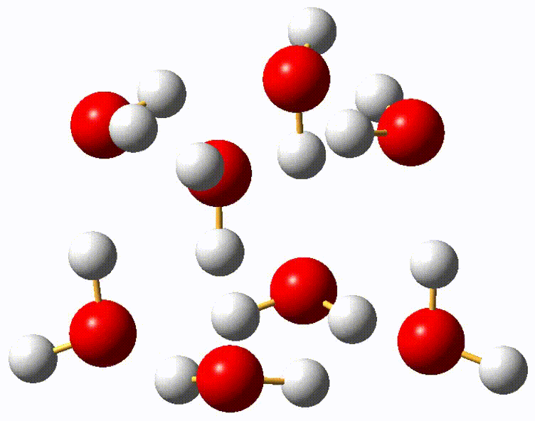
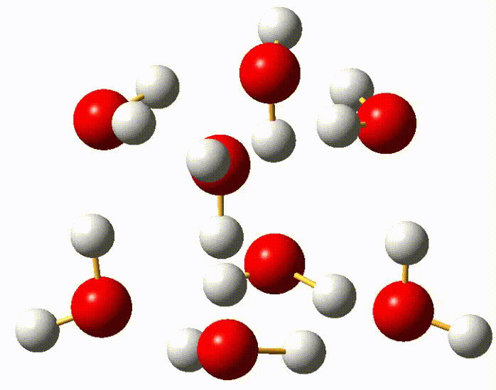
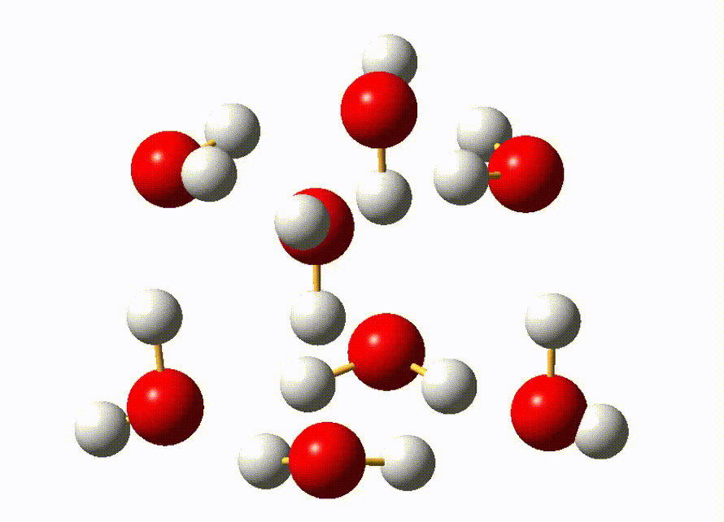
Animation of vibrational modes of isomer I (D_{2d})
Note: The mode numbers are the same as the corresponding ones in Table S2.
ν₃ (S)
ν₄ (S)
ν₅ (D^{sym})
ν₈ (D^{sym})
ν₁₁ (D^{asym})
ν₁₅ (F)

Slide 2
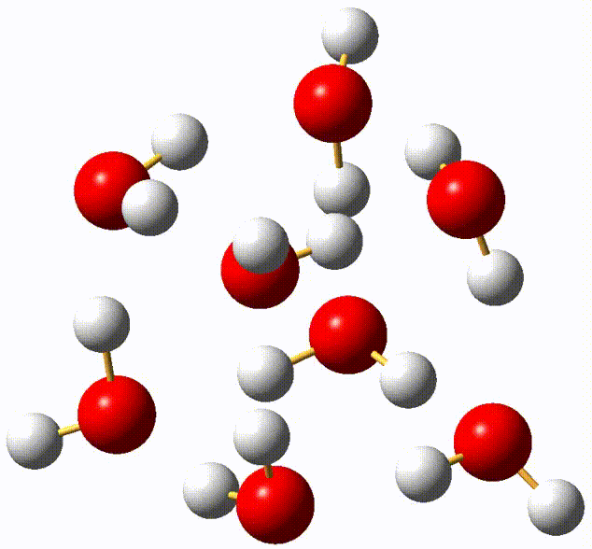
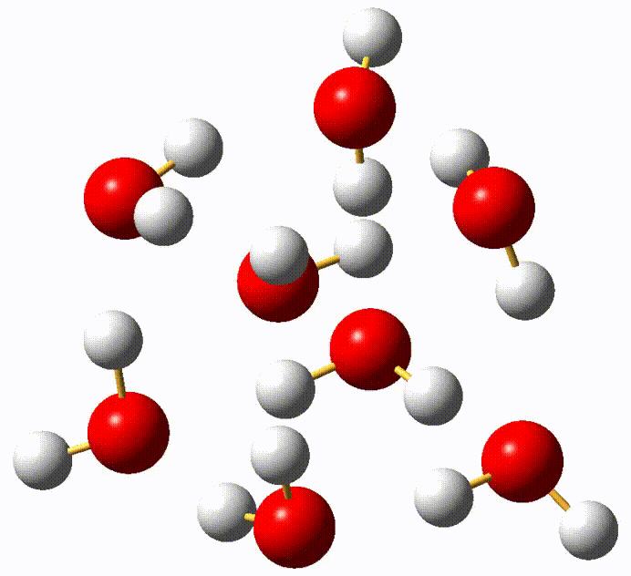
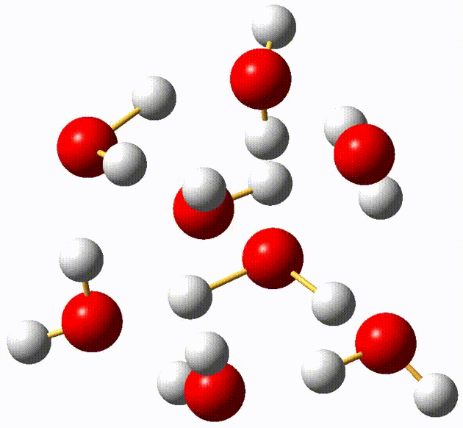
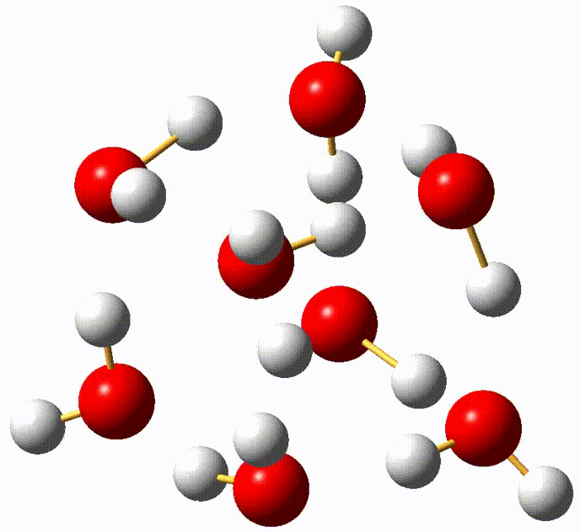
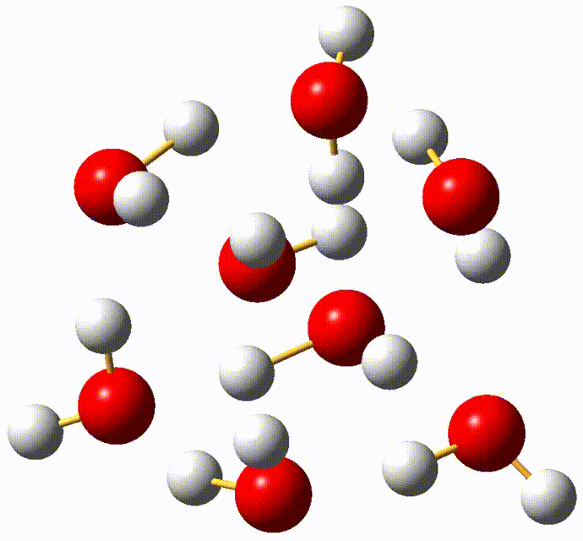
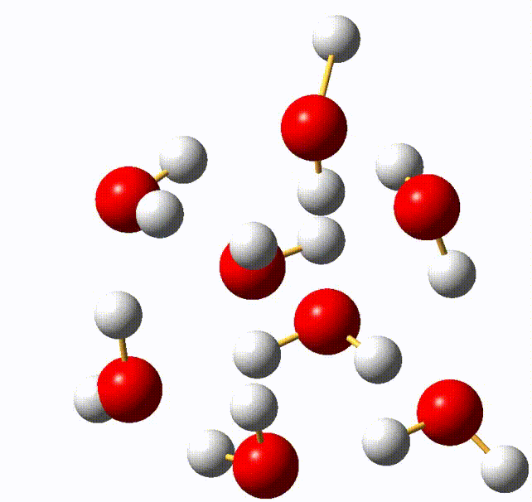
Animation of vibrational modes of isomer II (S₄)
Note: The mode numbers are the same as the corresponding ones in Table S3.
ν₂ (S)
ν₃ (S)
ν₅ (D^{sym})
ν₁₀ (D^{asym})
ν₁₂ (D^{asym})
ν₁₅ (F)

Slide 3
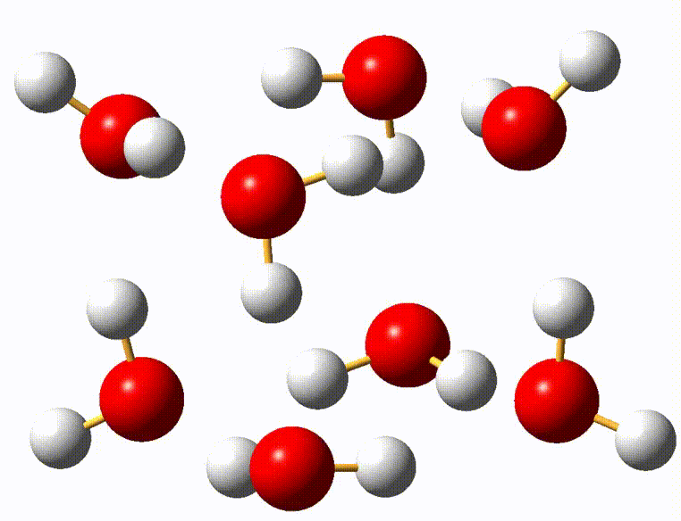
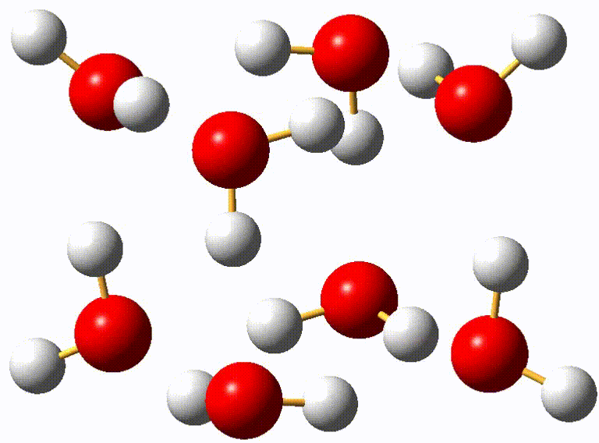
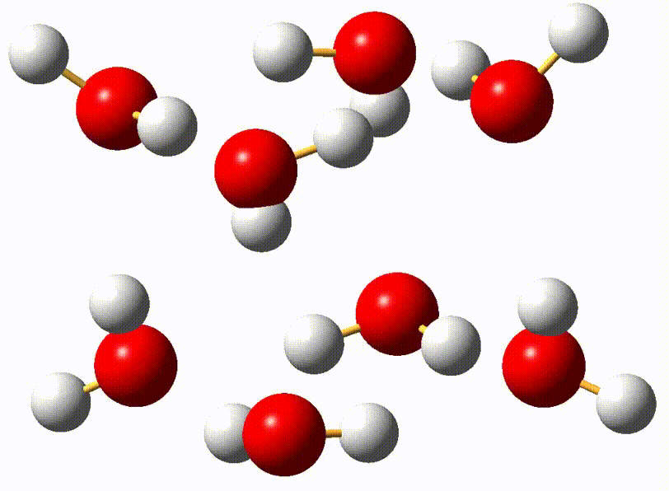
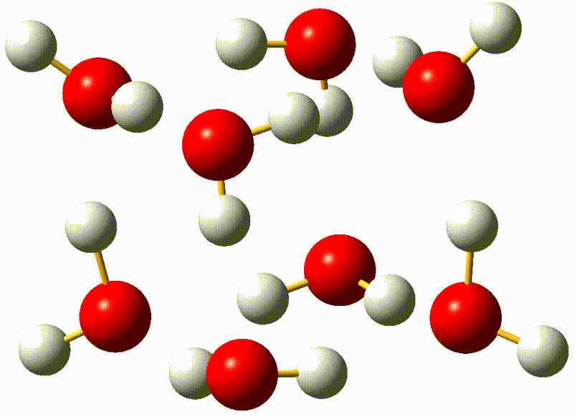
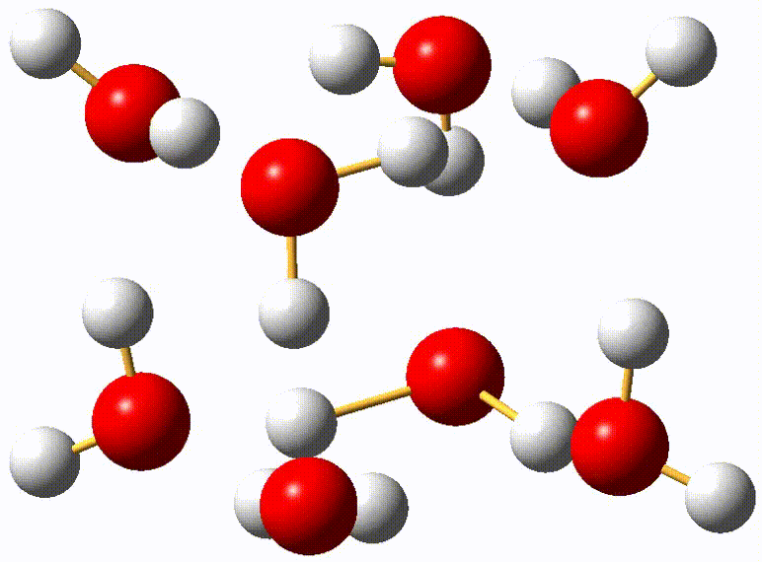
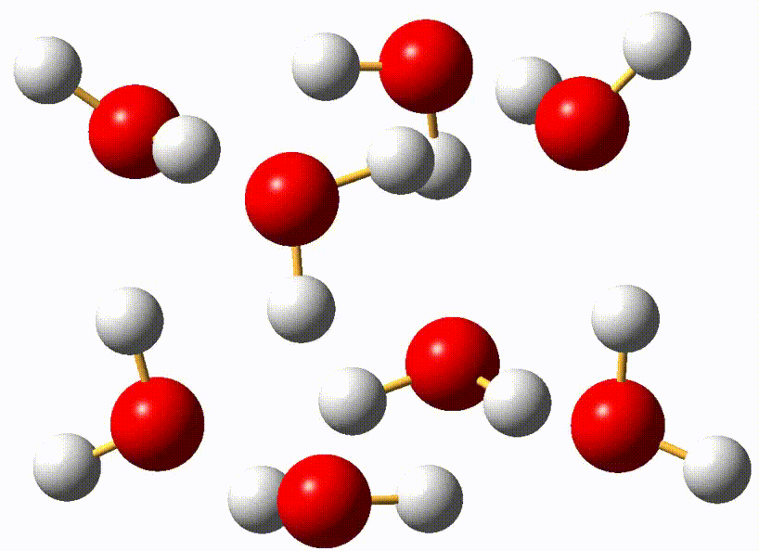
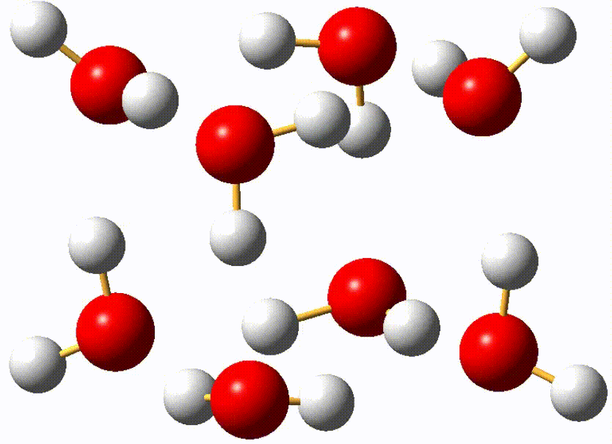
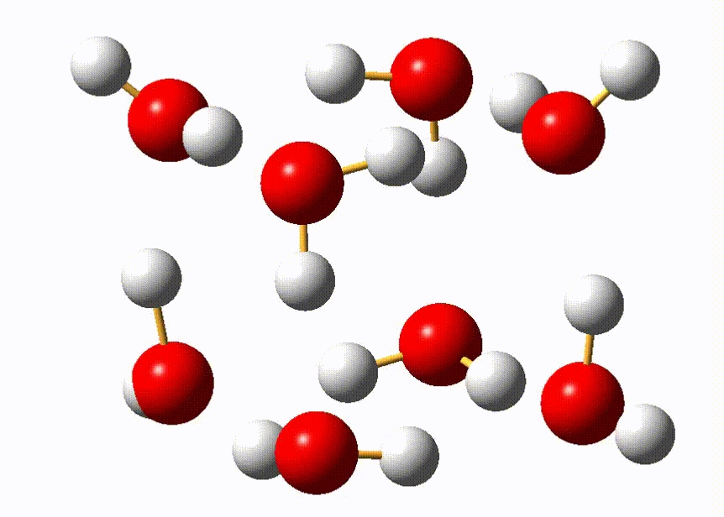
Animation of vibrational modes of isomer III (C₂)
Note: The mode numbers are the same as the corresponding ones in Table S4.
ν₁ (S)
ν₂ (S)
ν₃ (S)
ν₆ (S)
ν₇ (D^{sym})
ν₁₀ (D^{asym})
ν₁₂ (D^{asym})
ν₁₆ (F)

Slide 4
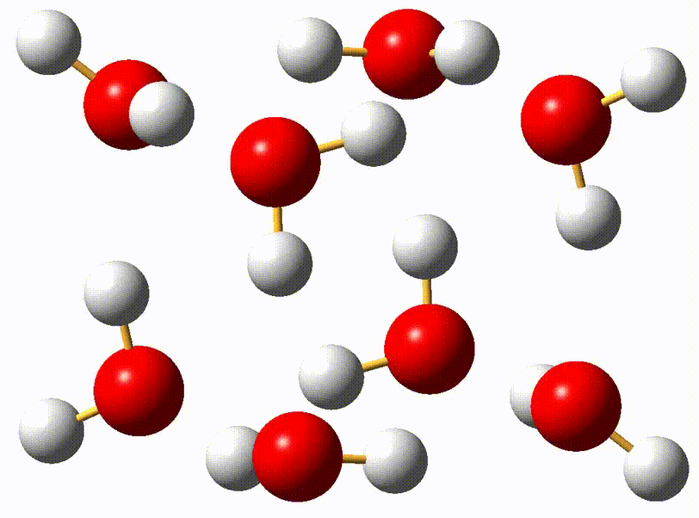
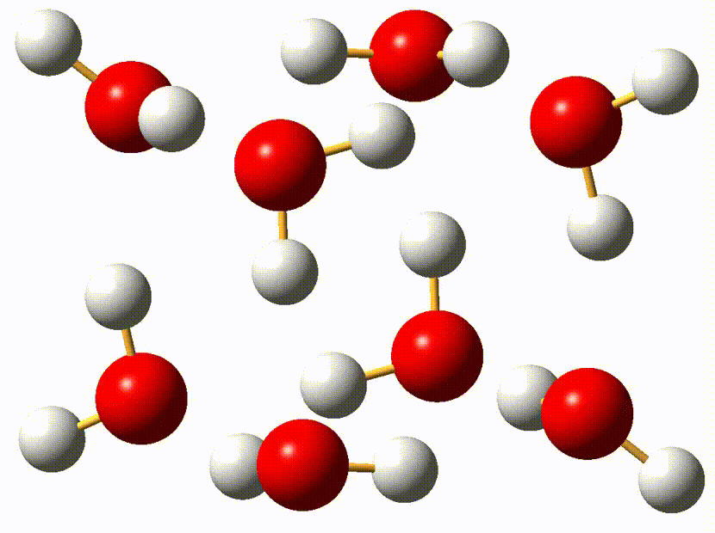
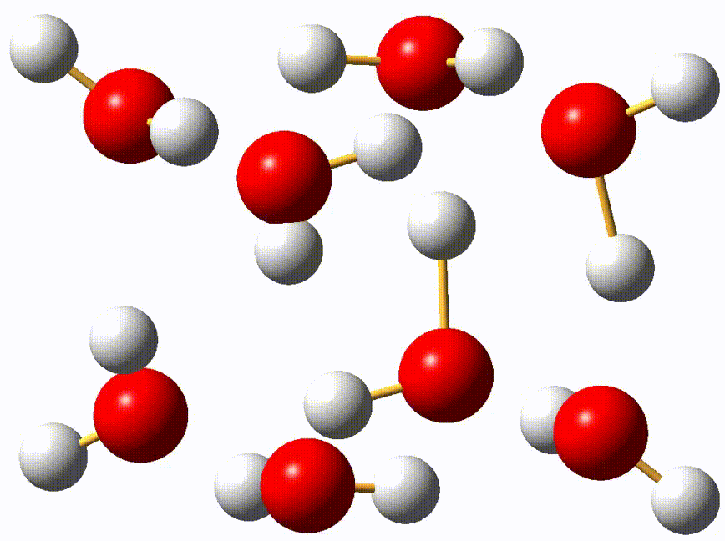
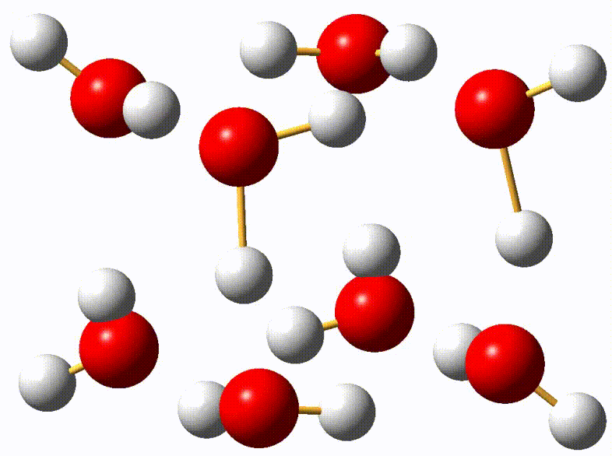
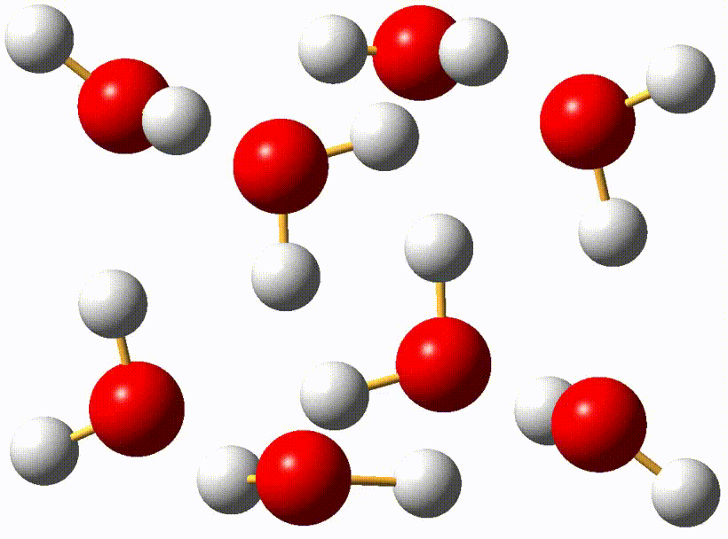
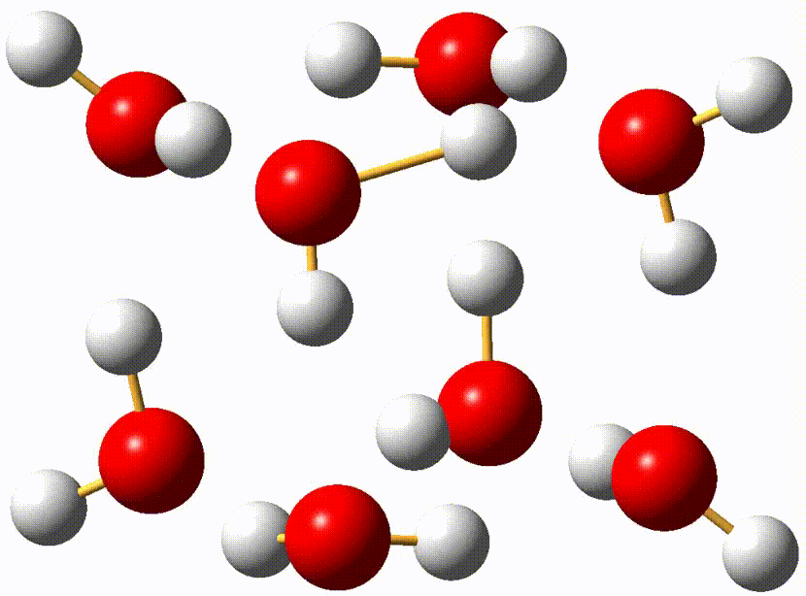
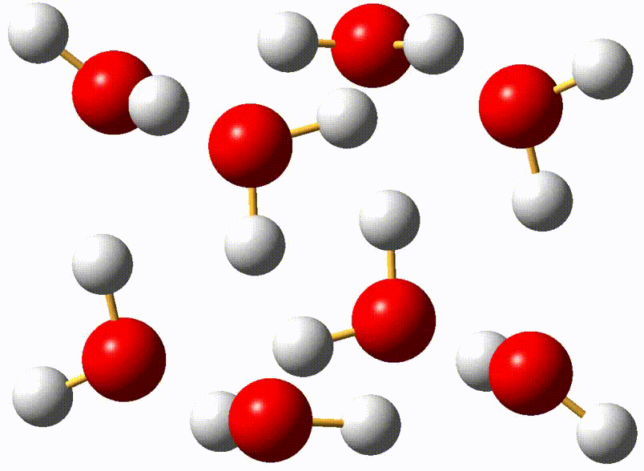
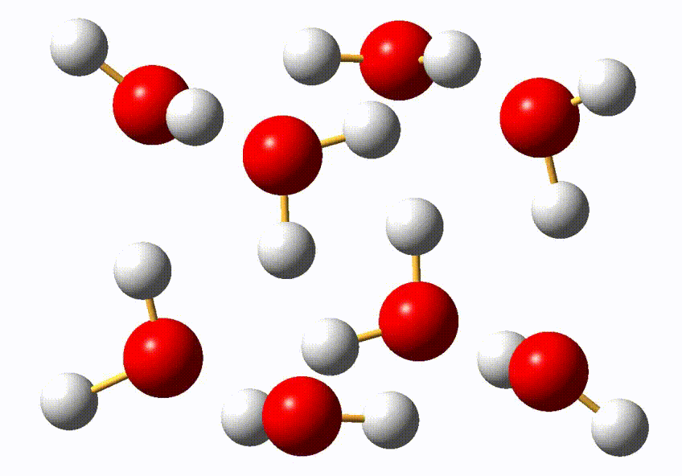
Animation of vibrational modes of isomer V (C_{i})
Note: The mode numbers are the same as the corresponding ones in Table S5.
ν₁ (S)
ν₂ (S)
ν₃ (S)
ν₆ (S)
ν₈ (D^{sym})
ν₁₀ (D^{asym})
ν₁₂ (D^{asym})
ν₁₆ (F)

