Slide 1
Supplementary Table 1. Molecular analysis programs running at the CLB Molecular Tumor Board
Program | Tissue | Type | Organisation | Tool
Profiler | FFPE | DNA: Target seq RNA seq CGH | Rhône Alpes: Data, analysis & MTB centralized at CLB | In house
FMG2025 -AURAGEN | Frozen +/- FFPE | WGS, RNAseq | France, reports at CLB for MTB | National
PRISM portal | Plasma | Circulating target seq | France. In Rhône Alpes: Data, analysis & MTB centralized at CLB | Fondation medecine
Routine | FFPE, Frozen | DNA: Target seq RNA seq Circulating target seq | CLB | Ariana, In house

Slide 2
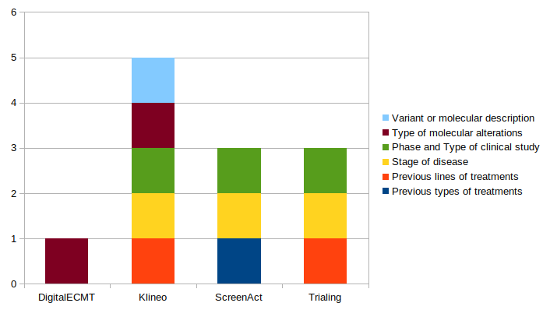
Supplementary Figure 1. Types of input data allowed by DigitalECMT, Klineo, ScreenAct and Trialing

Slide 3
Supplementary Table 2. Contact and answers of clinical trials
NCT | CLINICALTRIALS.GOV STATUS | CONTACT’S STATUS |  | NCT | CLINICALTRIALS.GOV STATUS | CONTACT’S STATUS
NCT05143970 | open | open |  | NCT04982926 | open | no response
NCT04862663 | open | open |  | NCT05865990 | open | no response
NCT04644068 | open | open |  | NCT05853575 | open | no response
NCT03424005 | open | open |  | NCT05307705 | open | no response
NCT04449874 | open | open |  | NCT05512377 | open | open
NCT03006172 | open | open |  | NCT05445778 | Not yet recruiting Europe | no response
NCT05646862 | open | open |  | NCT05456685 | open | no response
NCT05063786 | open | no response |  | NCT04857372 | open | no response
NCT05501886 | open | no response |  | NCT05876754 | open | open
NCT05216432 | open | no response |  | NCT04116541 | Not yet recruiting Europe | no response
NCT05654623 | open | no response |  | NCT05650879 | open | no response
NCT04720729 | open | no response |  | NCT04595266 | open | no response
NCT05768139 | open | open |  | NCT05639751 | open | open
NCT05810870 | open | no response |  | NCT04925284 | open | no response
NCT06039384 | open | no response |  | NCT05840211 | open | open
NCT04570943 | open | open |  | NCT05386108 | open | no response
NCT05988814 | open | open |  | NCT04965766 | open | no response
NCT04493632 | open | open |  | NCT04653740 | open | open
NCT05181605 | open | no response |  | NCT04601857 | open | no response
NCT05466799 | open | open |  | NCT05544552 | open | no response
NCT04300790 | open | open |  | NCT05076396 | open | no response
NCT03742895 | open | open |  | NCT05659914 | open | open
NCT05094336 | open | no response |  | NCT05841563 | open | no response
NCT04794699 | open | open |  | NCT03915678 | open | no response
NCT03767075 | open | open |  | NCT05403554 | open | no response
NCT06024174 | Not yet recruiting Europe | no response |  | NCT04758780 | open | no response
NCT05955170 | open | no response |  | NCT05325866 | open | no response

Slide 4
Supplementary Table 3. Confusion matrix of ClinicalTrials.gov’s status for the CLB’s trials in comparison with the status of our local database
 |  | Status of the CLB’s trials on the local database
 |  | Recruiting | Not recruiting
Status of the CLB’s trials on ClinicalTrials.gov | Recruiting | 33 | 8 | Sensitivity= 0.80
 | Not recruiting | 13 | 21 | Specificity= 0.62
 |  | Precision= 0.72 | Negative Predictive Value= 0.72 | Accuracy= 0.72

Slide 5
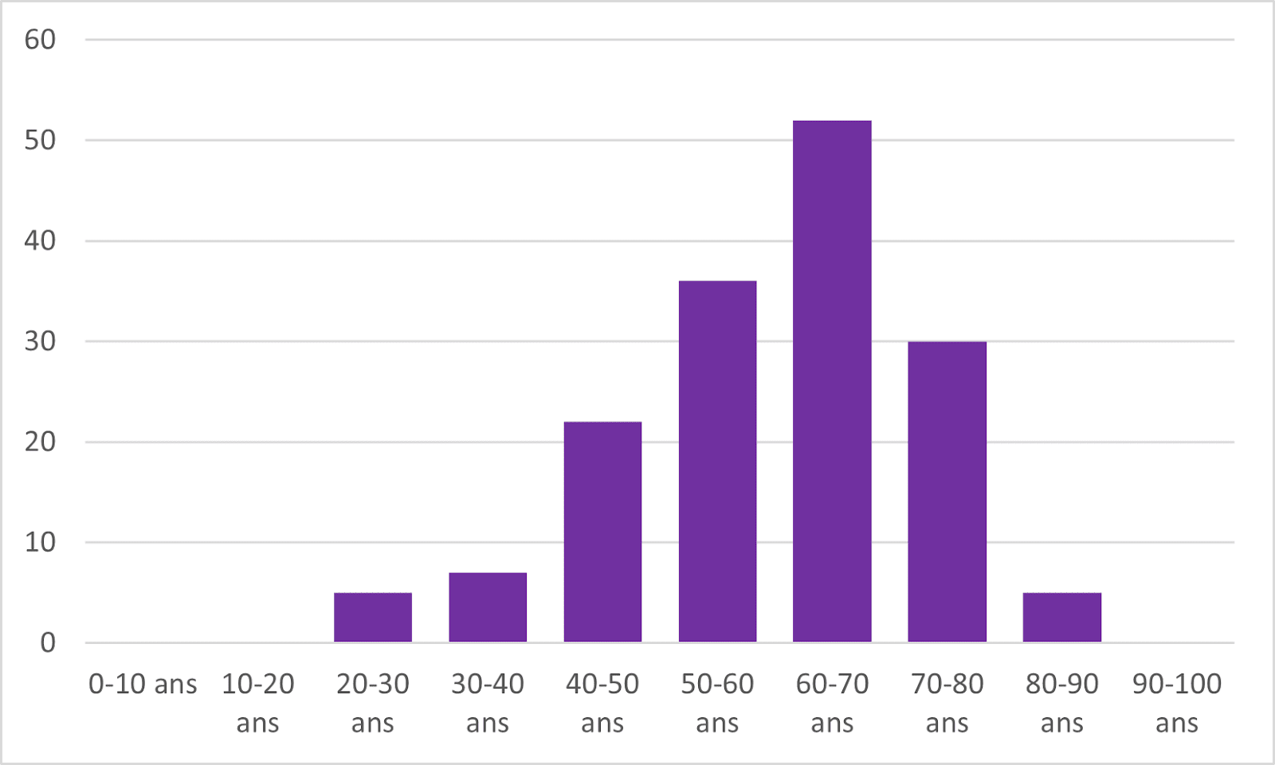
Supplementary Figure 2. Distribution of the 157 patients’ age

Slide 6
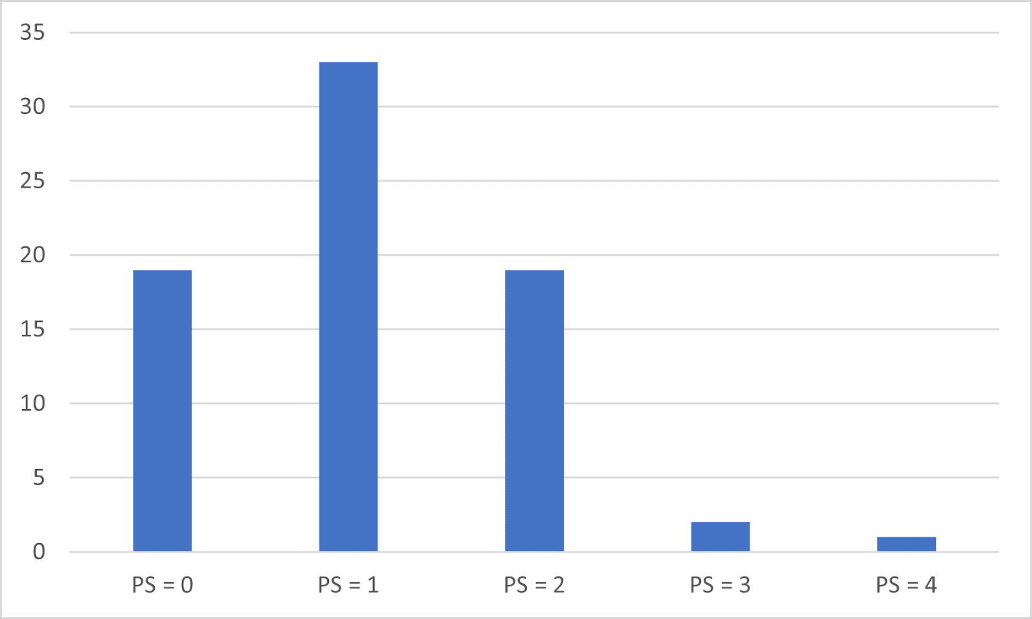
Supplementary Figure 3. Distribution of the 157 patients’ performance status

Slide 7
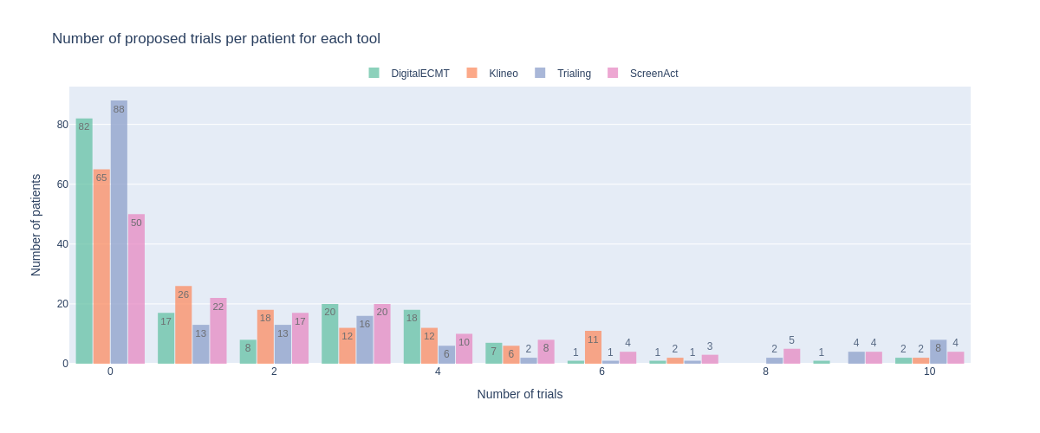
Supplementary Figure 4. Distribution of the number of clinical trials per patient for each tool.
Each colour represents one tool. Each bar represents the number of patients for which the tool suggested the number of trials indicated on the x-axis.

Slide 8
Table 4. Average confusion matrices
a | Retrieved | Not retrieved
Eligible | 0.45 | 1.78
Ineligible | 1.10 | 85 322.68
b | Retrieved | Not retrieved
Eligible | 1.02 | 1.20
Ineligible | 1.07 | 85 322.71
c | Retrieved | Not retrieved
Eligible | 0.62 | 1.60
Ineligible | 1.31 | 85 322.47
d | Retrieved | Not retrieved
Eligible | 0.85 | 1.37
Ineligible | 2.37 | 85 321.41
a Digital ECMT. b Klineo. c Trialing. d ScreenAct.

Slide 9
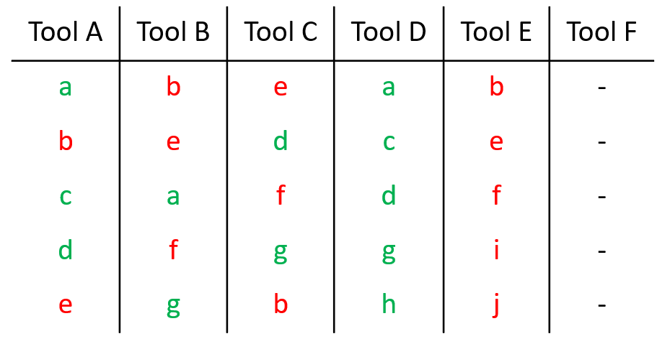
Supplementary Table 5. Synthetic example of trial matching tools ranking of trials.
The rankings of each tool are represented in this table. Eligible trials according to the patient’s criteria are in green, ineligible ones in red. Trials a, c, d, g and h (green) are eligible and trials b, e, f, i, and j (red) are not correct. Tool F didn’t retrieve any trial.

Slide 10
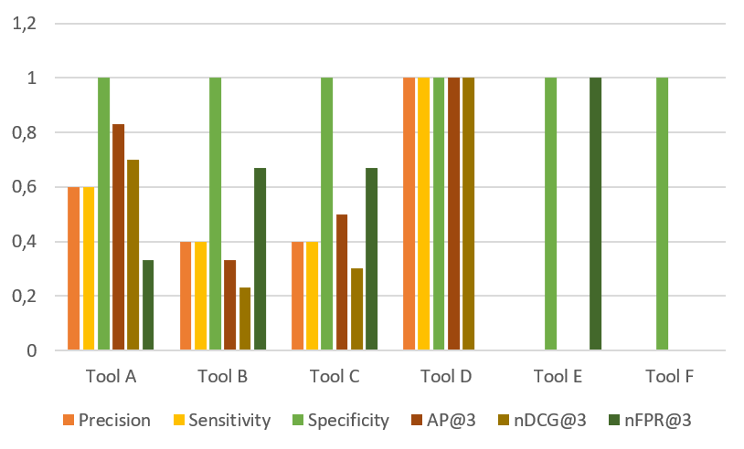
Supplementary Figure 5. Metrics corresponding to the synthetic example.

Slide 11
Supplementary Table 6. Interpretation of AP@3 scores
Ranking | AP@3 score
True, True, True | 1
True, True, False | 1
True, False, False | 1
False, True, True | 0.58
False, True, False | 0.5
False, False, True | 0.33
False, False, False | 0

Slide 12
Table 7. Average Precision results at ranks 3, 5 and 10
Metric | Digital ECMT | Klineo | Trialing | ScreenAct | Total
Eligibility
AP@3 | 0.37 (sd 0.47) | 0.67 (sd 0.43) | 0.39 (sd 0.45) | 0.46 (sd 0.46) | 0.47 (sd 0.47)
AP@5 | 0.37 (sd 0.46) | 0.67 (sd 0.42) | 0.40 (sd 0.44) | 0.46 (sd 0.45) | 0.47 (sd 0.45)
AP@10 | 0.37 (sd 0.46) | 0.66 (sd 0.42) | 0.38 (sd 0.42) | 0.45 (sd 0.43) | 0.46 (sd 0.45)
Status
AP@3 | 0.62 (sd 0.48) | 0.73 (sd 0.43) | 0.51 (sd 0.48) | 0.78 (sd 0.34) | 0.66 (sd 0.45)
AP@5 | 0.62 (sd 0.48) | 0.73 (sd 0.42) | 0.51 (sd 0.47) | 0.77 (sd 0.33) | 0.66 (sd 0.44)
AP@10 | 0.62 (sd 0.48) | 0.73 (sd 0.42) | 0.5 (sd 0.47) | 0.77 (sd 0.33) | 0.66 (sd 0.44)
Eligibility + Status
AP@3 | 0.39 (sd 0.48) | 0.66 (sd 0.42) | 0.34 (sd 0.42) | 0.42 (sd 0.46) | 0.45 (sd 0.46)
AP@5 | 0.39 (sd 0.46) | 0.66 (sd 0.41) | 0.33 (sd 0.41) | 0.41 (sd 0.44) | 0.45 (sd 0.45)
AP@10 | 0.39 (sd 0.46) | 0.65 (sd 0.4) | 0.32 (sd 0.38) | 0.4 (sd 0.42) | 0.44 (sd 0.44)

Slide 13
Table 8. Normalized Discounted Cumulative Gain results at ranks 3, 5 and 10. The best score is 1 and the worst score is 0.
Metric | Digital ECMT | Klineo | Trialing | ScreenAct | Total
Eligibility
NDCG@3 | 0.26 (sd 0.36) | 0.56 (sd 0.39) | 0.30 (sd 0.36) | 0.33 (sd 0.35) | 0.36 (sd 0.38)
NDCG@5 | 0.23 (sd 0.32) | 0.53 (sd 0.37) | 0.29 (sd 0.33) | 0.32 (sd 0.33) | 0.34 (sd 0.35)
NDCG@10 | 0.21 (sd 0.30) | 0.50 (sd 0.36) | 0.28 (sd 0.32) | 0.32 (sd 0.31) | 0.33 (sd 0.34)
Status
NDCG@3 | 0.53 (sd 0.44) | 0.61 (sd 0.39) | 0.4 (sd 0.4) | 0.66 (sd 0.32) | 0.55 (sd 0.40)
NDCG@5 | 0.45 (sd 0.38) | 0.55 (sd 0.37) | 0.33 (sd 0.35) | 0.62 (sd 0.32) | 0.49 (sd 0.37)
NDCG@10 | 0.35 (sd 0.31) | 0.46 (sd 0.32) | 0.28 (sd 0.31) | 0.56 (sd 0.31) | 0.41 (sd 0.33)
Eligibility + Status
NDCG@3 | 0.28 (sd 0.36) | 0.54 (sd 0.37) | 0.25 (sd 0.32) | 0.29 (sd 0.34) | 0.34 (sd 0.37)
NDCG@5 | 0.25 (sd 0.33) | 0.52 (sd 0.35) | 0.23 (sd 0.30) | 0.29 (sd 0.32) | 0.32 (sd 0.34)
NDCG@10 | 0.24 (sd 0.31) | 0.50 (sd 0.35) | 0.23 (sd 0.29) | 0.30 (sd 0.32) | 0.32 (sd 0.33)

Slide 14
Table 9. Normalised False Positive Rate (NFPR) results at ranks 3, 5 and 10.
Metric | Digital ECMT | Klineo | Trialing | ScreenAct | Total
Eligibility
NFPR@3 | 0.26 (sd 0.4) | 0.16 (sd 0.26) | 0.19 (sd 0.31) | 0.39 (sd 0.38) | 0.25 (sd 0.35)
NFPR@5 | 0.2 (sd 0.3) | 0.14 (sd 0.24) | 0.15 (sd 0.26) | 0.31 (sd 0.32) | 0.2 (sd 0.29)
NFPR@10 | 0.11 (sd 0.17) | 0.09 (sd 0.16) | 0.1 (sd 0.21) | 0.21 (sd 0.24) | 0.13 (sd 0.2)
Status
NFPR@3 | 0.01 (sd 0.06) | 0.03 (sd 0.1) | 0.08 (sd 0.17) | 0.11 (sd 0.18) | 0.06 (sd 0.14)
NFPR@5 | 0.01 (sd 0.04) | 0.03 (sd 0.07) | 0.06 (sd 0.13) | 0.08 (sd 0.12) | 0.05 (sd 0.1)
NFPR@10 | 0.0 (sd 0.02) | 0.02 (sd 0.06) | 0.05 (sd 0.09) | 0.05 (sd 0.07) | 0.03 (sd 0.07)
Eligibility + Status
NFPR@3 | 0.26 (sd 0.4) | 0.18 (sd 0.27) | 0.23 (sd 0.34) | 0.42 (sd 0.4) | 0.27 (sd 0.37)
NFPR@5 | 0.2 (sd 0.3) | 0.16 (sd 0.25) | 0.18 (sd 0.28) | 0.33 (sd 0.33) | 0.22 (sd 0.3)
NFPR@10 | 0.11 (sd 0.17) | 0.1 (sd 0.17) | 0.13 (sd 0.23) | 0.22 (sd 0.25) | 0.14 (sd 0.21)

Slide 15
Table 10. Correlations between ranks 3, 5 and 10 for the Average Precision (coefficient and p-value)
Correlations | Digital ECMT | Klineo | Trialing | ScreenAct
Eligibility
Between rank 3 & 5 | 0.982 p << 0.05 | 0.971 p << 0.05 | 0.979 p << 0.05 | 0.958 p << 0.05
Between rank 3 & 10 | 0.979 p << 0.05 | 0.968 p << 0.05 | 0.973 p << 0.05 | 0.925 p << 0.05
Between rank 5 & 10 | 0.998 p << 0.05 | 0.991 p << 0.05 | 0.993 p << 0.05 | 0.975 p << 0.05
Status
Between rank 3 & 5 | 1.0 p << 0.05 | 0.953 p << 0.05 | 0.986 p << 0.05 | 0.950 p << 0.05
Between rank 3 & 10 | 1.0 p << 0.05 | 0.946 p << 0.05 | 0.981 p << 0.05 | 0.922 p << 0.05
Between rank 5 & 10 | 1.0 p << 0.05 | 0.993 p << 0.05 | 0.993 p << 0.05 | 0.970 p << 0.05
Eligibility + Status
Between rank 3 & 5 | 0.982 p << 0.05 | 0.966 p << 0.05 | 0.986 p << 0.05 | 0.949 p << 0.05
Between rank 3 & 10 | 0.978 p << 0.05 | 0.961 p << 0.05 | 0.967 p << 0.05 | 0.931 p << 0.05
Between rank 5 & 10 | 0.998 p << 0.05 | 0.994 p << 0.05 | 0.979 p << 0.05 | 0.977 p << 0.05

Slide 16
Table 11. Correlations between ranks 3, 5 and 10 for the Normalised Discounted Cumulative Gain (coefficient and p-value)
Correlations | Digital ECMT | Klineo | Trialing | ScreenAct
Eligibility
Between rank 3 & 5 | 0.983 p << 0.05 | 0.959 p << 0.05 | 0.973 p << 0.05 | 0.966 p << 0.05
Between rank 3 & 10 | 0.972 p << 0.05 | 0.922 p << 0.05 | 0.94 p << 0.05 | 0.943 p << 0.05
Between rank 5 & 10 | 0.992 p << 0.05 | 0.977 p << 0.05 | 0.981 p << 0.05 | 0.97 p << 0.05
Status
Between rank 3 & 5 | 0.942 p << 0.05 | 0.941 p << 0.05 | 0.988 p << 0.05 | 0.941 p << 0.05
Between rank 3 & 10 | 0.892 p << 0.05 | 0.858 p << 0.05 | 0.969 p << 0.05 | 0.878 p << 0.05
Between rank 5 & 10 | 0.95 p << 0.05 | 0.936 p << 0.05 | 0.988 p << 0.05 | 0.942 p << 0.05
Eligibility + Status
Between rank 3 & 5 | 0.982 p << 0.05 | 0.943 p << 0.05 | 0.983 p << 0.05 | 0.97 p << 0.05
Between rank 3 & 10 | 0.971 p << 0.05 | 0.903 p << 0.05 | 0.955 p << 0.05 | 0.948 p << 0.05
Between rank 5 & 10 | 0.994 p << 0.05 | 0.978 p << 0.05 | 0.971 p << 0.05 | 0.971 p << 0.05

Slide 17
Table 12. Correlations between ranks 3, 5 and 10 for the Normalised False Positive Rate (coefficient and p-value)
Correlations | Digital ECMT | Klineo | Trialing | ScreenAct
Eligibility
Between rank 3 & 5 | 0.953 p << 0.05 | 0.919 p << 0.05 | 0.997 p << 0.05 | 0.952 p << 0.05
Between rank 3 & 10 | 0.947 p << 0.05 | 0.899 p << 0.05 | 0.984 p << 0.05 | 0.909 p << 0.05
Between rank 5 & 10 | 0.996 p << 0.05 | 0.979 p << 0.05 | 0.987 p << 0.05 | 0.974 p << 0.05
Status
Between rank 3 & 5 | 1.0 p << 0.05 | 0.82 p << 0.05 | 0.836 p << 0.05 | 0.876 p << 0.05
Between rank 3 & 10 | 1.0 p << 0.05 | 0.795 p << 0.05 | 0.734 p << 0.05 | 0.772 p << 0.05
Between rank 5 & 10 | 1.0 p << 0.05 | 0.97 p << 0.05 | 0.920 p << 0.05 | 0.894 p << 0.05
Eligibility + Status
Between rank 3 & 5 | 0.953 p << 0.05 | 0.958 p << 0.05 | 0.975 p << 0.05 | 0.952 p << 0.05
Between rank 3 & 10 | 0.947 p << 0.05 | 0.954 p << 0.05 | 0.963 p << 0.05 | 0.92 p << 0.05
Between rank 5 & 10 | 0.996 p << 0.05 | 0.996 p << 0.05 | 0.996 p << 0.05 | 0.981 p << 0.05

Slide 18
Table 13. Correlations between the Average Precision and the Normalised False Positive Rate (coefficient and p-value)
Correlations | Digital ECMT | Klineo | Trialing | ScreenAct
Eligibility
Rank 3 | 0.967 p << 0.05 | 0.878 p << 0.05 | 0.958 p << 0.05 | 0.951 p << 0.05
Rank 5 | 0.953 p << 0.05 | 0.849 p << 0.05 | 0.933 p << 0.05 | 0.935 p << 0.05
Rank 10 | 0.958 p << 0.05 | 0.837 p << 0.05 | 0.927 p << 0.05 | 0.94 p << 0.05
Status
Rank 3 | 0.886 p << 0.05 | 0.804 p << 0.05 | 0.902 p << 0.05 | 0.731 p << 0.05
Rank 5 | 0.82 p << 0.05 | 0.713 p << 0.05 | 0.827 p << 0.05 | 0.589 p << 0.05
Rank 10 | 0.805 p << 0.05 | 0.671 p << 0.05 | 0.781 p << 0.05 | 0.498 p << 0.05
Eligibility + Status
Rank 3 | 0.965 p << 0.05 | 0.97 p << 0.05 | 0.97 p << 0.05 | 0.958 p << 0.05
Rank 5 | 0.955 p << 0.05 | 0.95 p << 0.05 | 0.953 p << 0.05 | 0.951 p << 0.05
Rank 10 | 0.958 p << 0.05 | 0.98 p << 0.05 | 0.955 p << 0.05 | 0.951 p << 0.05

Slide 19
Table 14. Mean comparisons using student paired t-tests
NDCG@3 | Digital ECMT | Klineo | Trialing | ScreenAct
Eligibility
Digital ECMT |  | p << 0.05 diff = -0.297 CI= -0.385, -0.210 | p = 0.417 diff = -0.041 CI= -0.141, 0.059 | p = 0.190 diff = -0.066 CI= -0.167, 0.034
Klineo |  |  | p << 0.05 diff=0.256 CI=0.148, 0.365 | p << 0.05 diff = 0.231 CI= 0.117, 0.344
Trialing |  |  |  | p = 0.542 diff = -0.026 CI= -0.108, 0.057
ScreenAct
Status
Digital ECMT |  | p = 0.080 diff = -0.075 CI= -0.159, -0.009 | p = 0.001 diff = 0.138 CI= 0.053, 0.223 | p = 0.008 diff = -0.128 CI= -0.223, -0.033
Klineo |  |  | p << 0.05 diff = 0.213 CI= 0.116, 0.309 | p = 0.305 diff = -0.054 CI= -0.157, 0.050
Trialing |  |  |  | p << 0.05 diff = -0.266 CI= -0.348, -0.185
ScreenAct
Eligibility + Status
Digital ECMT |  | p << 0.05 diff = -0.263 CI= -0.352, -0.174 | p = 0.555 diff = 0.030 CI= -0.070, 0.129 | p = 0.764 diff = -0.016 CI= -0.121, 0.089
Klineo |  |  | p << 0.05 diff = 0.292 CI= 0.189, 0.396 | p << 0.05 diff = 0.247 CI= 0.137, 0.357
Trialing |  |  |  | p = 0.282 diff = -0.045 CI= -0.129, 0.038
ScreenAct

Slide 20
Table 15. Results of Klineo before and after the update
 |  | Before the update | After the update
AP@3 | Eligibility | 0.52 (sd 0.45) | 0.69 (sd 0.43)
 | Status | 0.77 (sd 0.40) | 0.69 (sd 0.45)
 | Eligibility + Status | 0.50 (sd 0.44) | 0.66 (sd 0.43)
NDCG@3 | Eligibility | 0.44 (sd 0.42) | 0.57 (sd 0.39)
 | Status | 0.61 (sd 0.36) | 0.59 (sd 0.41)
 | Eligibility + Status | 0.42 (sd 0.39) | 0.54 (sd 0.37)

