Slide 1
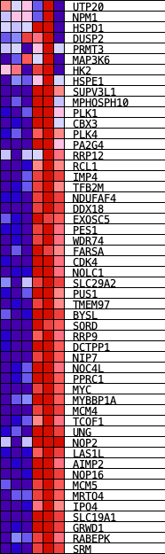
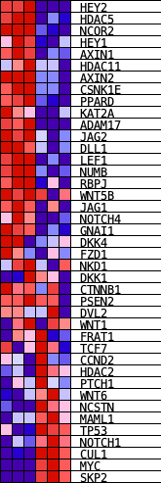
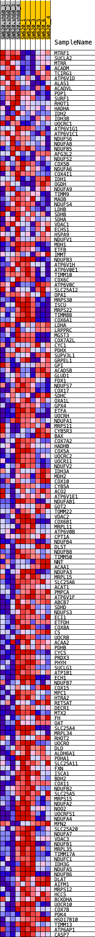
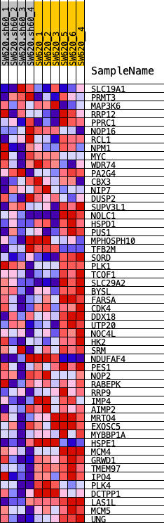
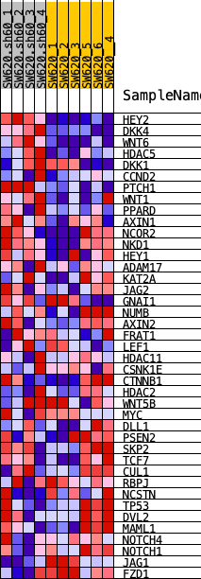
A
KM12SM-sh60 vs KM12SM
P-value
C
G2M checkpoint
DNA repair
TNFα signaling
Hypoxia
MYC targets
E2F targets
EMT
Wnt signaling
KM12SM
KM12SM sh60
KM12SM
KM12SM sh60
KM12SM
KM12SM
KM12SM
KM12SM sh60
KM12SM sh60
KM12SM
KM12SM
KM12SM sh60
KM12SM
KM12SM sh60
KM12SM sh60
KM12SM sh60
SW620-sh60 vs SW620
P-value
B
E2F targets
Oxidative phosphorylation
MYC targets
G2M checkpoint
EMT
Hypoxia
TNFα signaling
Wnt signaling
SW620
SW620
SW620 sh60
SW620
SW620
SW620 sh60
SW620 sh60
SW620 sh60
SW620
SW620
SW620
SW620 sh60
SW620 sh60
SW620 sh60
SW620
KM12SM-sh60 vs KM12SM
SW620 sh60
SW620-sh60 vs SW620
Figure S1. Transcriptomic analysis of CDH17-silenced colon cancer cells. KEGG (A) and GSEA (B) Analysis of significantly altered genes between CDH17-silenced (sh60) and control KM12SM and SW620 cells. (C) Heatmaps of selected GSEA hallmarks significantly altered in CDH17-silenced cells.

Slide 2
A
B
**
*
Figure S2. CDH17 silencing promotes cell migration and invasion. CDH17-silenced and control KM12SM cells were subjected to wound-healing (A) and cell invasion (B) assays. Cell migration and invasion were significantly increased after CDH17 silencing (*, p < 0.05; **, p < 0.01).

Slide 3
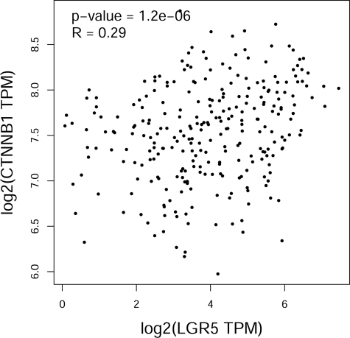
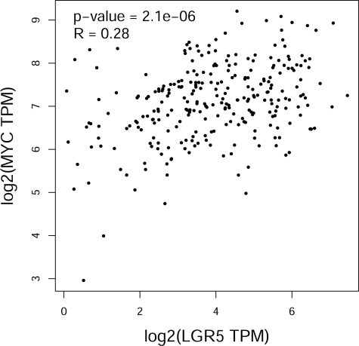
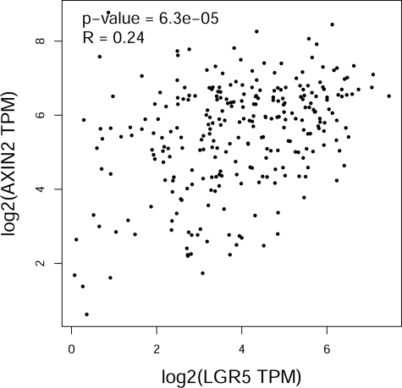
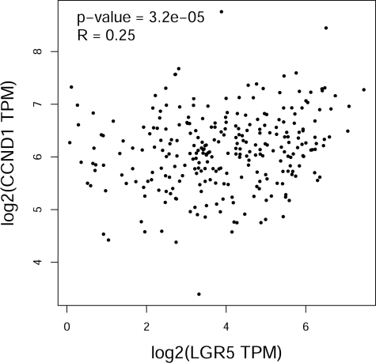
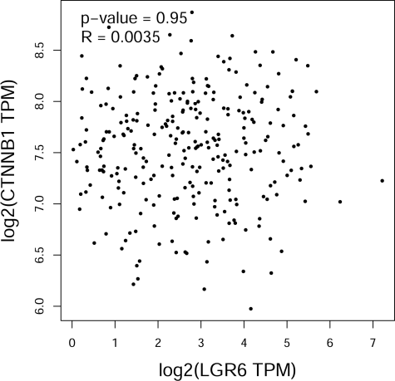
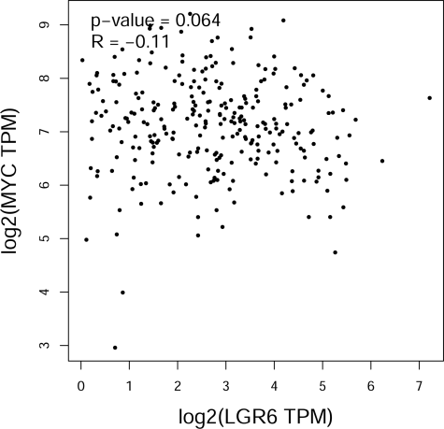
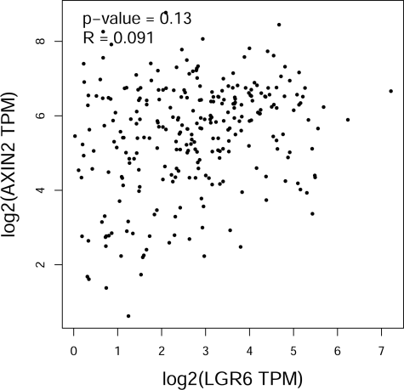
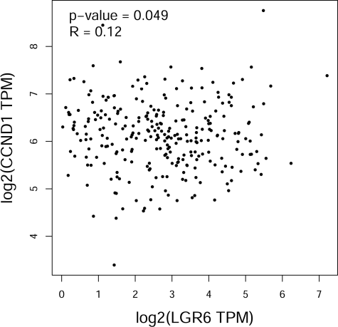
Figure S3. LGR5 correlates with Wnt signaling pathway activation. Correlations between the expression levels of LGR5 (A) or LGR6 (B) and β-catenin (CTNNB1) or β-catenin-controlled genes: c-myc (MYC), axin-2 (AXIN2) and cyclin-D1 (CCND1) according to the TCGA colon adenocarcinoma dataset.

Slide 4








A
B
KM12SM
SW620
KM12SM
SW620
ICG-001 (μM):
0 5 0 5
ICG-001 (μM):
0 1 2.5 5 10 25
0 1 2.5 5 10 25
EPHB2
LGR5
1.0 0.3 1.0 0.5
CD133
CDH17
1.0 0.5 1.0 0.6
RhoGDI
ABCG2
1.0 0.2 1.0 0.0
RhoGDI
Figure S4. Inhibition of Wnt signaling pathway reduces the expression of cancer stem cell markers. (A) KM12SM and SW620 cells were treated with the indicated concentrations of the inhibitor ICG-001 for 48 h. Western blot analyses showed no alterations on LGR5 or CDH17 expression. RhoGDI was used as loading control. (B) The same cells were treated as before with or without ICG-001 (5 μM). Cell lysates were analyzed by Western blot to test the expression of the indicated cancer stem cell markers. Relative expression is shown below each band. RhoGDI was used as loading control.

Slide 5
A
B
KM12SM
SW620
KM12SM
SW620
KM12SM
SW620
***
***
***
siRNA:
Control
LGR5
Figure S5. LGR5 knock down reduces drug resistance. (A) Cell viability assays were carried out in the indicated cell lines previously transfected with control or LGR5-targeting siRNAs and treated with 5-FU (5 μM) or CPT-11 (20 μM) for 48 h. The percentage of viable cells following treatments was significantly reduced (***, p < 0.001). (B) The indicated cell lines were transfected with control or SLC38A-targeting siRNAs and subjected to flow cytometry assays to detect the expression of CDH17 in the cell surface.

Slide 6









A
CDH17 + SLC38A5
CDH17 + SLC38A5
B
CDH17 #2 + SLC38A5 #2
CDH17 #2 + SLC38A5 #2
Control
SLC38A5
Control
SLC38A5
SLC38A5 #2
SLC38A5 #2
CDH17
CDH17
Control
CDH17 #2
Control
siRNA:
siRNA:
siRNA:
siRNA:
CDH17 #2
CDH17
CDH17
CDH17
CDH17
SLC38A5
1.0 0.6 1.0 0.6
SLC38A5
1.0 0.3 0.9 0.3
SLC38A5
1.0 0.1 1.2 0.1
SLC38A5
1.0 0.2 1.1 0.2
RhoGDI
1.0 1.0 0.6 0.6
RhoGDI
1.0 1.0 0.2 0.2
β-actin
1.0 1.0 0.2 0.2
β-actin
1.0 1.1 0.2 0.3
KM12SM
SW620
KM12SM
SW620
C
D
KM12SM
SW620
KM12SM
SW620
***
***
***
*
***
***
***
***
siRNA:
siRNA:
Figure S6. CDH17 and SLC38A collaborate to promote cell survival and chemoresistance. (A, B) Western blot analysis of KM12SM and SW620 cells previously transfected with the indicated siRNAs. As loading control, RhoGDI or β-actin were used. Band quantification is shown below each band. (C) The indicated transfectants were incubated with the chemotherapy drugs 5-FU (5 μM) or CPT-11 (20 μM) for 48 h and subjected to cell viability assays. (D) The indicated transfectants were incubated in presence or absence of H₂O₂ (0.5 mM) or in detachment conditions for 16 h, and subjected to cell viability assays. Dashed lines indicate the input, i.e. the value of cell viability at the beginning of the assay. The silencing of SLC38A alone or combined with CDH17 silencing caused a significant reduction in the percentage of viable cells (*, p < 0.05; ***, p < 0.001) after exposition to the different treatments.

Slide 7
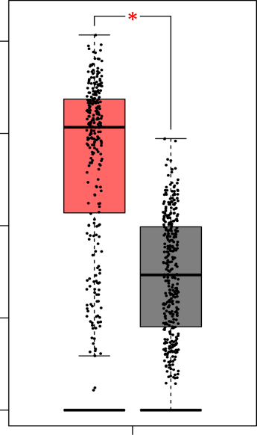
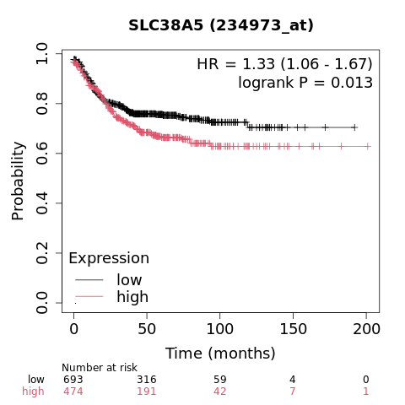
A
SLC38A5
B
SLC38A5
0 2 4 6 8
Expression – log2(TPM+1)
Colon cancer
Normal colon
Figure S7. SLC38A5 expression levels correlates with poor survival in colon cancer patients. (A) Analysis of SLC38A5 mRNA expression in colon cancer or normal colon tissue using GEPIA2 website and TCGA colorectal cancer database. SLC38A5 expression was significantly higher in tumors (*, p < 0.05). (B) Kaplan-Meier analysis of colon cancer patient survival using Kaplan-Meier Plotter website with a dataset of 1336 colon cancer patients according to SLC38A5 expression levels. Log-rank test and Hazard Ratio values are shown inside the panel. Samples were divided into high and low expression using the best cut off method.

