Slide 1
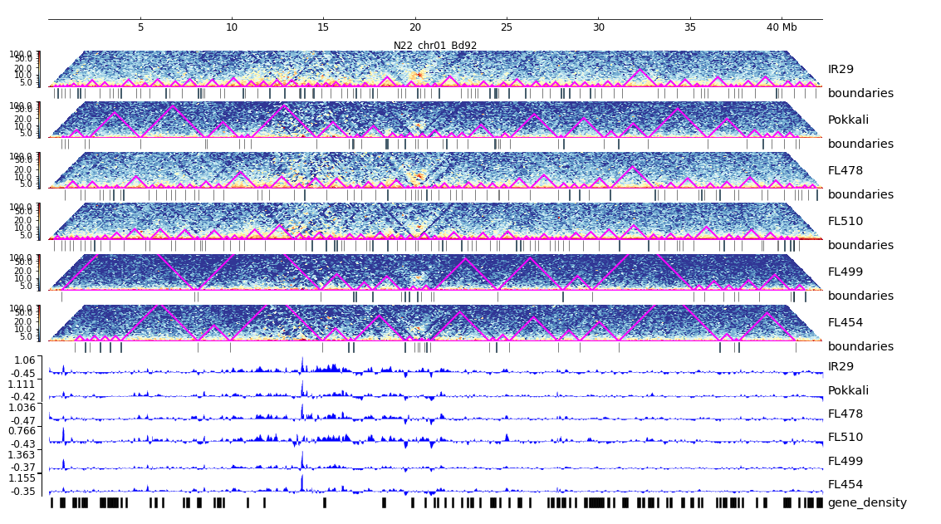
Additional File 26. HiC composite figure for Pokkali chr01

