Slide 1
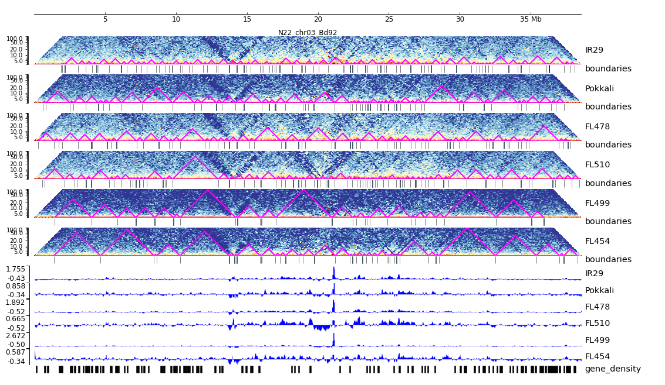
Additional File 28. HiC composite figure for Pokkali chr03

