Slide 1
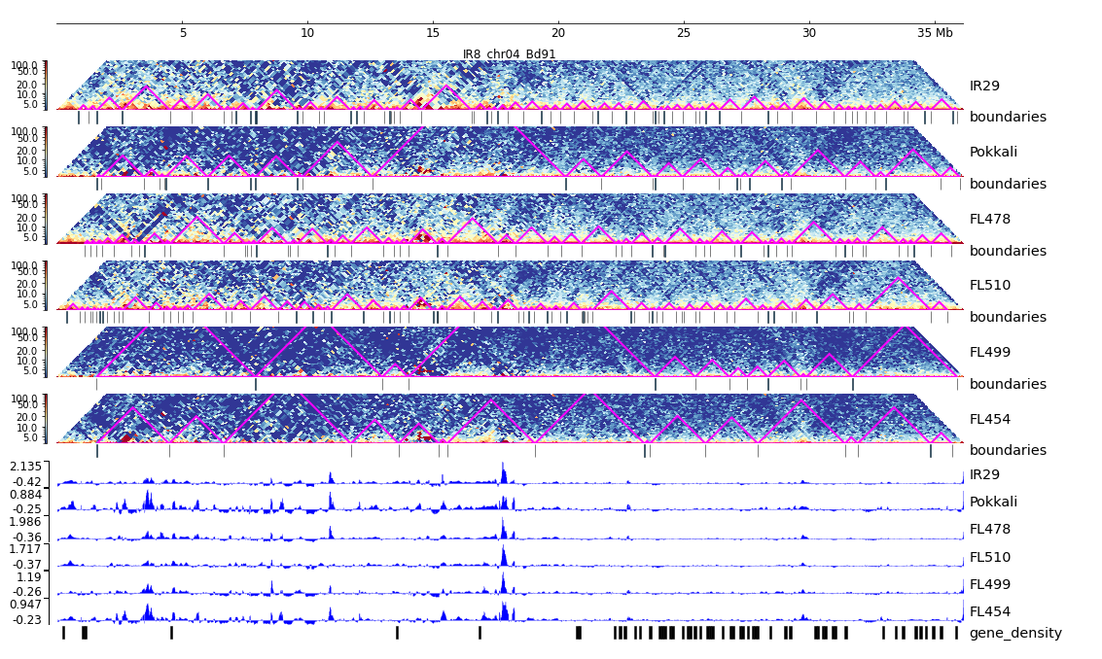
Additional File 17. HiC composite figure for IR29 chr04

