Slide 1
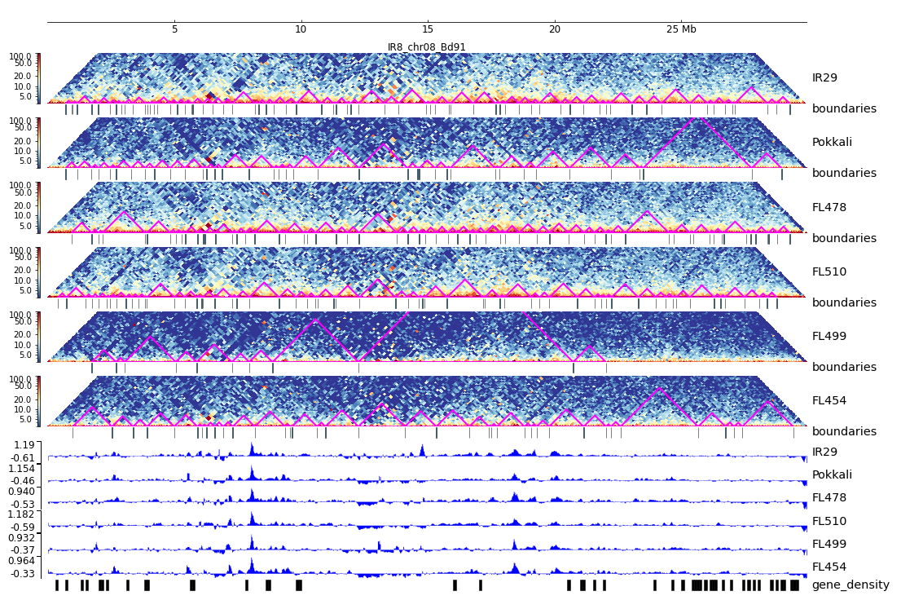
Additional File 21. HiC composite figure for IR29 chr08

