Slide 1
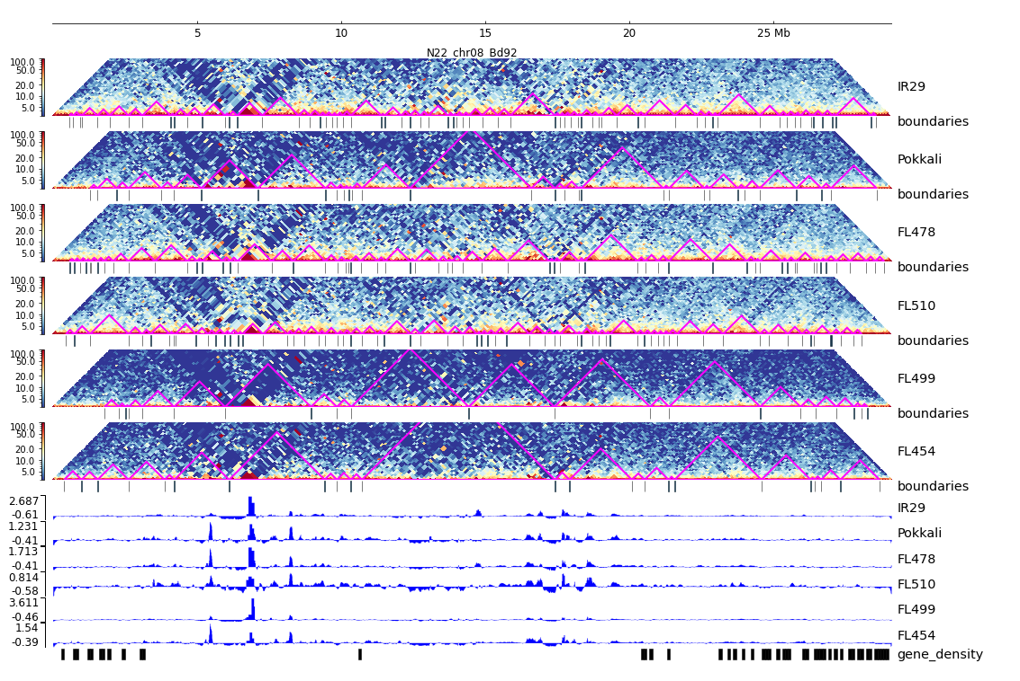
Additional File 33. HiC composite figure for Pokkali chr08

