Slide 1
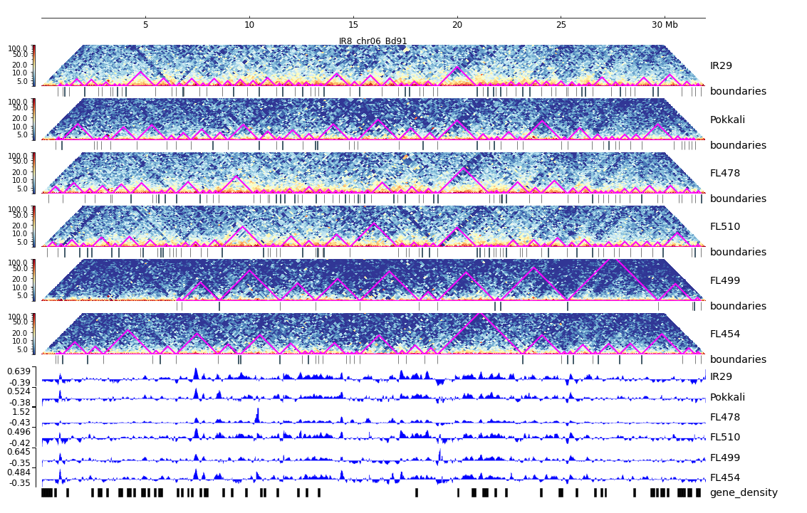
Additional File 19. HiC composite figure for IR29 chr06

