Slide 1
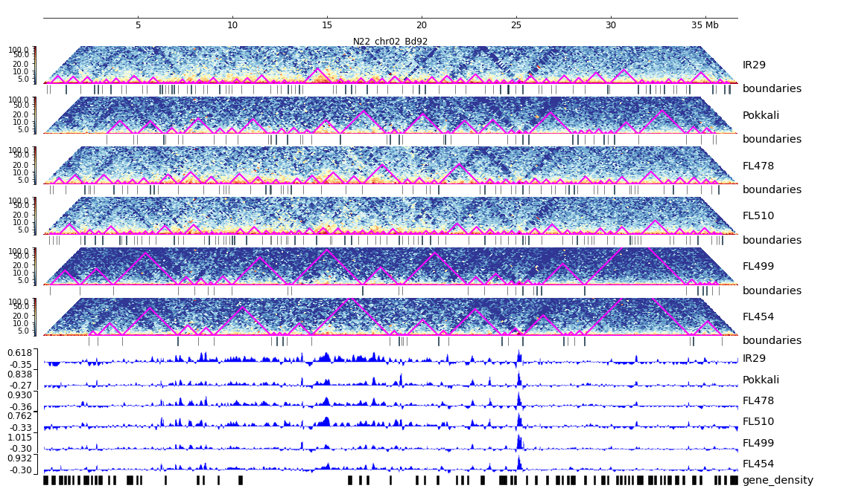
Additional File 27. HiC composite figure for Pokkali chr02

