Slide 1
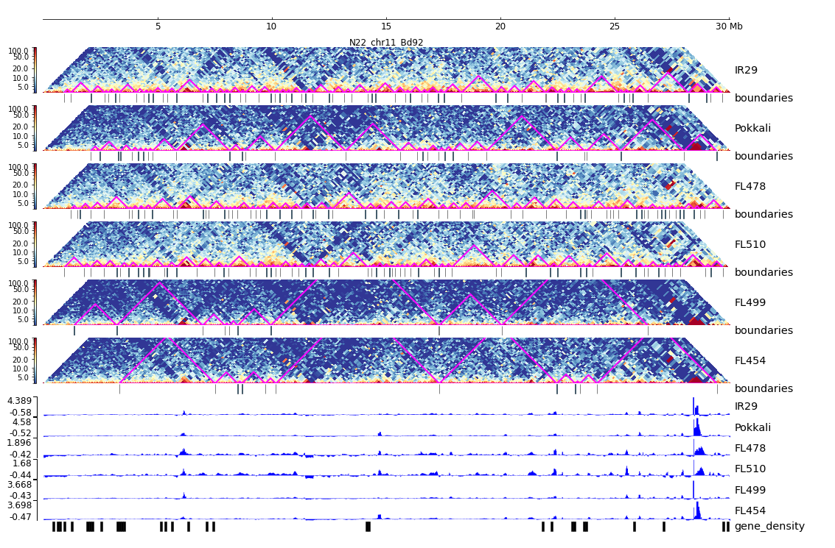
Additional File 36. HiC composite figure for Pokkali chr11

