Slide 1
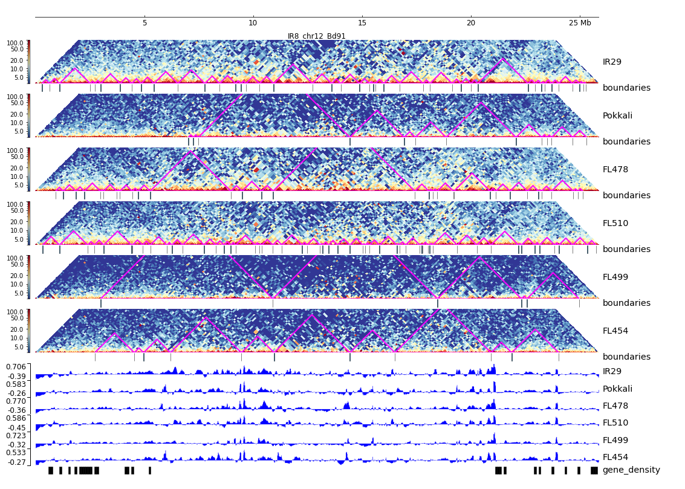
Additional File 25. HiC composite figure for IR29 chr12

