Slide 1
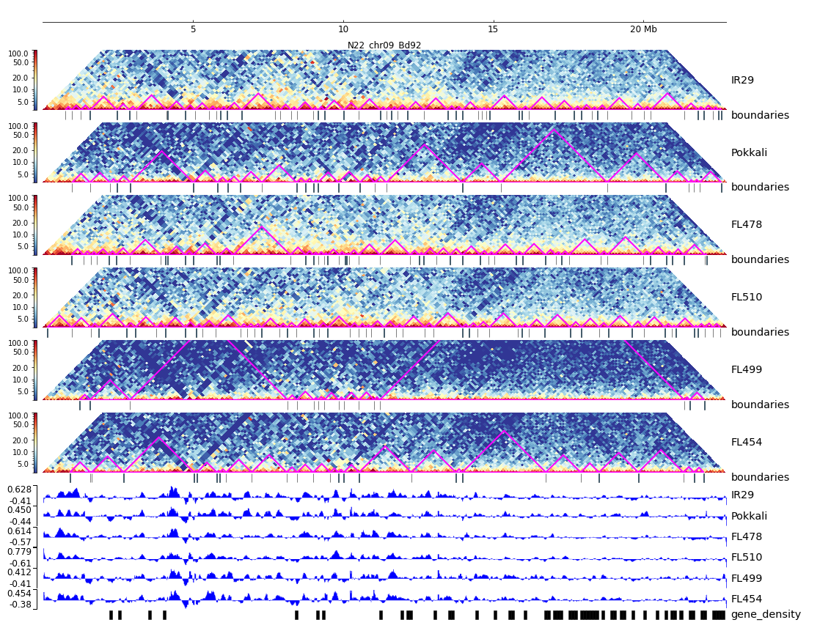
Supplementary Figure 31. HiC composite figure for Pokkali chr09

