Slide 1
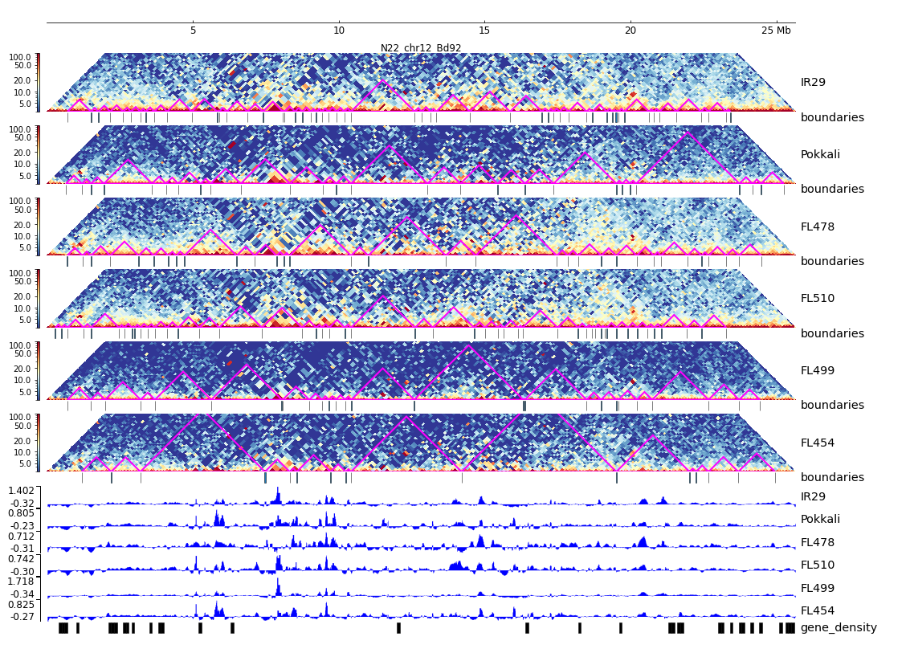
Additional File 37. HiC composite figure for Pokkali chr12

