Slide 1
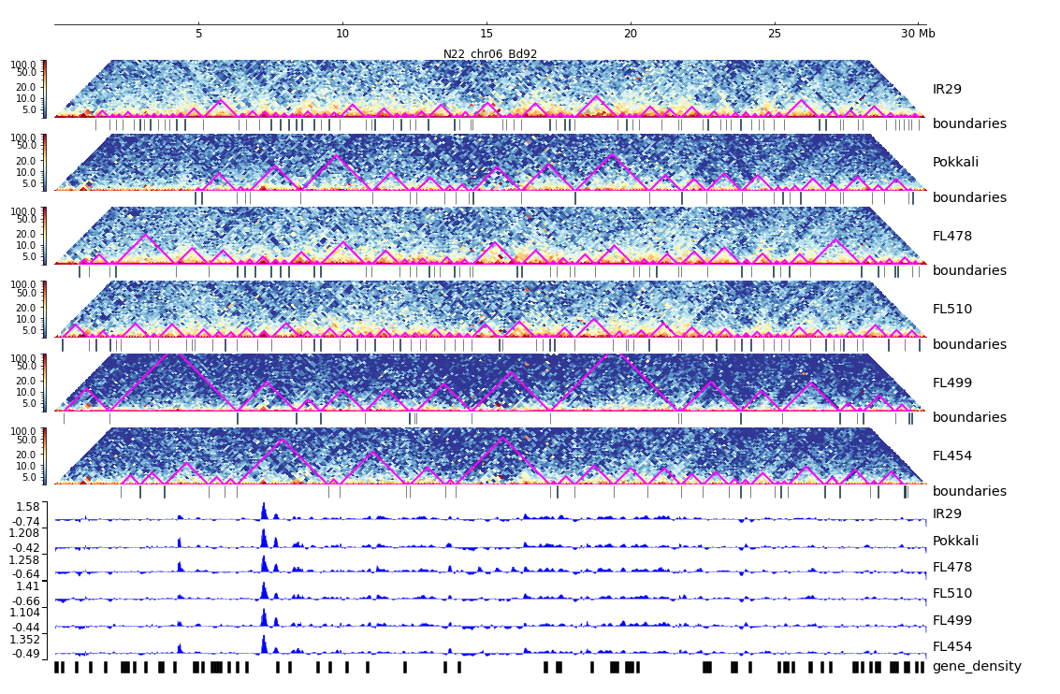
Additional File 31. HiC composite figure for Pokkali chr06

