Slide 1
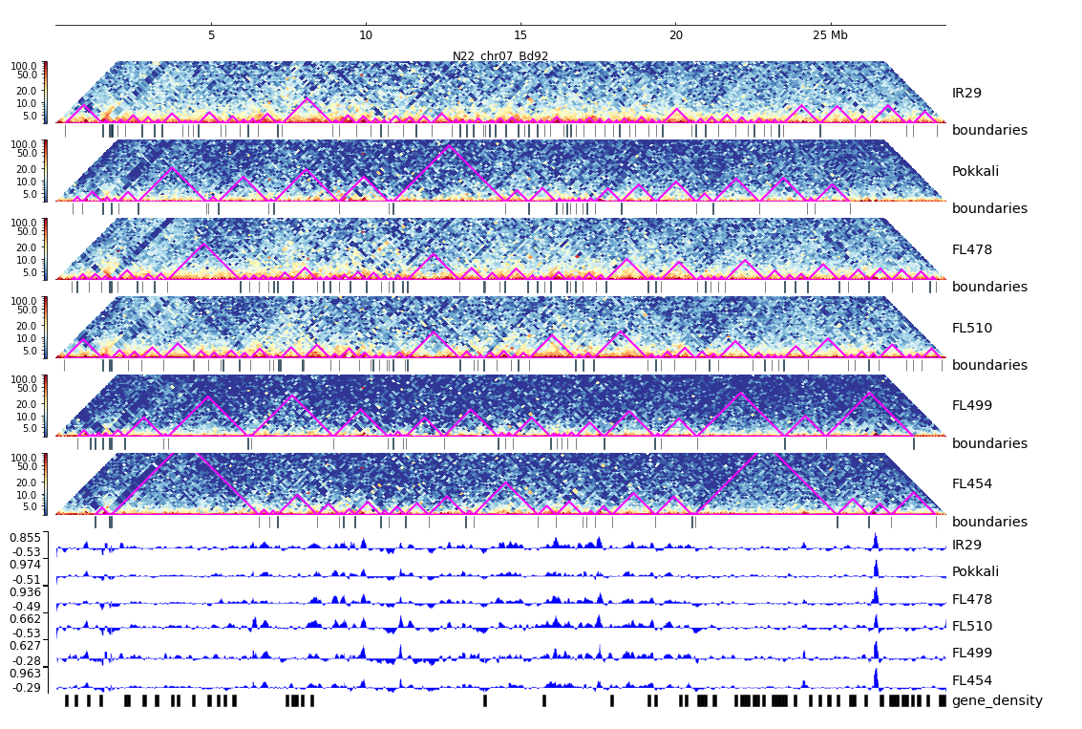
Additional File 32. HiC composite figure for Pokkali chr07

