Slide 1
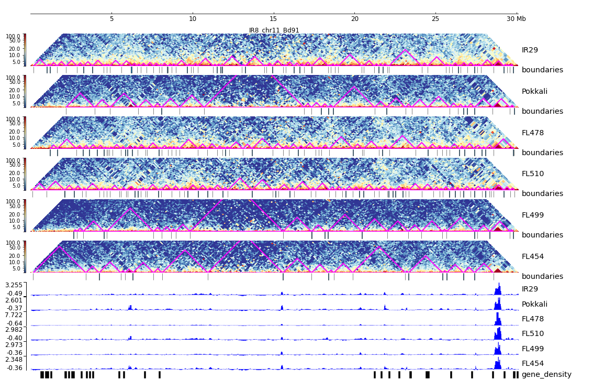
Additional File 24. HiC composite figure for IR29 chr11

