Slide 1
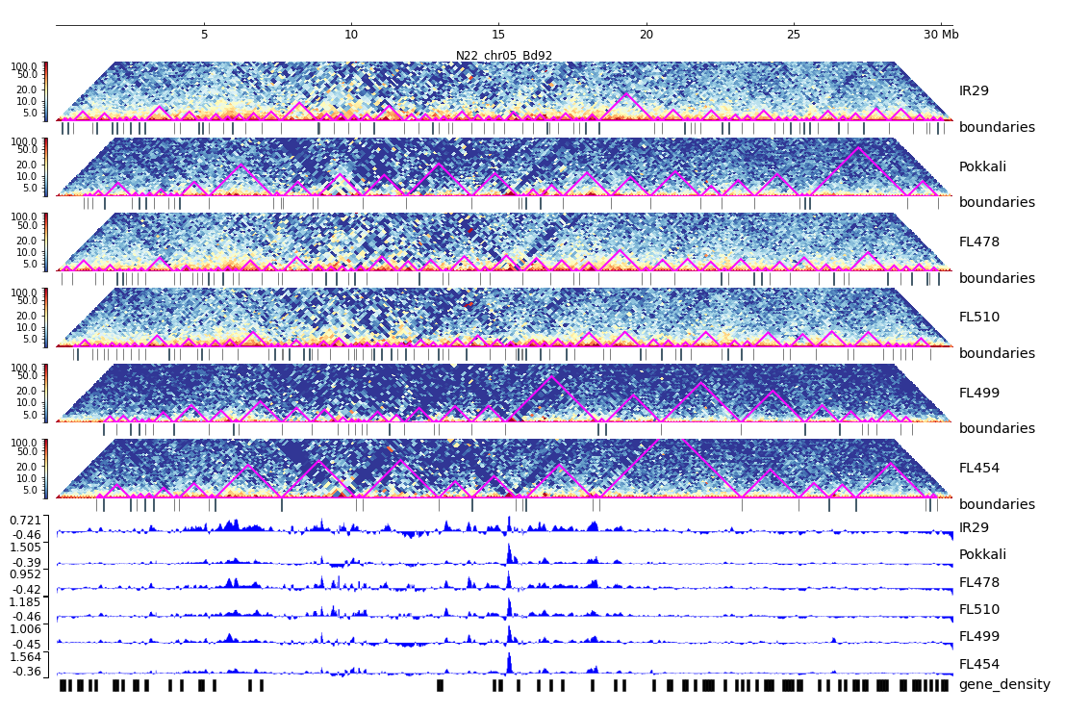
Additional File 30. HiC composite figure for Pokkali chr05

