Slide 1
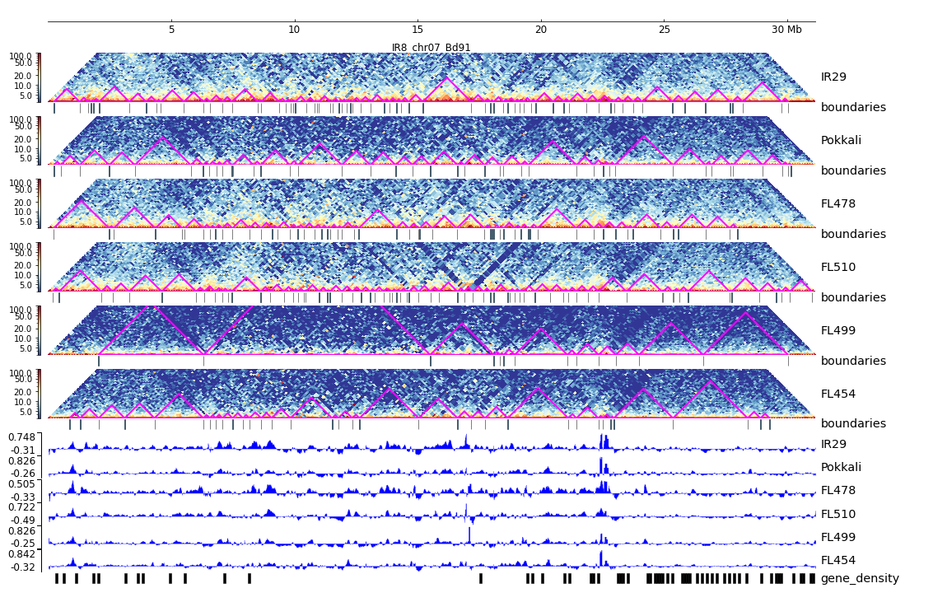
Additional File 20. HiC composite figure for IR29 chr07

