Slide 1
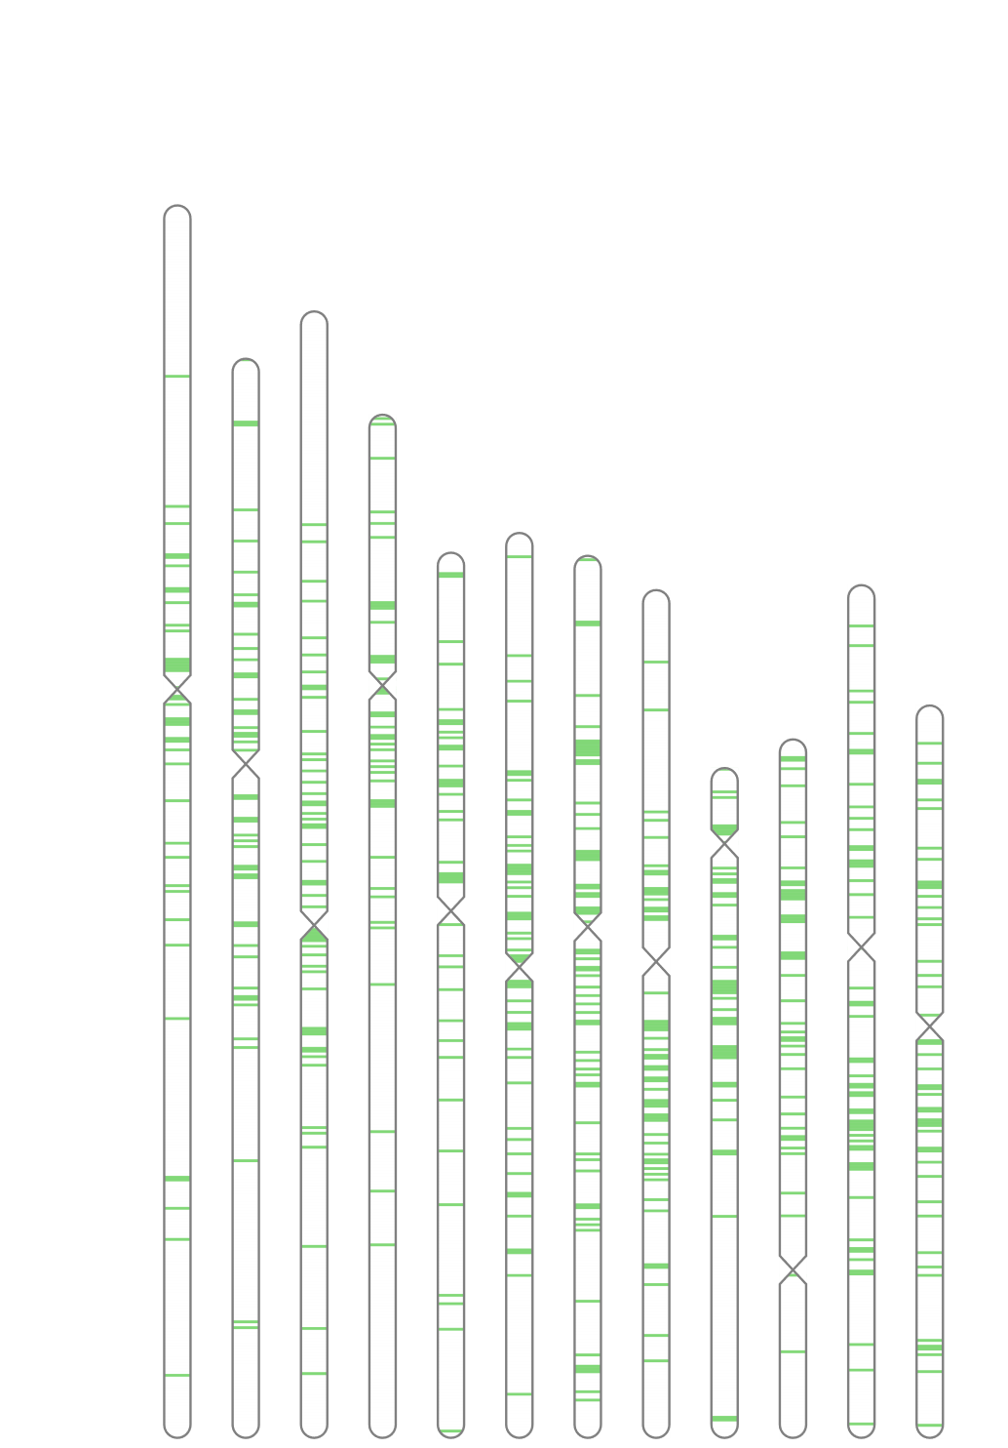
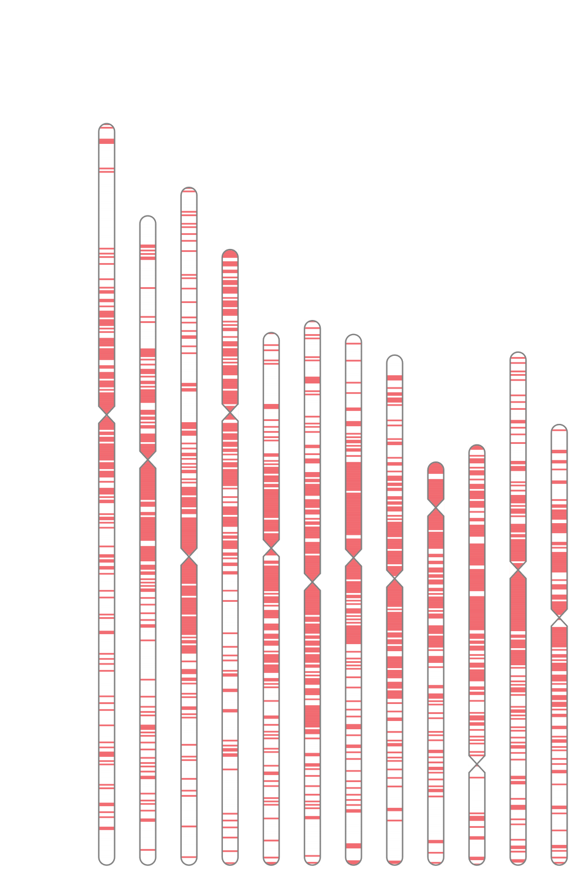
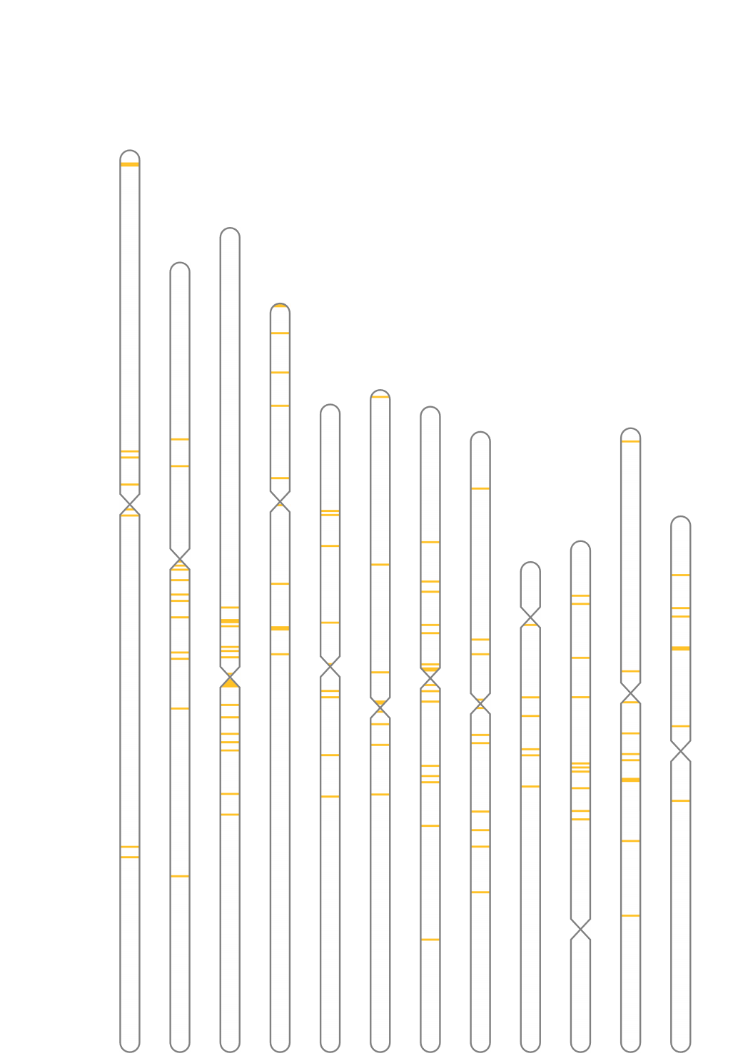
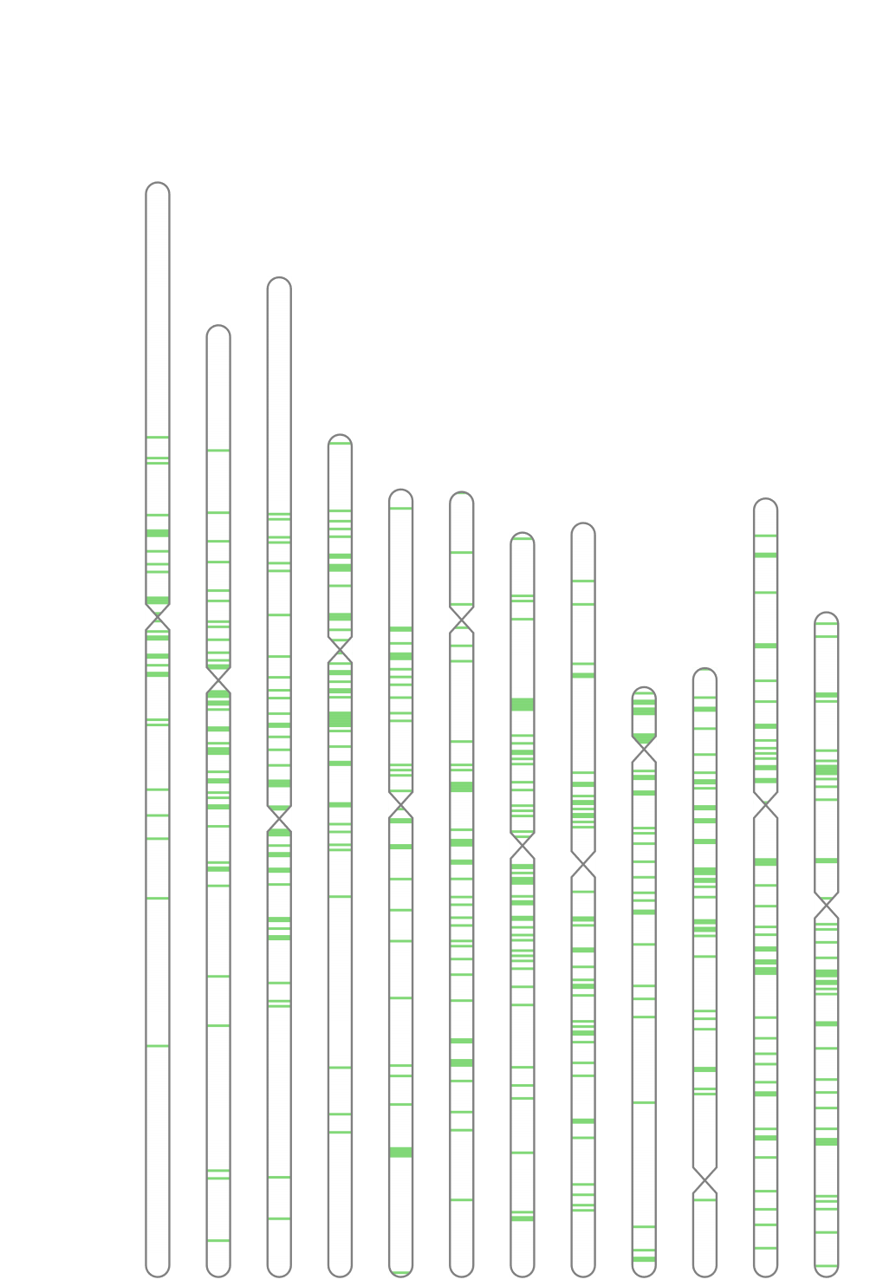
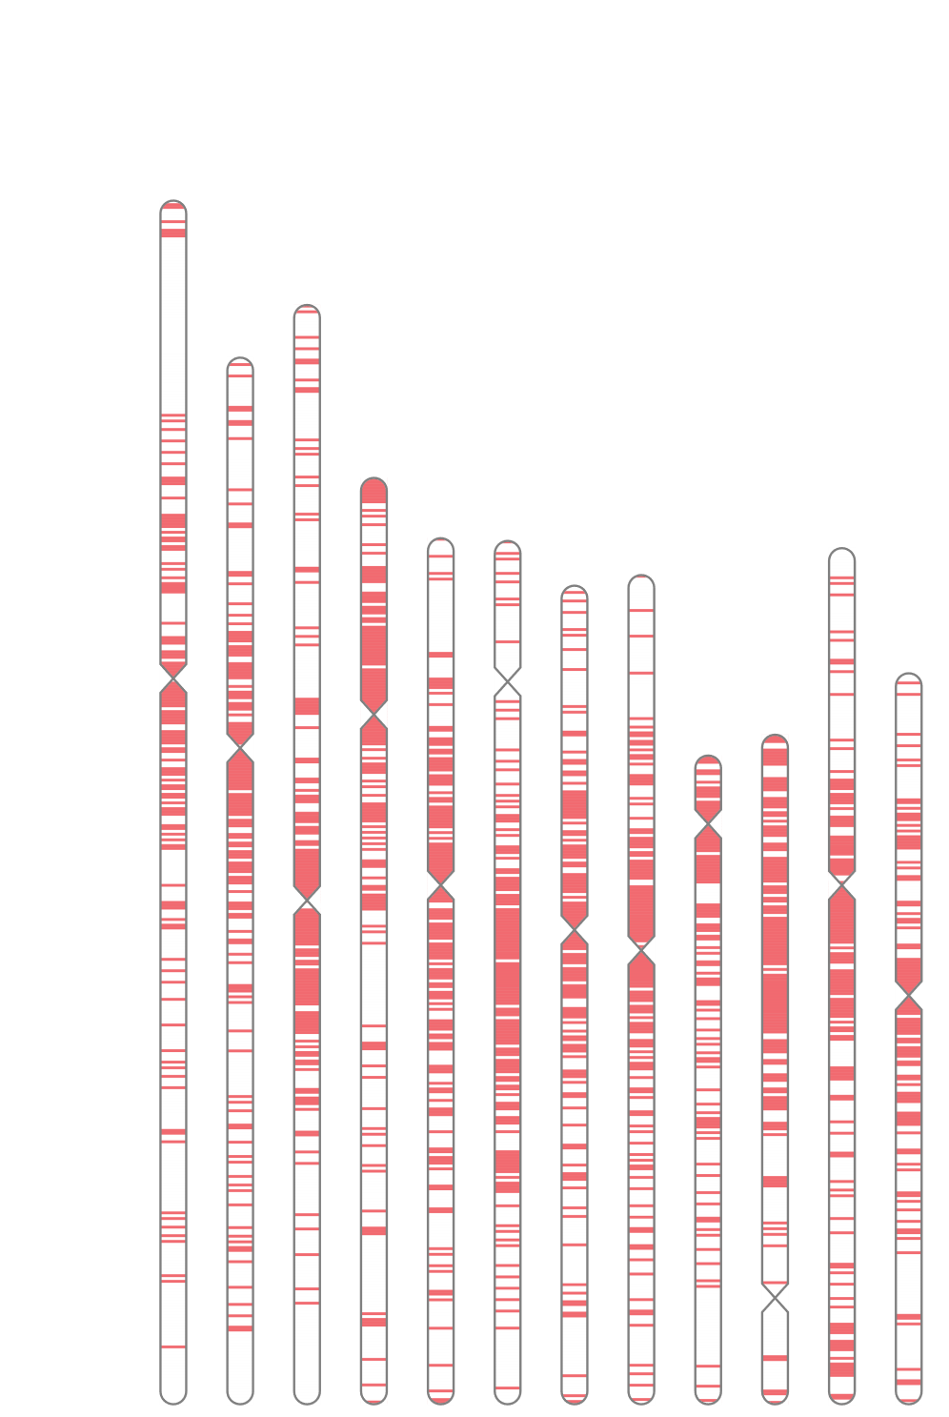
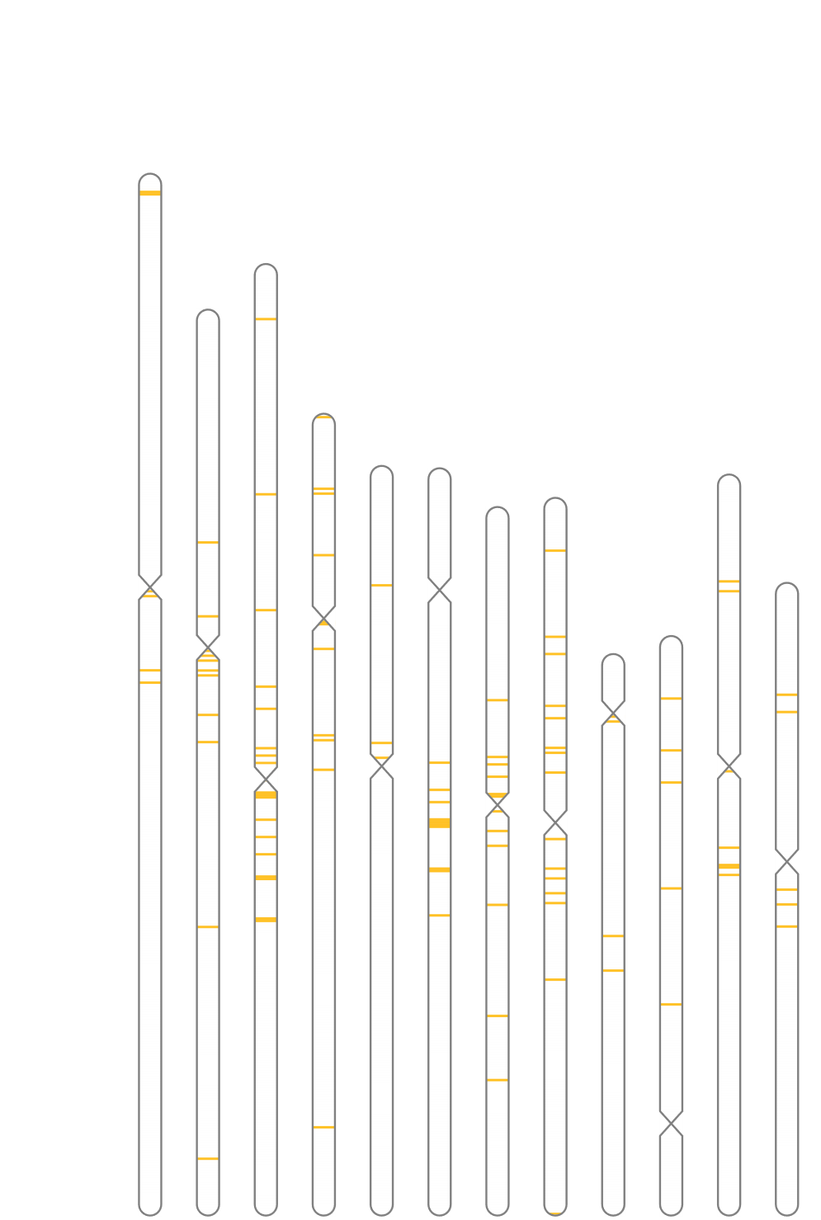
Additional File 13. Distribution of copia, gypsy and unclassified LTR in parental genomes
■copia
■gypsy
■Unclassified LTR
I = IR29,
P = Pokkali
Genome
Chr#
I P | I P | I P | I P | I P | I P | I P | I P | I P | I P | I P | I P
1 | 2 | 3 | 4 | 5 | 6 | 7 | 8 | 9 | 10 | 11 | 12
I P | I P | I P | I P | I P | I P | I P | I P | I P | I P | I P | I P
1 | 2 | 3 | 4 | 5 | 6 | 7 | 8 | 9 | 10 | 11 | 12
I P | I P | I P | I P | I P | I P | I P | I P | I P | I P | I P | I P
1 | 2 | 3 | 4 | 5 | 6 | 7 | 8 | 9 | 10 | 11 | 12

