Slide 1
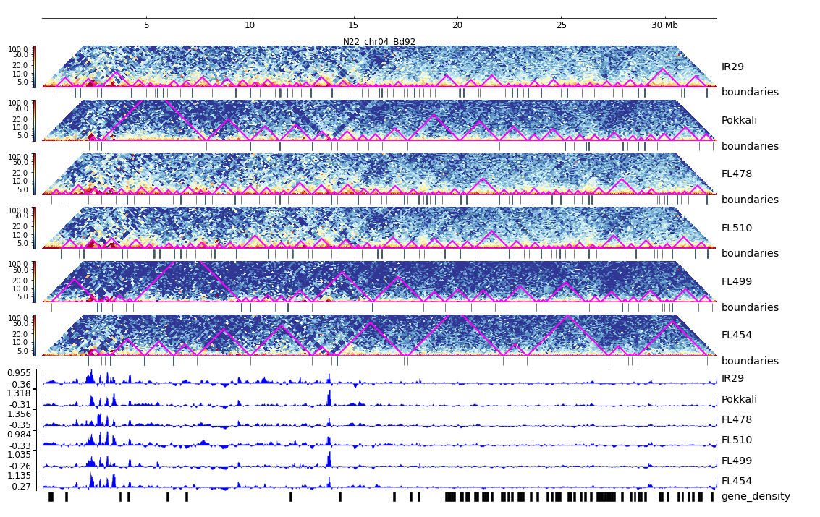
Additional File 29. HiC composite figure for Pokkali chr04

