Slide 1
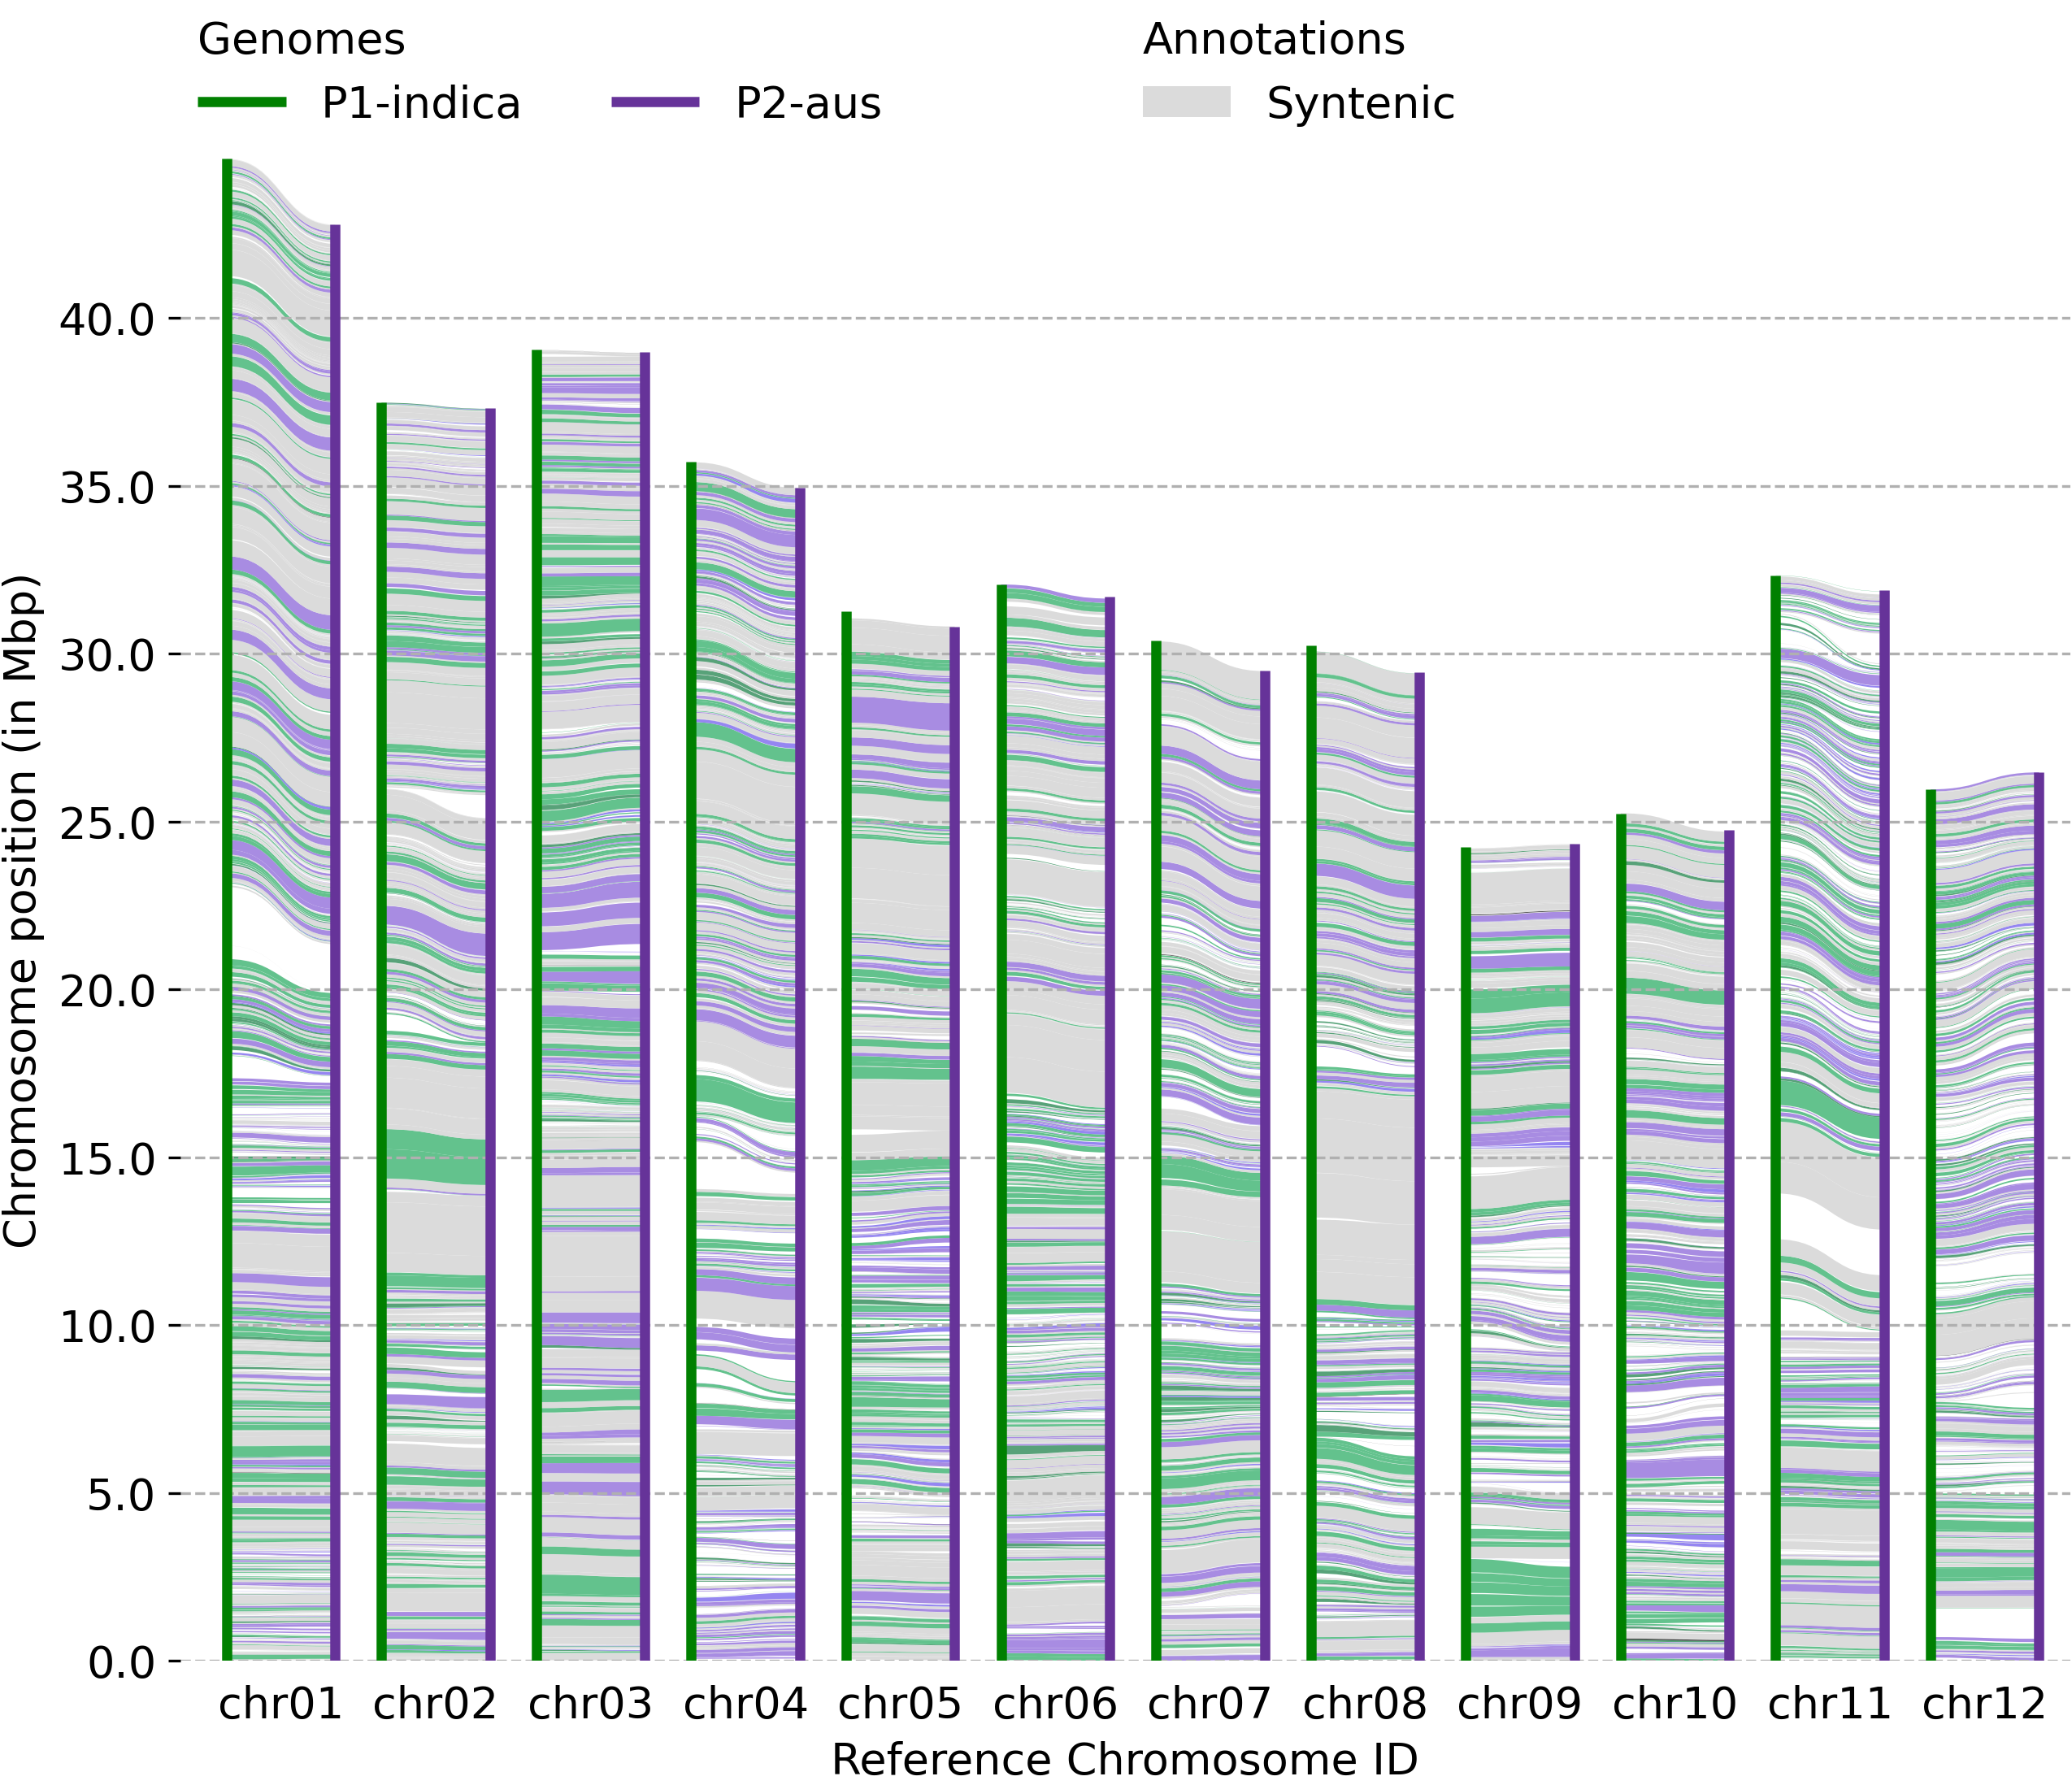
Additional File 11
Genomic size variation between pairs of syntenic region
 | P1-expanded by 50%
 | P1-expanded by 5%
 | P2-expanded by 5%
 | P2-expanded by 50%
 | P1-P2 are same or similar (<5%)

