Slide 1
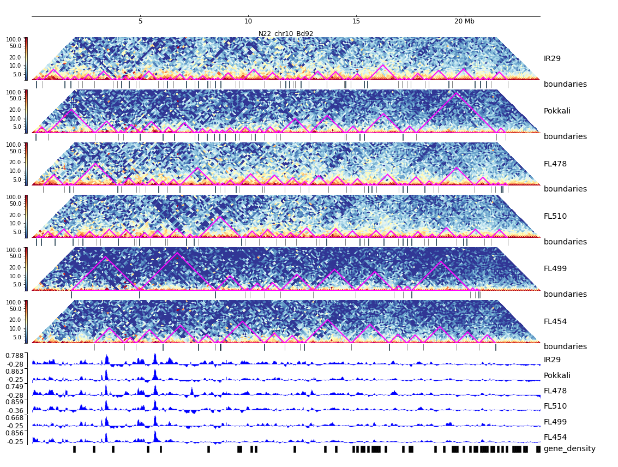
Additional File 35. HiC composite figure for Pokkali chr10

