Slide 1
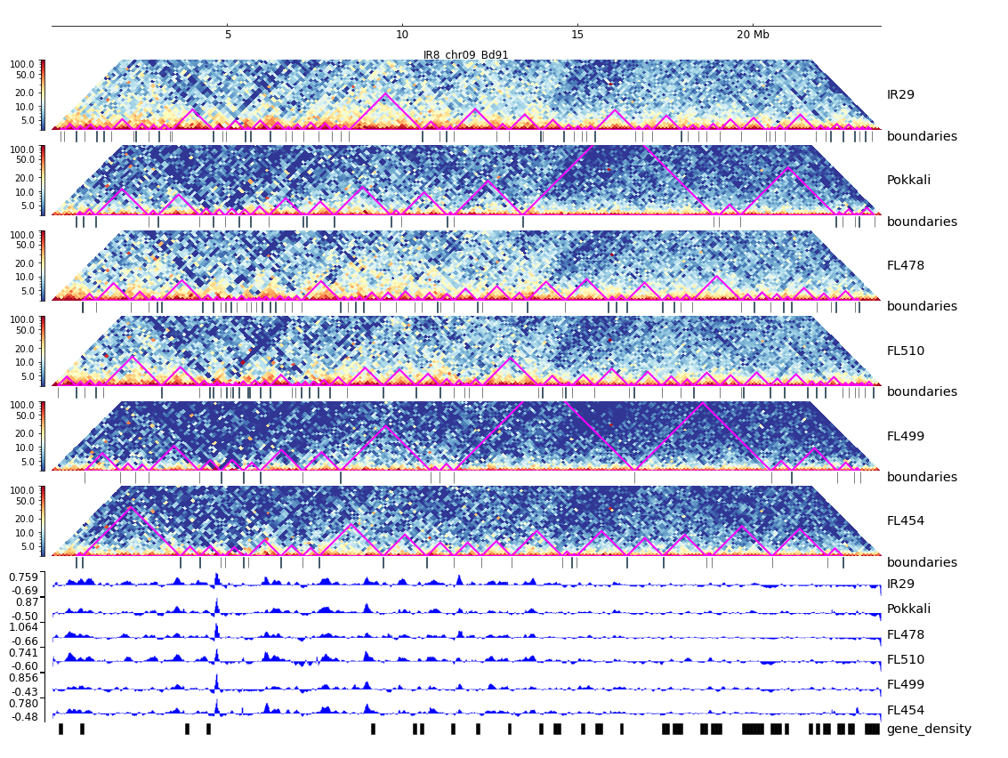
Additional File 22. HiC composite figure for IR29 chr09

