Slide 1
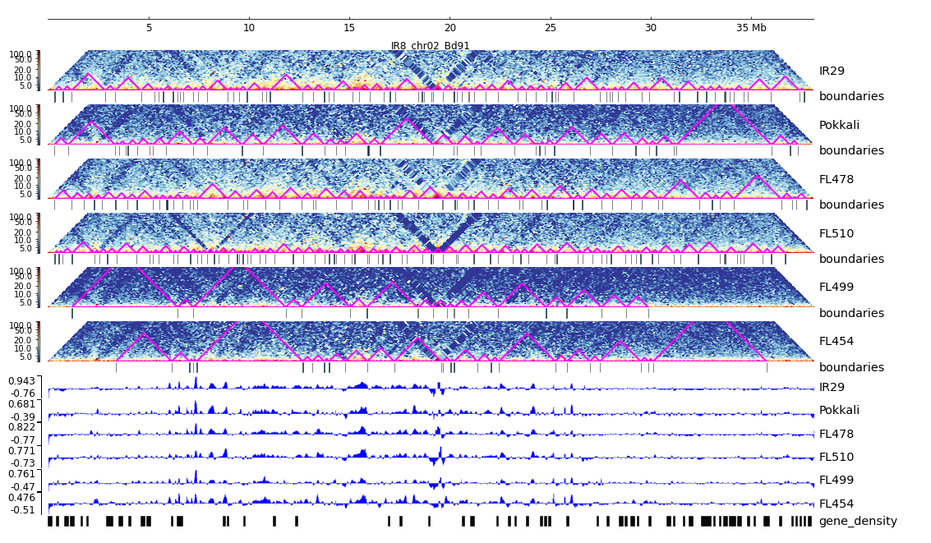
Additional File 15. HiC composite figure for IR29 chr02

