Slide 1
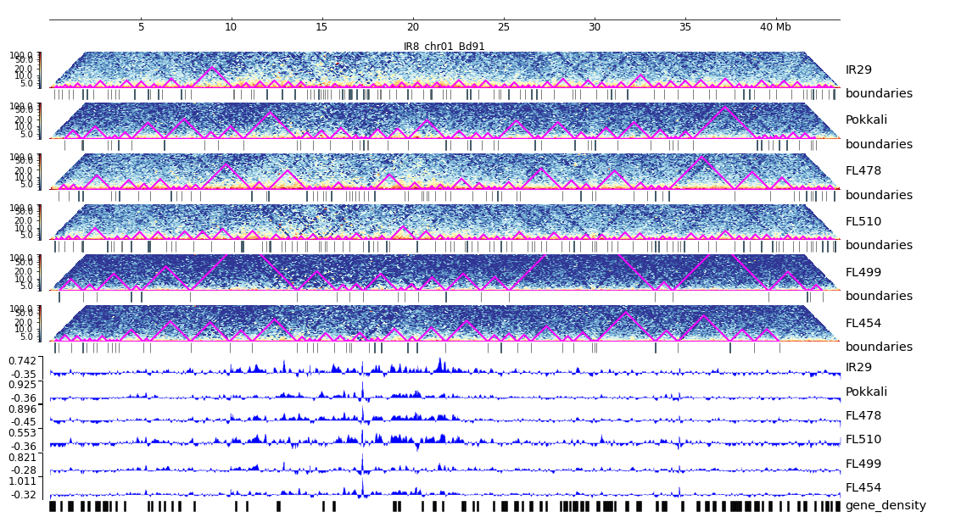
Additional File 14. HiC composite figure for IR29 chr01

