Slide 1
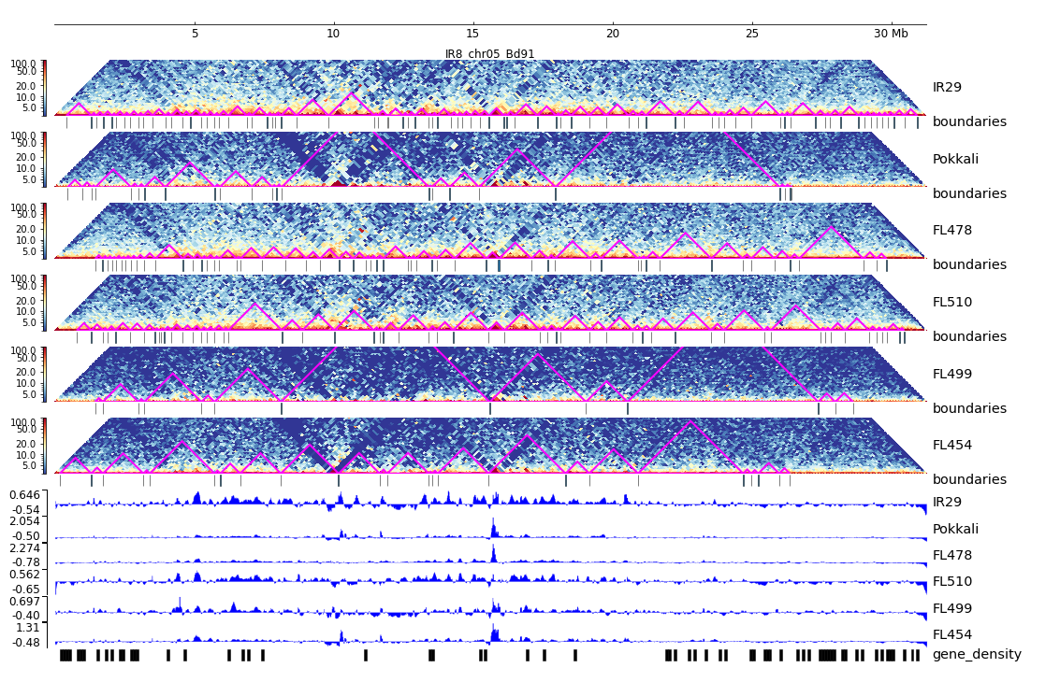
Additional File 18. HiC composite figure for IR29 chr05

