Slide 1
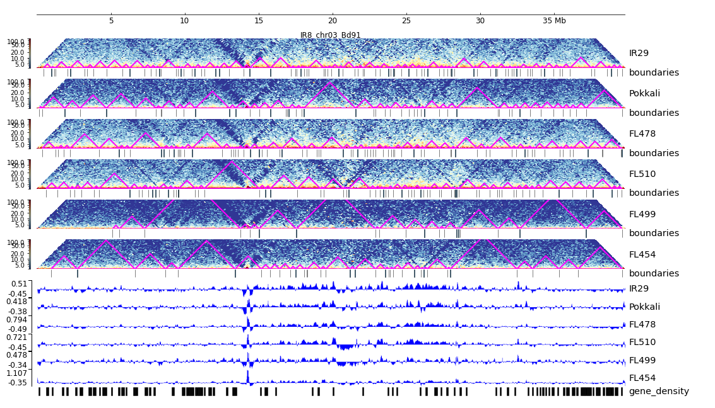
Additional File 16. HiC composite figure for IR29 chr03

