Slide 1
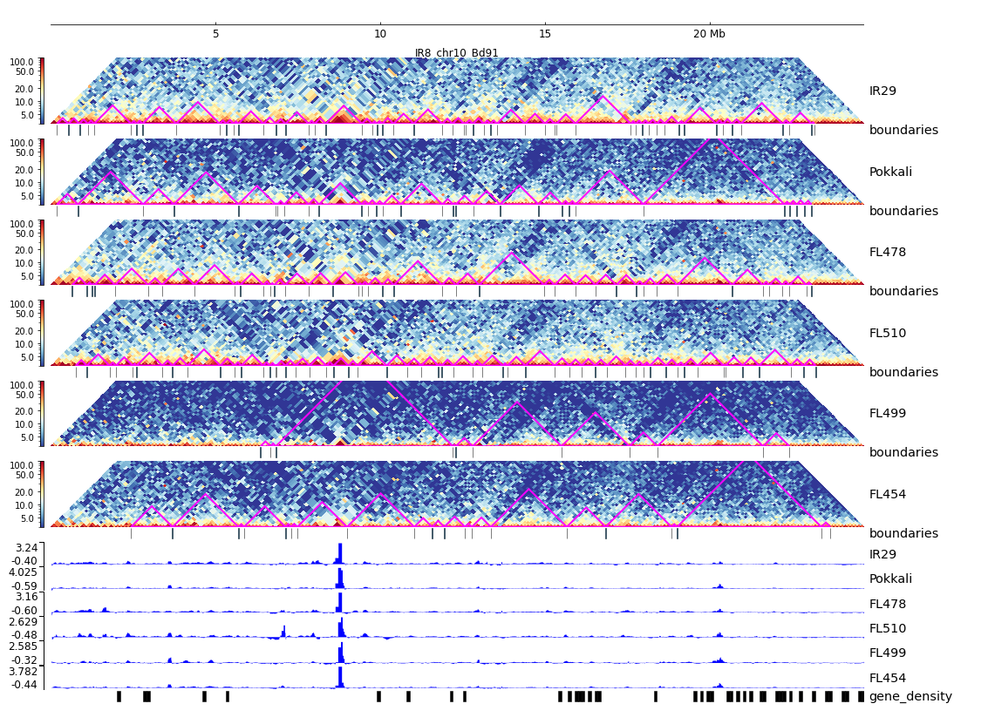
Additional File 23. HiC composite figure for IR29 chr10

