Slide 1
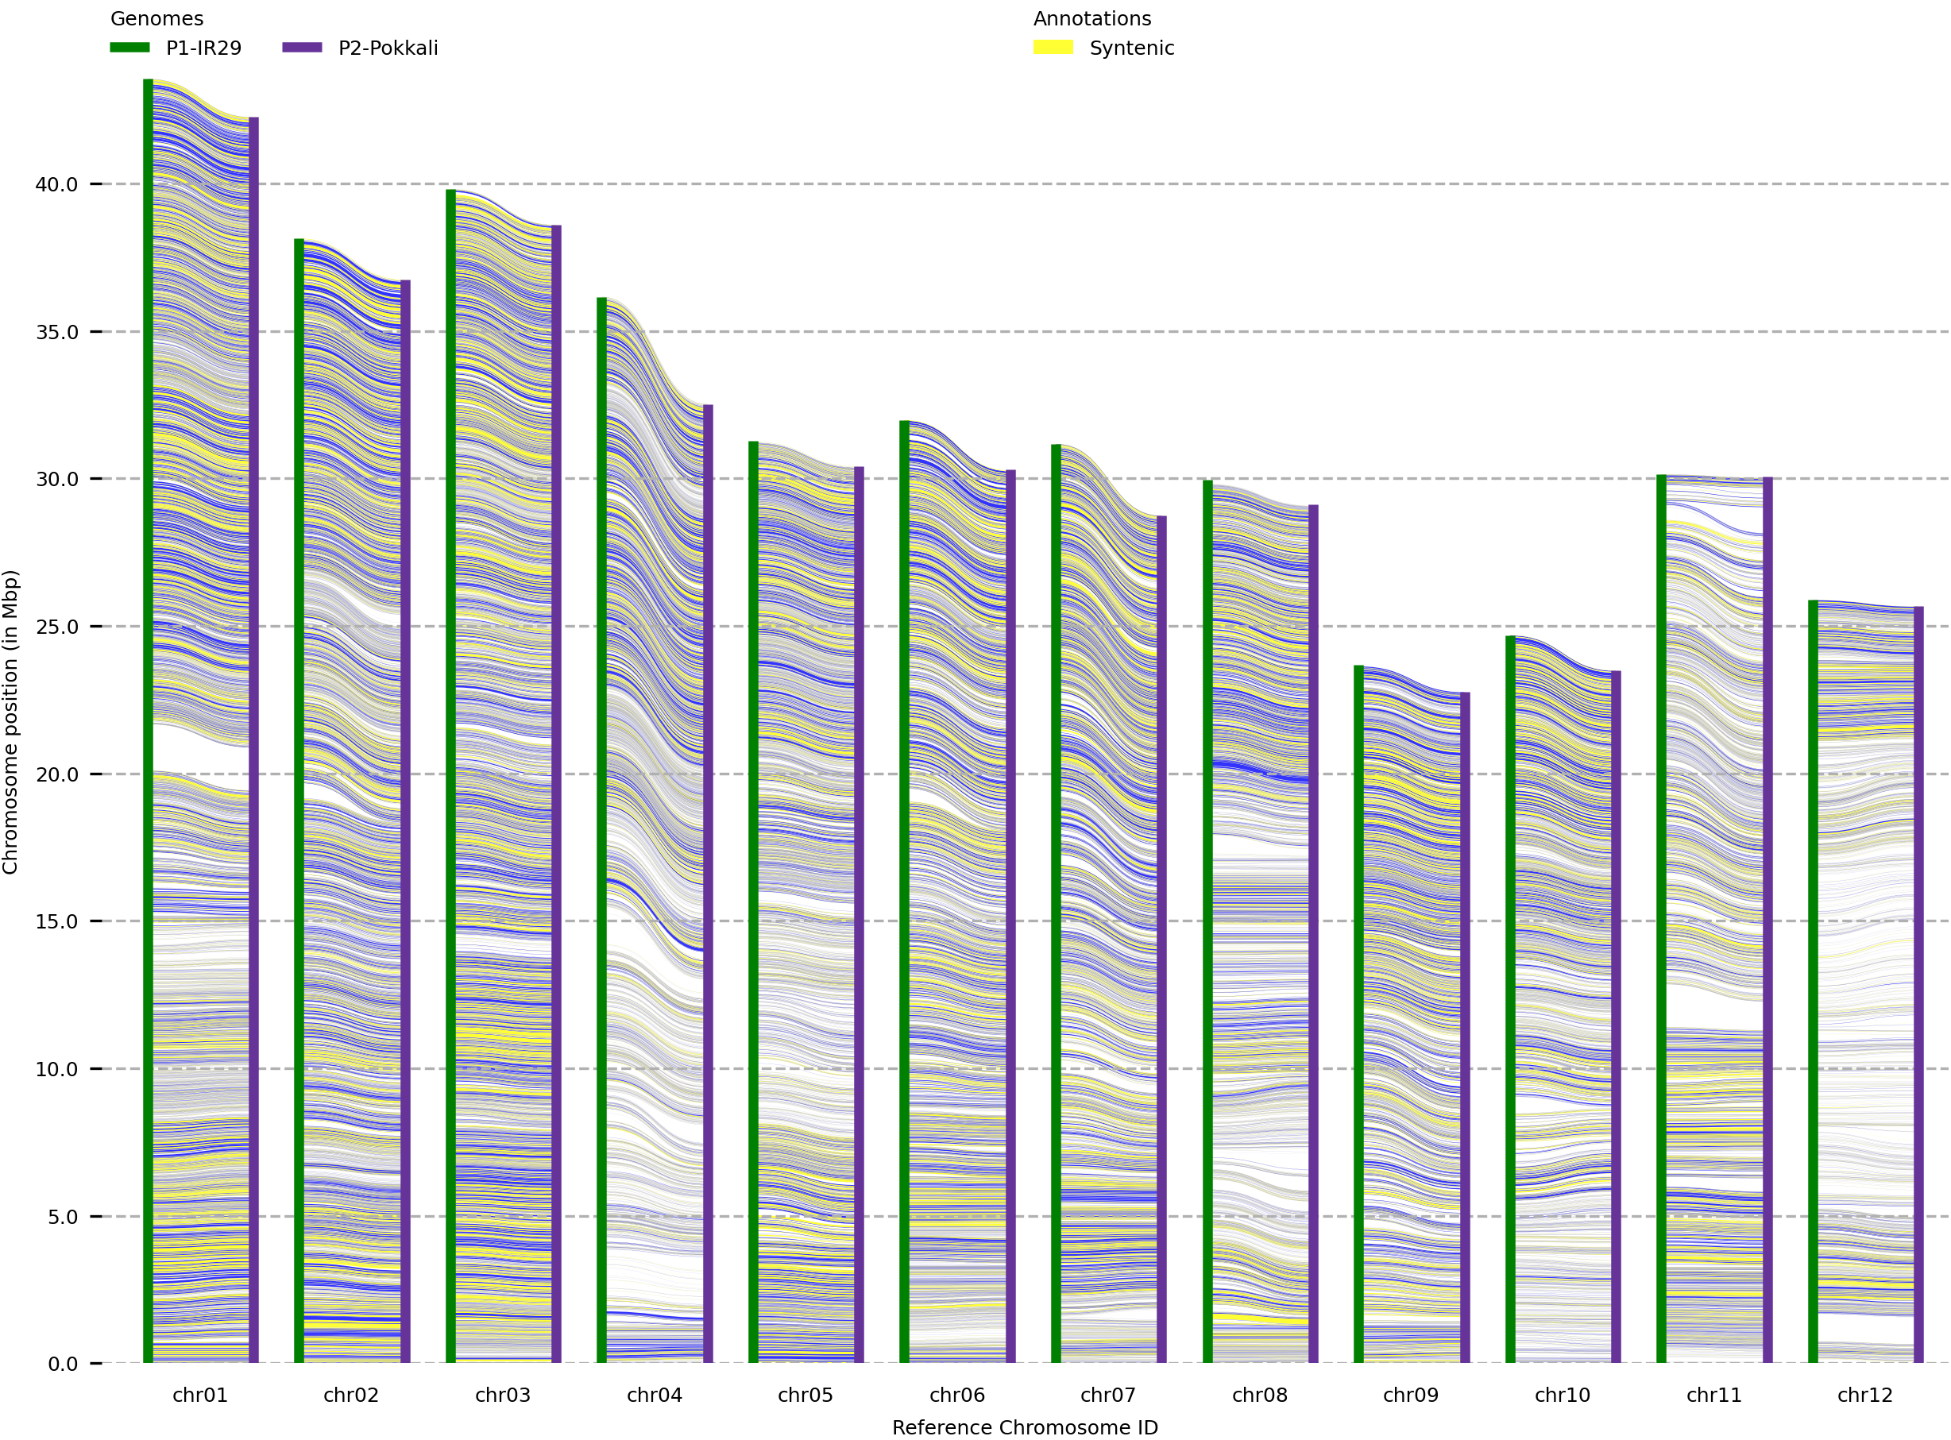
Additional File 9
chr01 | chr02 | chr03 | chr04 | chr05 | chr06 | chr07 | chr08 | chr09 | chr10 | chr11 | chr12
Parent-1
(IR8 genome adjusted with IR29 assembly)
Parent-2
(N22 genome adjusted with Pokkali assembly)
pair1
pair2
pair3
pair4
pair5

