Slide 1
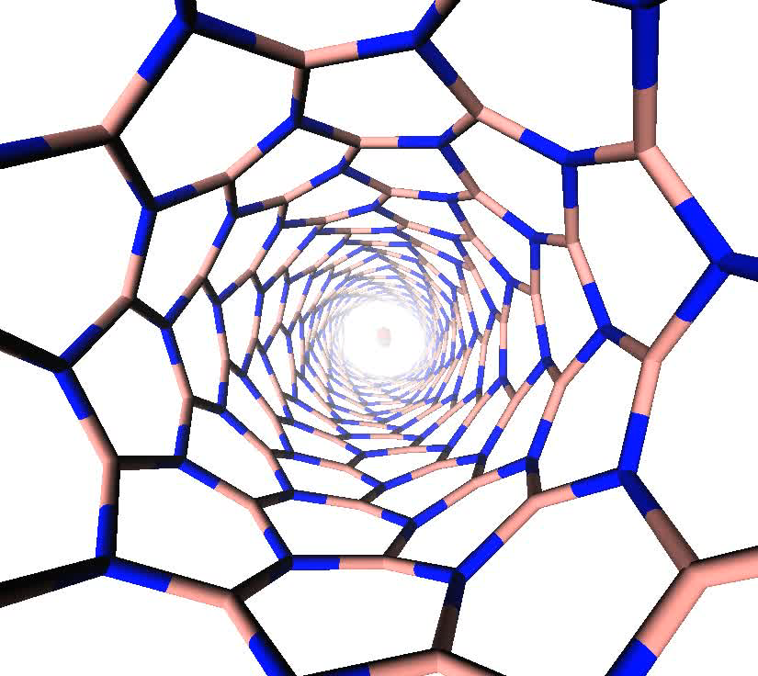
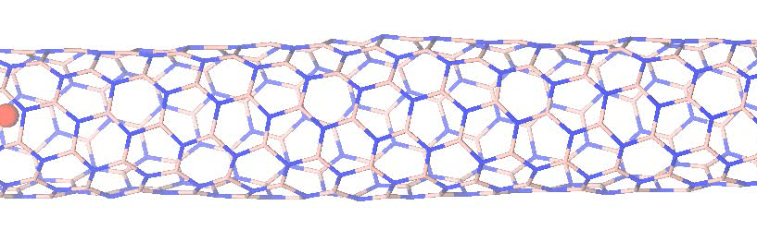
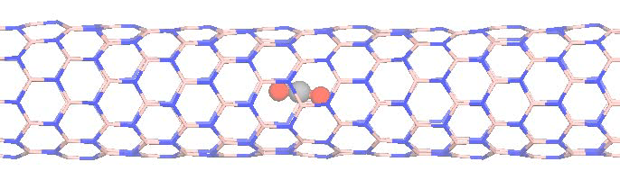
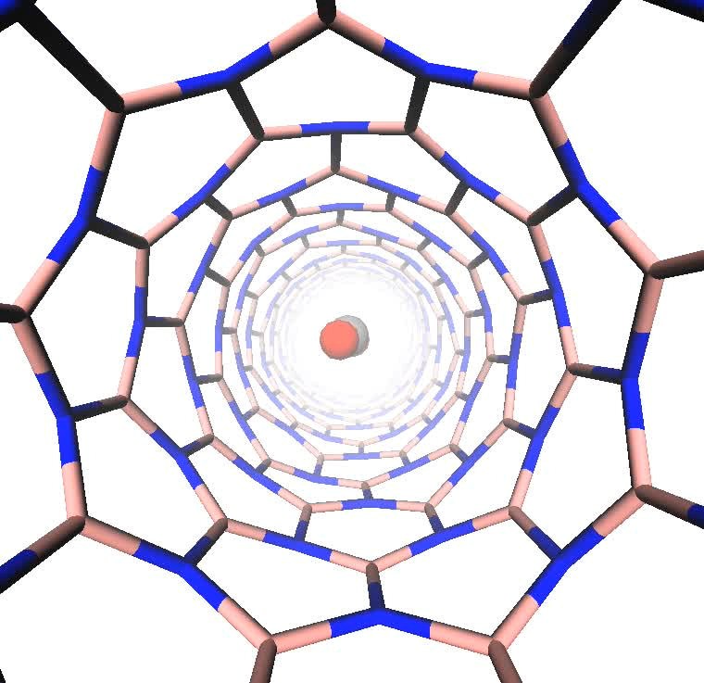
Examples of 8-ps portions in molecular trajectories show CO₂ diffuses fast in the (7,3) tube and almost doesn’t diffuse in the (9,0) tube.
CO₂ in (7,3)
Coordinates of the C atom in the zx and zy planes
Side view
z
Top view
CO₂ in (9,0)
Side view
Top view
z

Slide 2
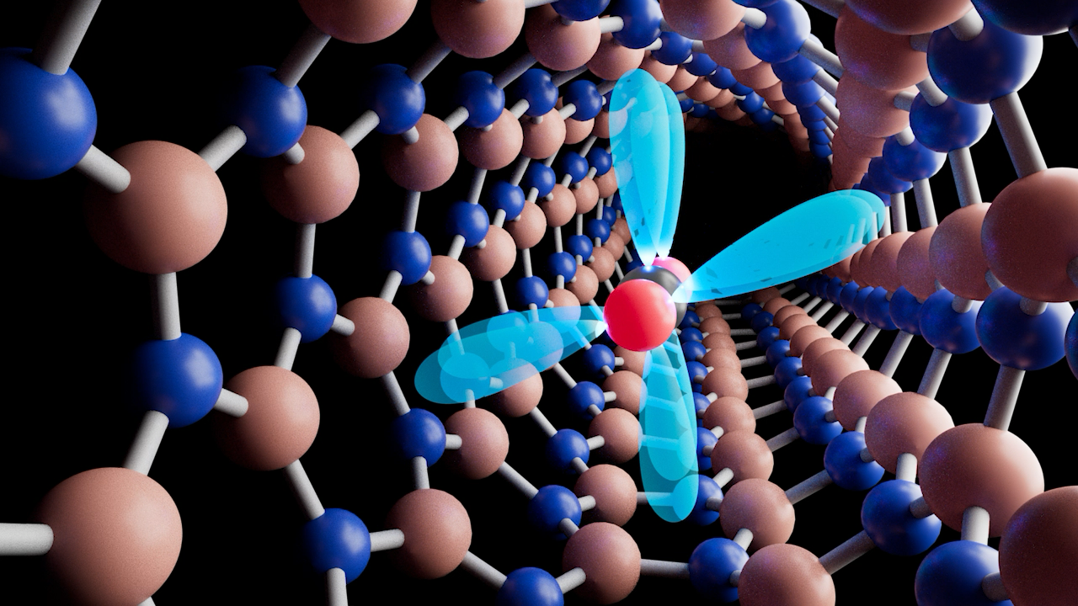
Artist’s rendition of movement of CO₂ in a chiral tube

