Slide 1
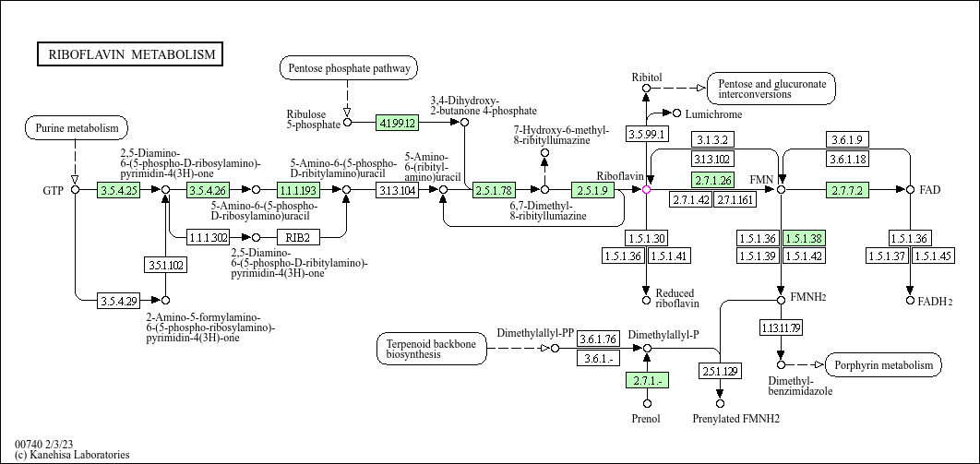
Supplementary Figure 3
ribA2
ribA2
ribD
ribD
ribH
ribE
Supplementary figure 3 Biosynthetic pathway of riboflavin (KEGG C00255) in Propionibacterium freudenreichii CIRM-BIA1 (equivalent to DSM 4902). The genes of the rib operon are marked in red.

