Slide 1
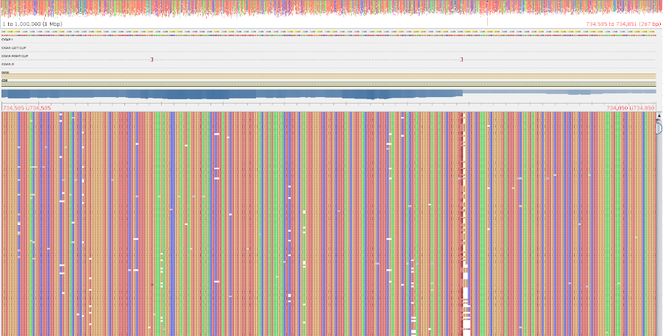
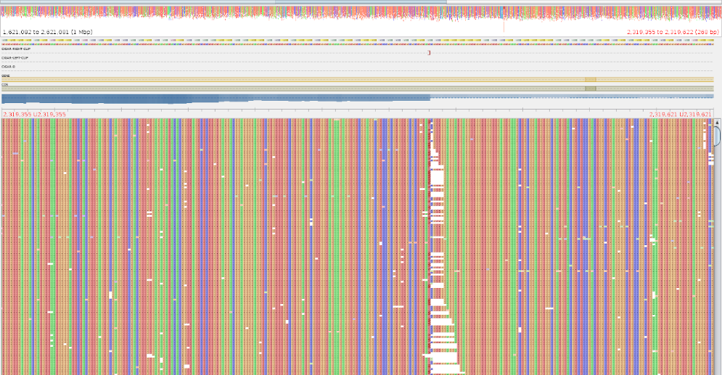
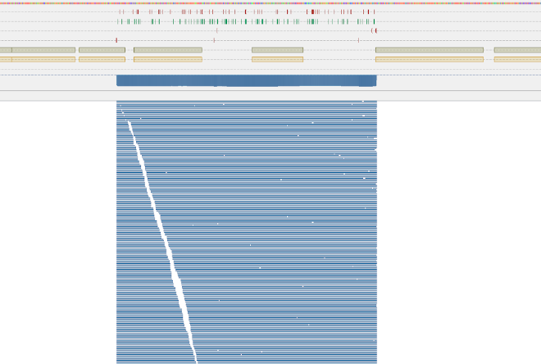
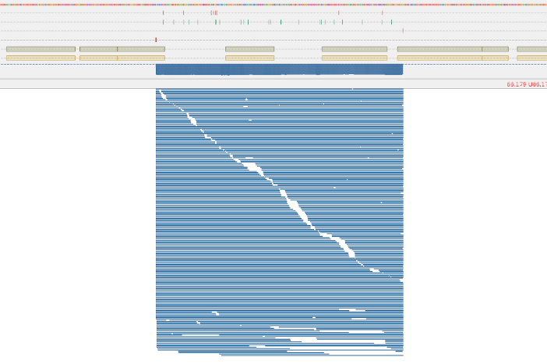
Supplementary Figure 2
A
B
Break in read mapping within the bluB/cobT2 gene locus
Break in read mapping within the ribA2 gene locus
Increased read coverage reflecting duplication of the part of bluB gene in the P.f ∆bluB mutant
Increased read coverage reflecting duplication of the part of ribA2 gene in the P.f ∆ribA mutant
C
D
Supplementary figure 2 Mapping of the Illumina sequencing reads to the reference genome LT618787 of the P.f ∆bluB mutant (A) and the P.f ∆ribA mutant (B) using the BWA-MEM algorithm. The breaks in read mapping indicate plasmid insertion sites. pBluescript:ErmE Nanopore reads mapped to the insertion sites of the P.f ∆bluB mutant (C) and the P.f ∆ribA mutant (D) assemblies. The read mapping was visualized with Tablet 1.17.08.17 (Milne I, Stephen G, Bayer M, Cock PJA, Pritchard L, Cardle L, Shaw PD and Marshall D. 2013. Using Tablet for visual exploration of second-generation sequencing data. Briefings in Bioinformatics 14(2), 193-202.)

