Slide 1
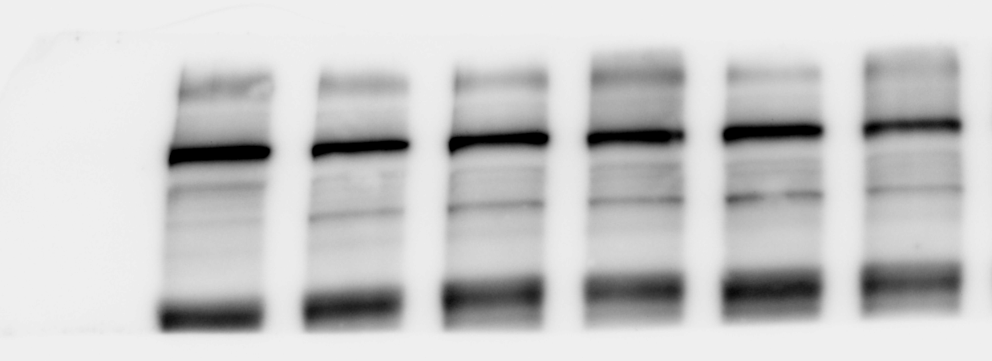
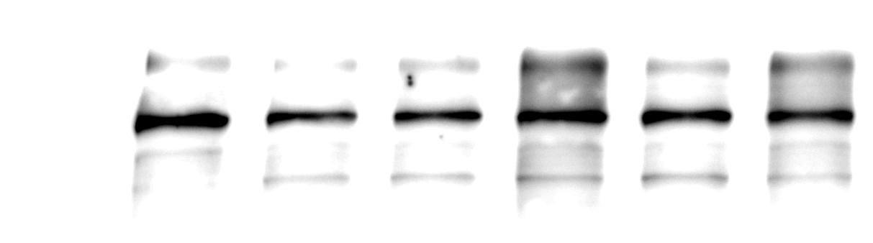
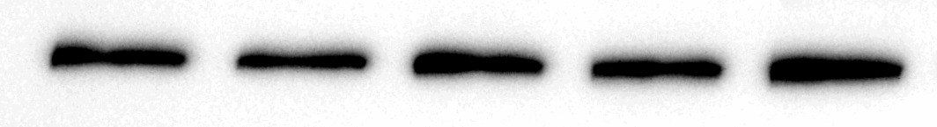


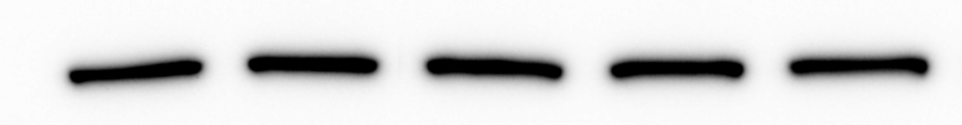

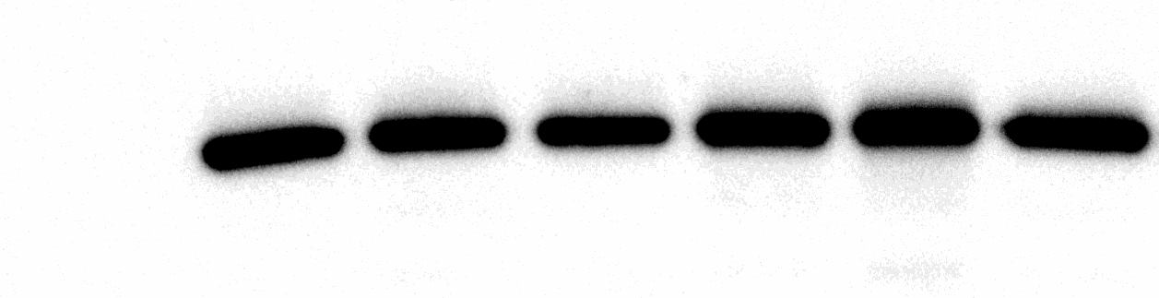
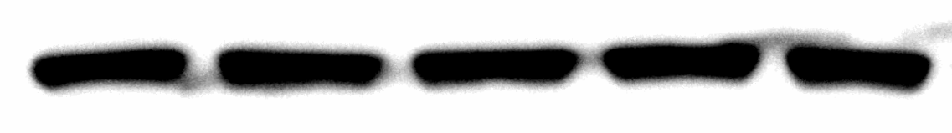
Western data in Figures (3 and 5)
Repeat 1
Repeat 2
Repeat 3
³²⁰
³²⁰
³²⁰
²⁵⁰
IP₃R
^{(320KDa)}
²⁵⁰
²⁵⁰
⁸⁵
⁸⁵
⁸⁵
PI3K
^{(95KDa)}
⁷⁵
⁷⁵
⁷⁵
⁶⁰
⁶⁰
⁶⁰
actin
^{(45KDa)}
⁴⁵
⁴⁵
⁴⁵
U46619 (0.05U) - + + + + +
Dioscin (μΜ) - - 16 24 32 positive con.
- + + + + +
- - 16 24 32 positive con.
- + + + +
- - 16 24 32

Slide 2
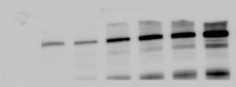
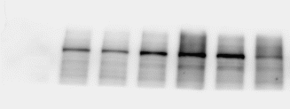
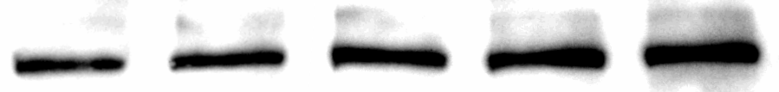
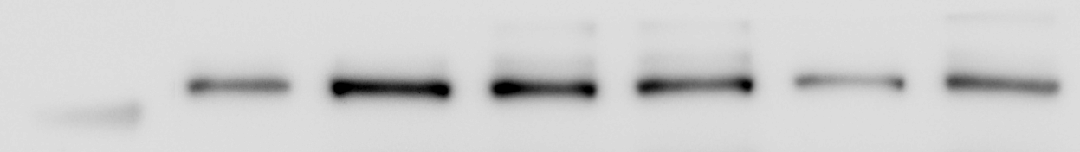

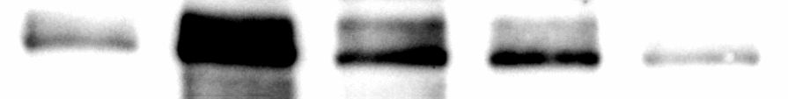



Western data in Figures (3, 4 and 5)
Repeat 1
Repeat 2
Repeat 3
³²⁰
³²⁰
³²⁰
²⁵⁰
p-IP₃R
^{(320KDa)}
²⁵⁰
²⁵⁰
p-PI3K
^{(95KDa)}
⁸⁵
⁸⁵
⁸⁵
T-VASP
^{(46, 50KDa)}
⁵⁰
⁵⁰
⁵⁰
U46619 (0.05U) - + + + + +
Dioscin (μΜ) - - 16 24 32 positive con.
- + + + + +
- - 16 24 32 positive con.
- + + + +
- - 16 24 32

Slide 3
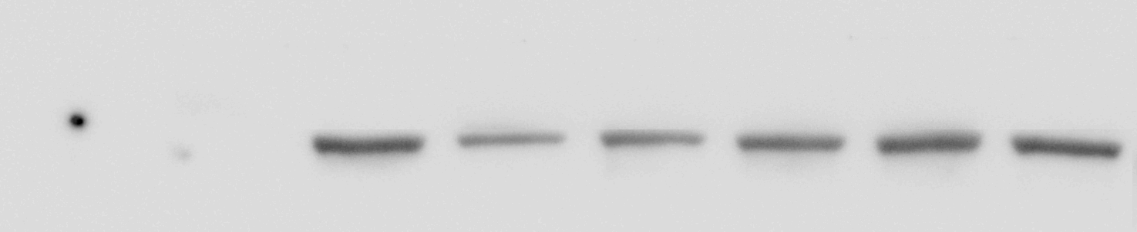
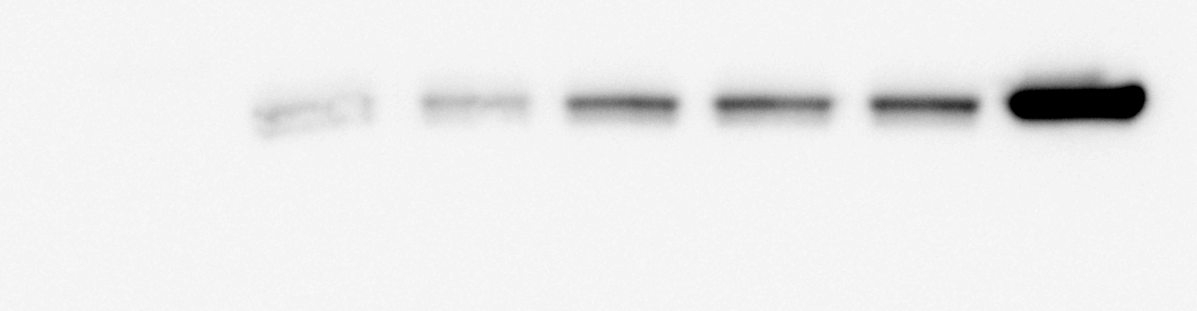
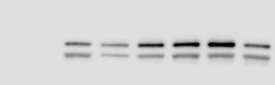
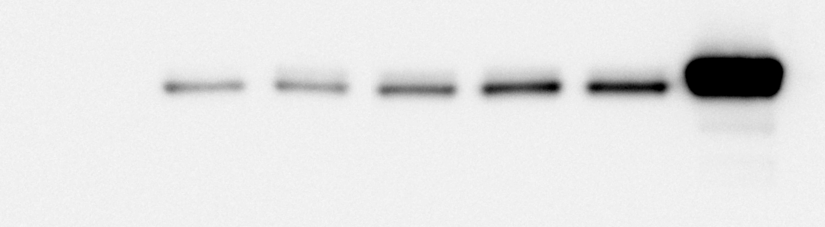
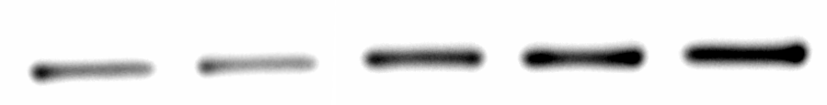
Western data in Figures (4)
Repeat 1
Repeat 2
Repeat 3
p-VASP
(S157)
^{(50KDa)}
⁵⁰
⁵⁰
⁵⁰
p-VASP
(S239)
^{(48, 50 KDa)}
⁵⁰
⁵⁰
⁵⁰
⁴⁸
⁴⁸
⁴⁸
U46619 (0.05U) - + + + + +
Dioscin (μΜ) - - 16 24 32 positive con.
- + + + + +
- - 16 24 32 positive con.
- + + + +
- - 16 24 32

Slide 4



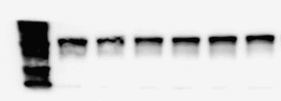
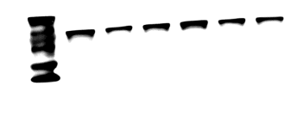
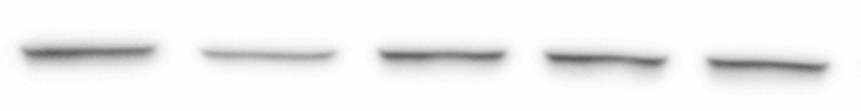
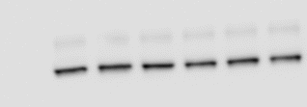


Western data in Figures (5)
Repeat 1
Repeat 2
Repeat 3
¹⁰⁰
¹⁰⁰
¹⁰⁰
cPLA₂
^{(98KDa)}
Akt
^{(60KDa)}
⁶⁰
⁶⁰
⁶⁰
⁵⁰
⁴⁰
⁵⁰
⁴⁰
⁵⁰
⁴⁰
p38
^{(40KDa)}
U46619 (0.05U) - + + + + +
Dioscin (μΜ) - - 16 24 32 positive con.
- + + + + +
- - 16 24 32 positive con.
- + + + +
- - 16 24 32

Slide 5


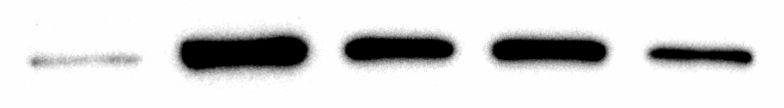
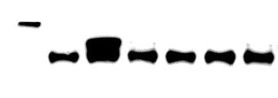
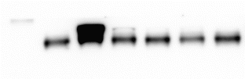
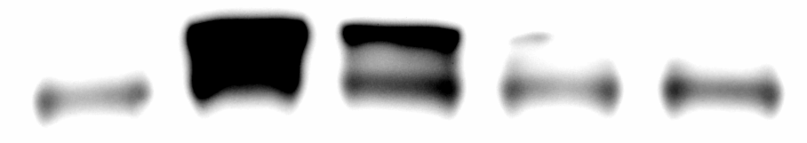


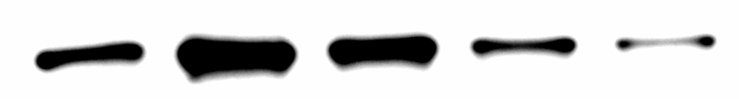
Western data in Figures (5)
Repeat 1
Repeat 2
Repeat 3
¹⁰⁰
¹⁰⁰
¹⁰⁰
p-cPLA₂
^{(95KDa)}
⁸⁵
⁶⁰
⁸⁵
⁶⁰
⁸⁵
⁶⁰
p-Akt
^{(60KDa)}
⁵⁰
⁴⁰
⁵⁰
⁴⁰
p-p38
^{(40KDa)}
⁵⁰
⁴⁰
U46619 (0.05U) - + + + + +
Dioscin (μΜ) - - 16 24 32 positive con.
- + + + + +
- - 16 24 32 positive con.
- + + + +
- - 16 24 32

Slide 6


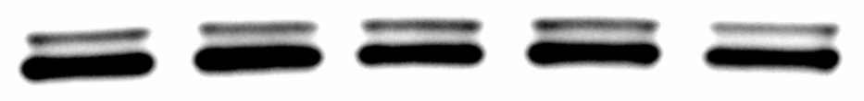

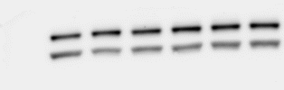

Western data in Figures (5)
Repeat 1
Repeat 2
Repeat 3
⁵⁰
⁴⁴
⁴²
⁵⁰
⁴⁴
⁴²
⁵⁰
⁴⁴
⁴²
Erk
^{(42,44KDa)}
JNK
^{(46,54KDa)}
⁵⁴
⁴⁶
⁵⁴
⁴⁶
⁵⁴
⁴⁶
U46619 (0.05U) - + + + + +
Dioscin (μΜ) - - 16 24 32 positive con.
- + + + + +
- - 16 24 32 positive con.
- + + + +
- - 16 24 32

Slide 7
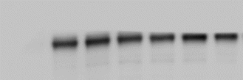



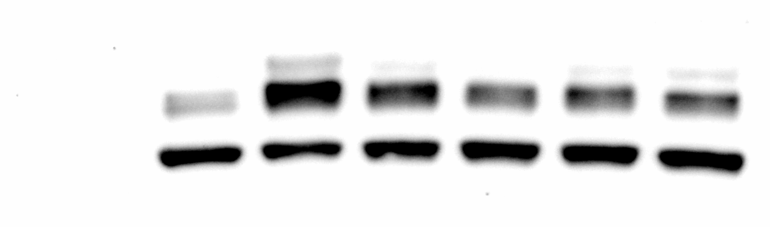
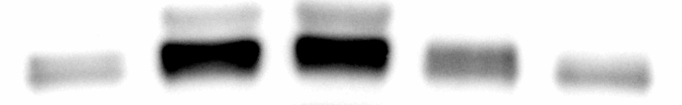
Western data in Figures (5)
Repeat 1
Repeat 2
Repeat 3
⁴⁴
⁴²
p-Erk
^{(44KDa)}
⁴⁴
⁴²
⁴⁴
⁴²
p-JNK
^{(46,54KDa)}
⁵⁴
⁴⁶
⁵⁴
⁴⁶
⁵⁴
⁴⁶
U46619 (0.05U) - + + + + +
Dioscin (μΜ) - - 16 24 32 positive con.
- + + + + +
- - 16 24 32 positive con.
- + + + +
- - 16 24 32

