Slide 1
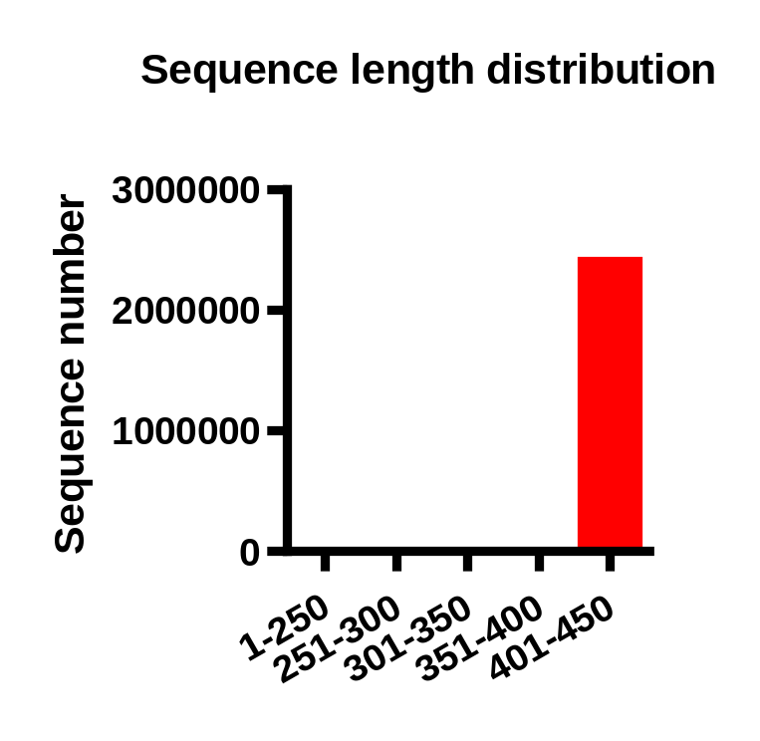
Figure S1. The length distribution of sequences obtained from PCR amplification of fecal bacterial 16s rRNA V4 region and following sequencing.

Slide 2
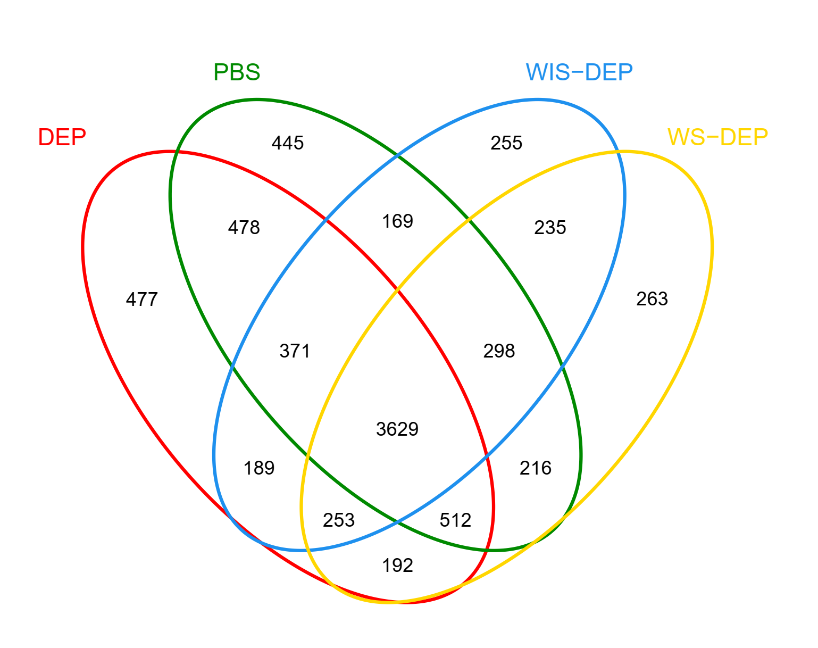
Figure S2. The Venn diagraph showing the numbers of OTUs shared in-between groups after all the obtained bacterial 16s rRNA V4 region sequences were clustered into OTUs.

Slide 3
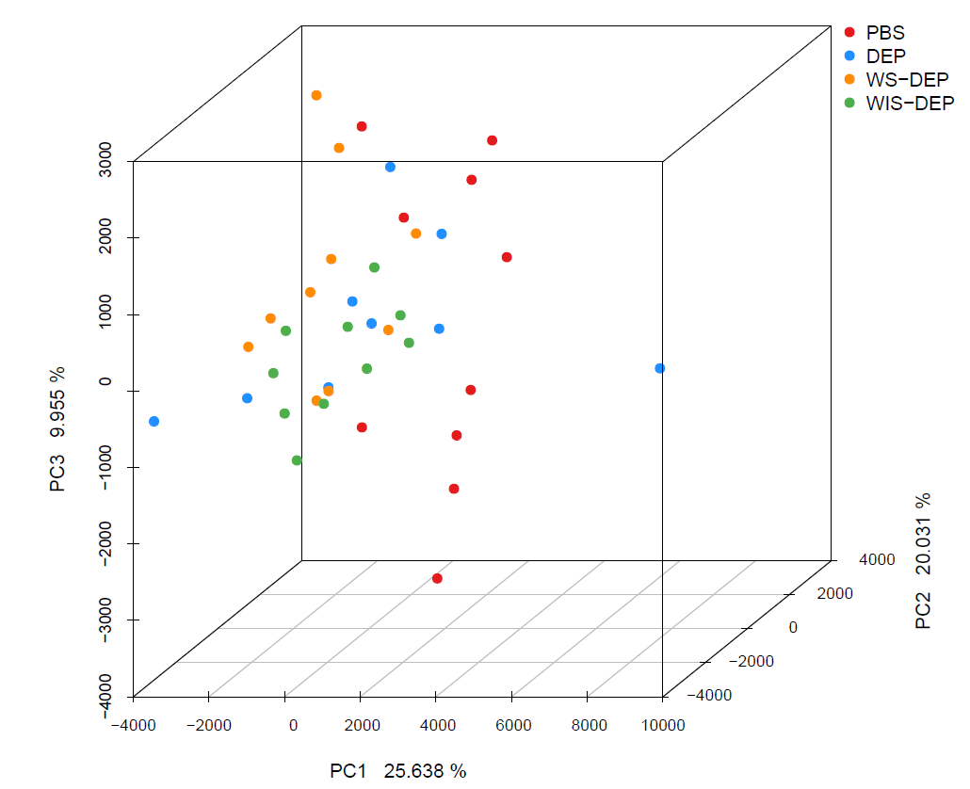
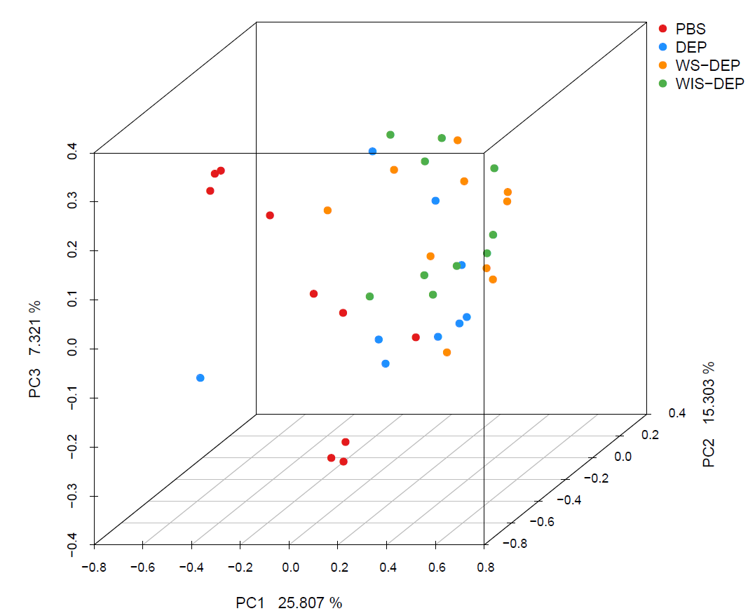
A
B
Figure S3. The 3D PCA analysis (A) and 3D PCOA analysis (B) results obtained using the community ecology package, R-forge (Vegan 2.0 package was used to generate the
figures).

Slide 4
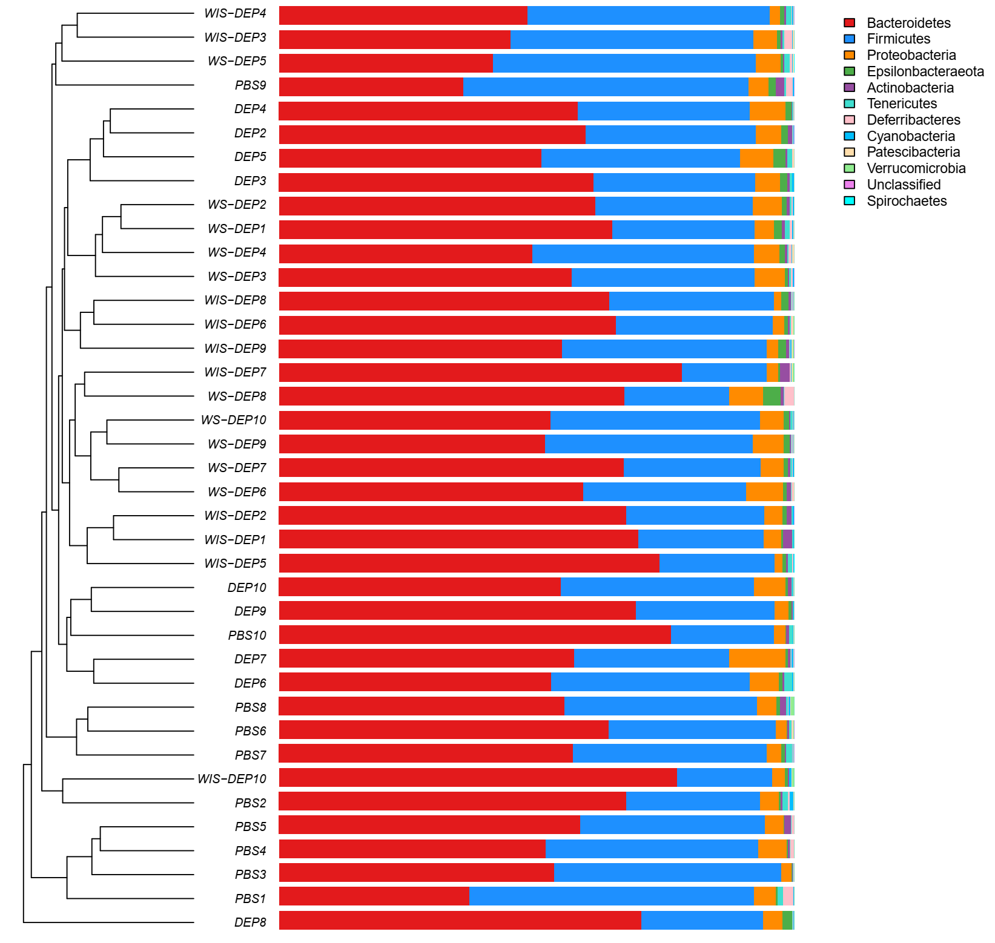
Figure S4. The microbial community composition bar plot with cluster tree. The cluster tree on the left was obtained using the bray-Curtis distance, and the bar plot showing the composition of bacterial phyla.

