Slide 1
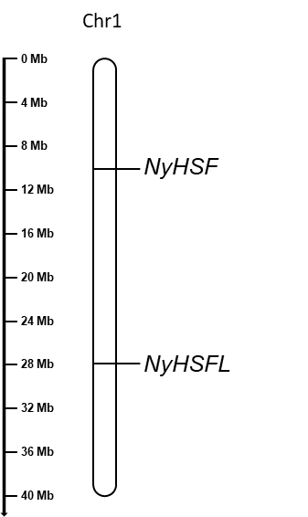
supplementary figure 1

