Slide 1
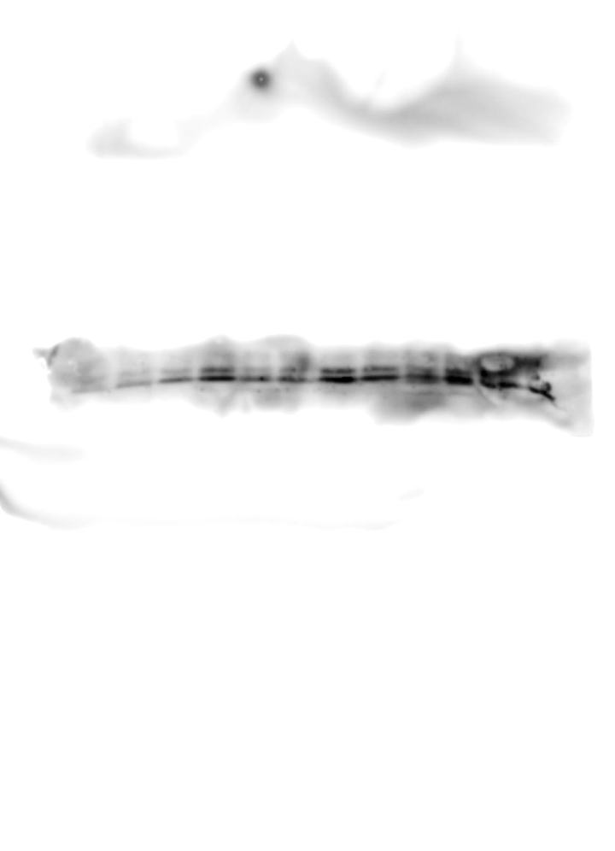

Figure 1C
OCI-LY19
IB: β-actin
IB: Cleaved Caspase-3
Lordello, L. et al.

Slide 2
Figure 1C
MD-901
IB: β-actin
IB: Cleaved Caspase-3
Lordello, L. et al.

Slide 3

Figure 1C
SU-DHL4
IB: Cleaved Caspase-3
IB: β-actin
Lordello, L. et al.

Slide 4
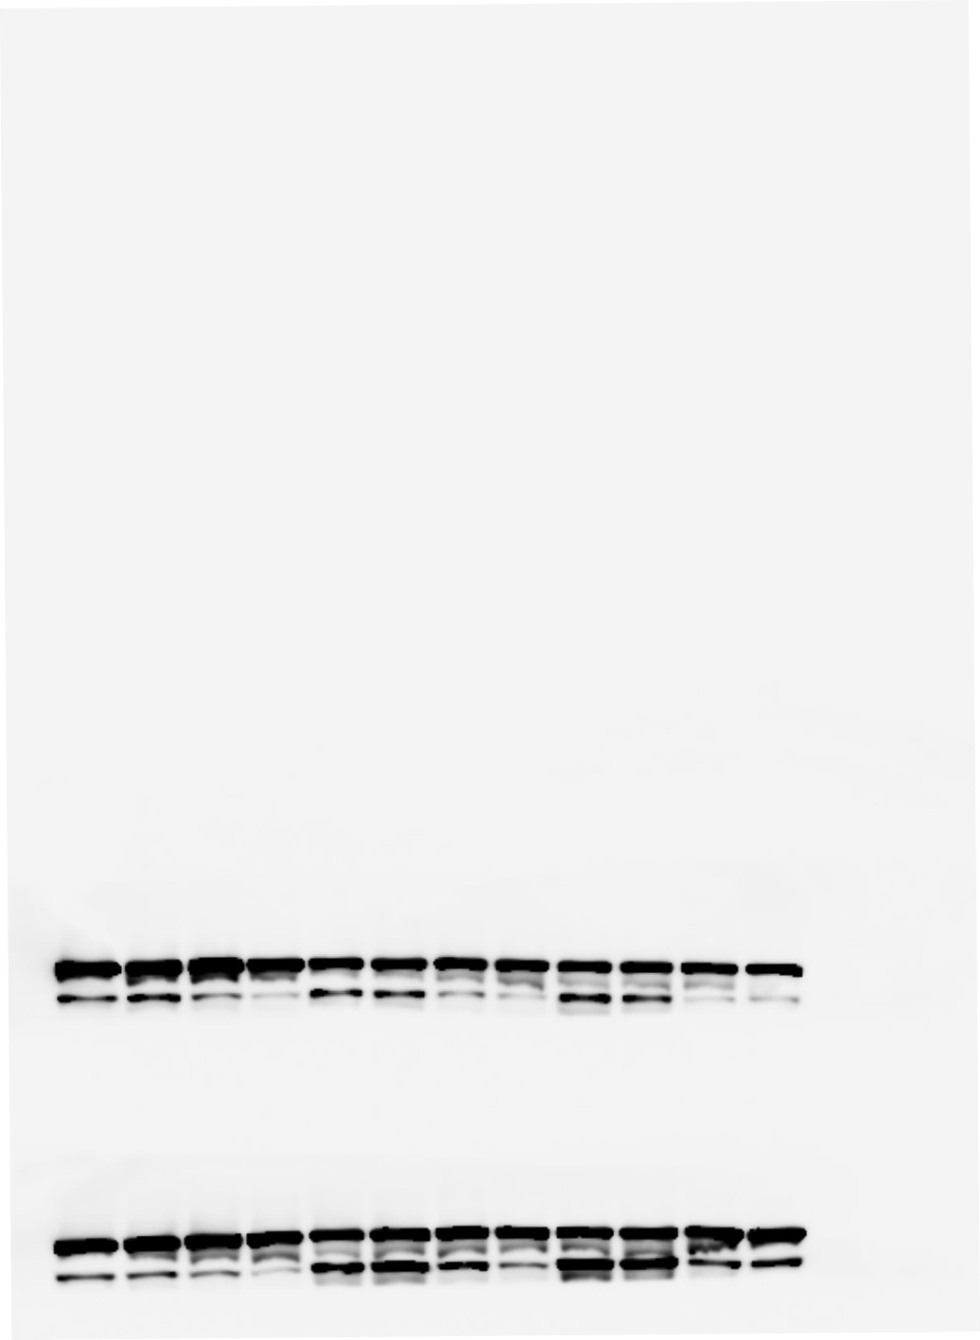
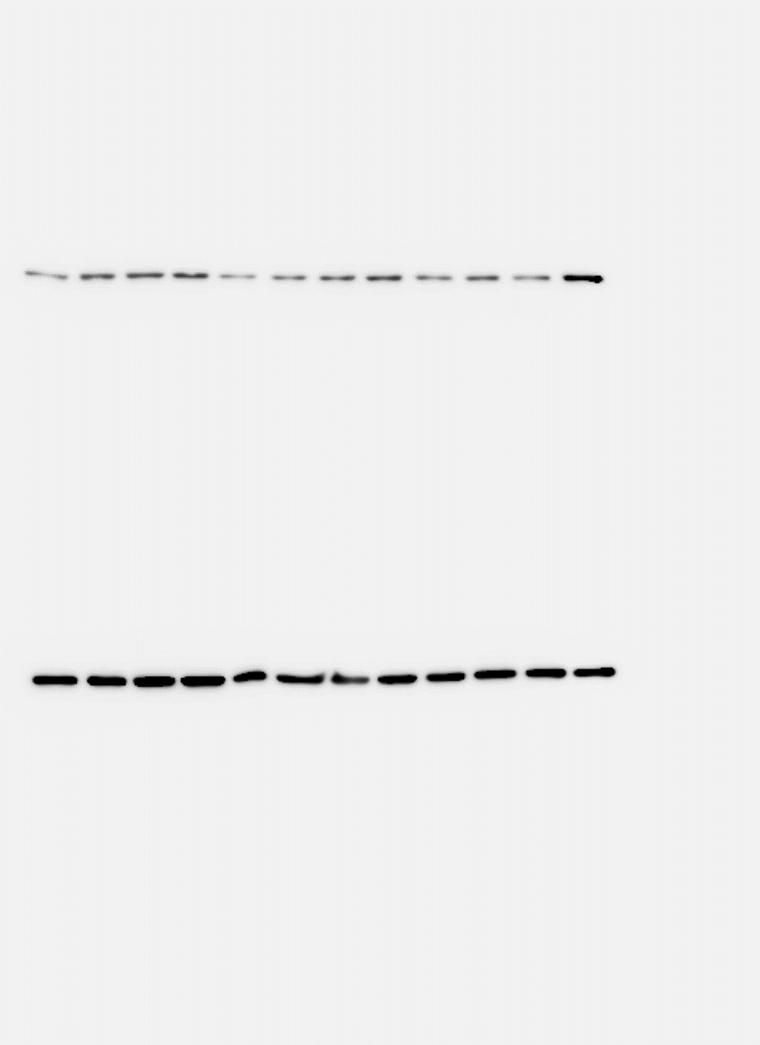
Figure 1D
OCI-LY19
IB: β-actin
IB: PARP-1
Lordello, L. et al.

Slide 5
Figure 1D
MD-901
IB: β-actin
IB: PARP-1
Lordello, L. et al.

Slide 6
Figure 1D
SU-DHL4
IB: PARP-1
IB: β-actin
Lordello, L. et al.

Slide 7
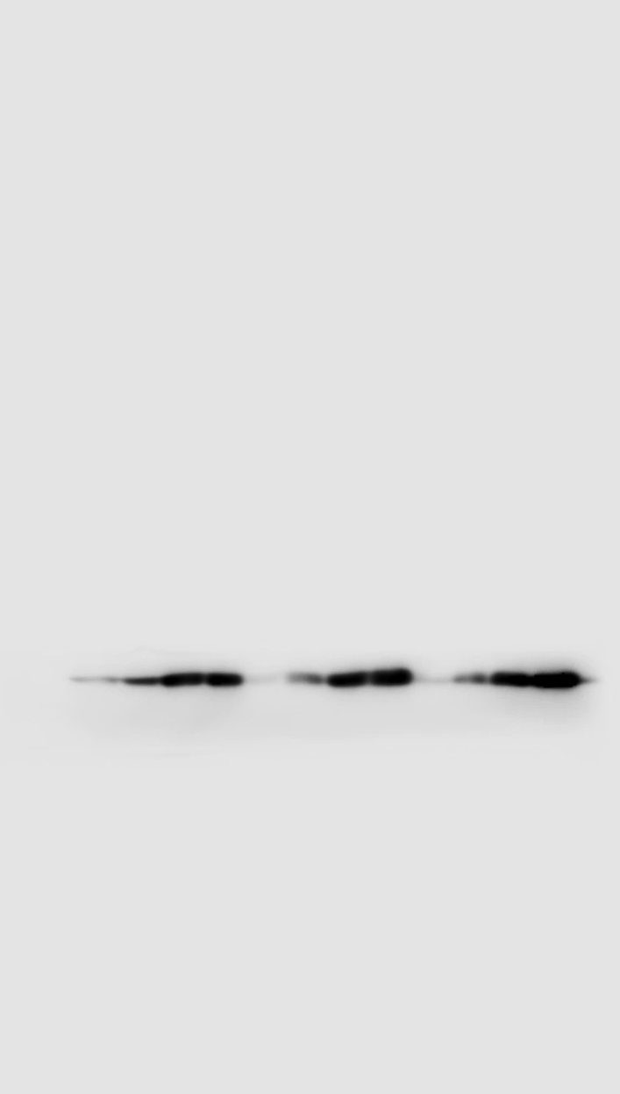

Figure 1E
OCI-LY19
IB: γH2AX
IB: β-actin
Lordello, L. et al.

Slide 8

Figure 1E
MD-901
IB: β-actin
IB: γH2AX
Lordello, L. et al.

Slide 9
Figure 1E
SU-DHL4
IB: β-actin
IB: γH2AX
Lordello, L. et al.

Slide 10
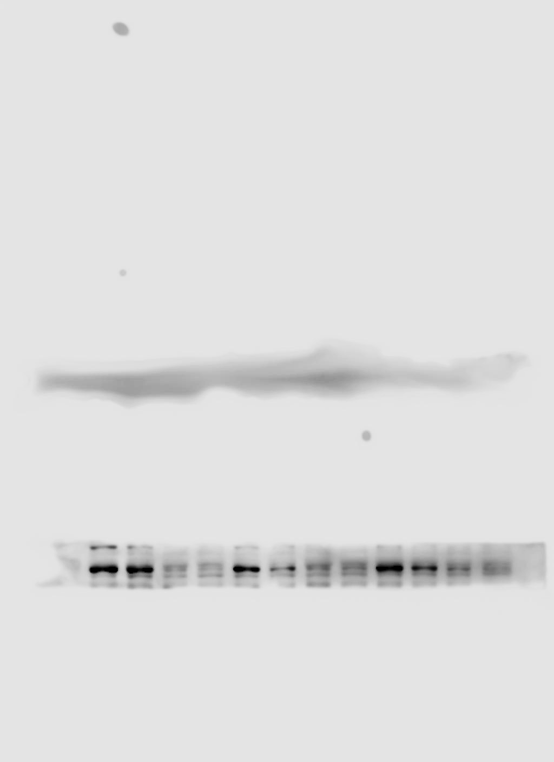
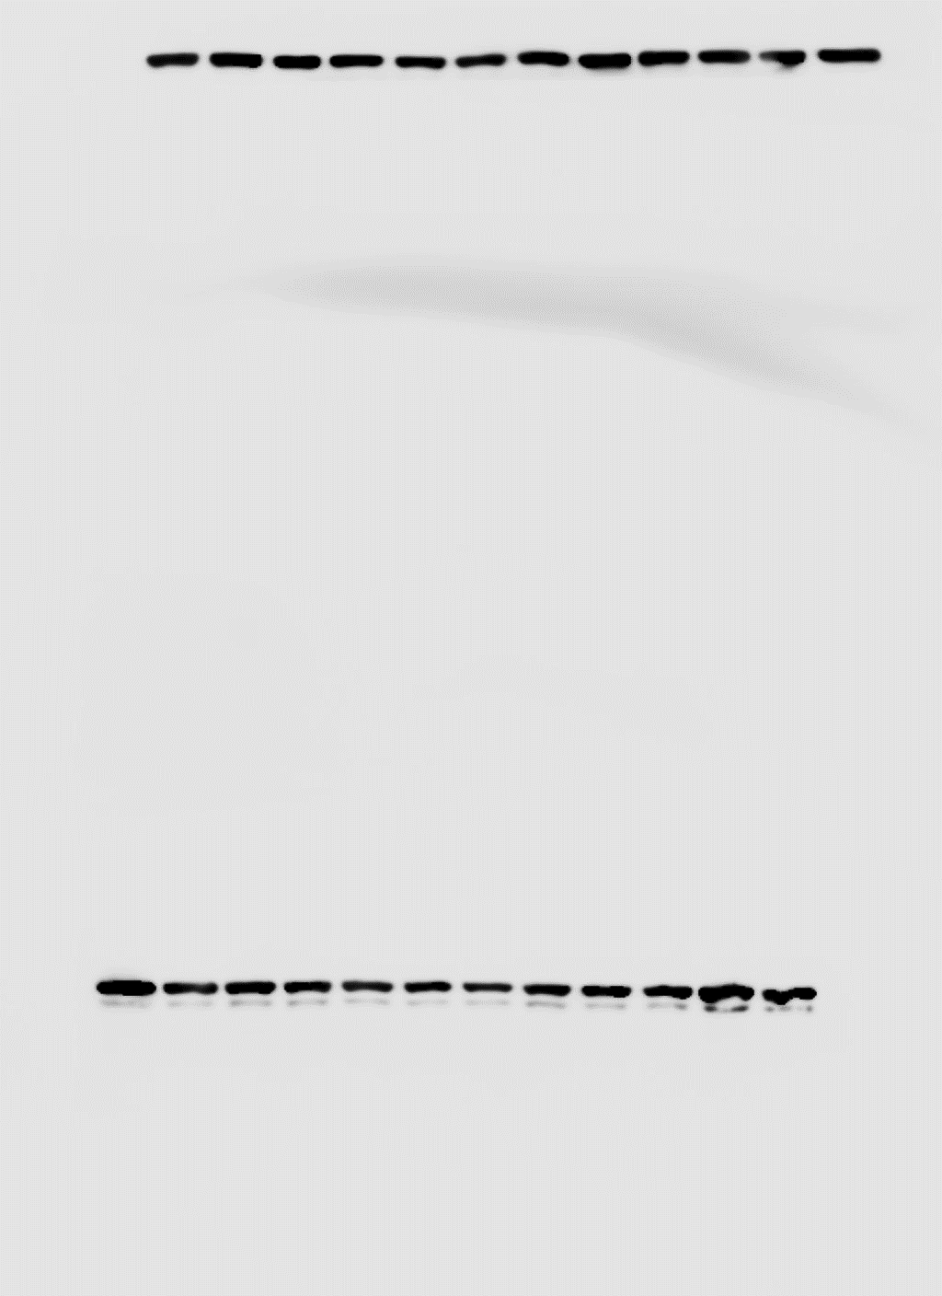


Figure 4A
OCI-LY19
IB: β-actin
IB: P(Thr389)-p70S6K
IB: β-actin
IB: S6K
Lordello, L. et al.

Slide 11
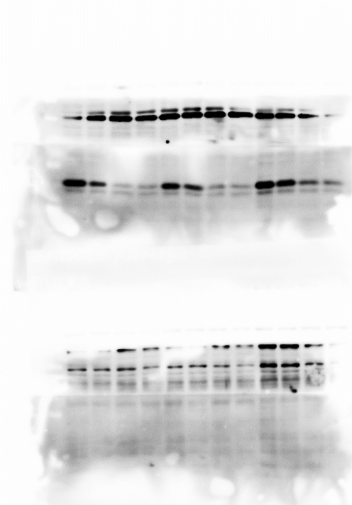
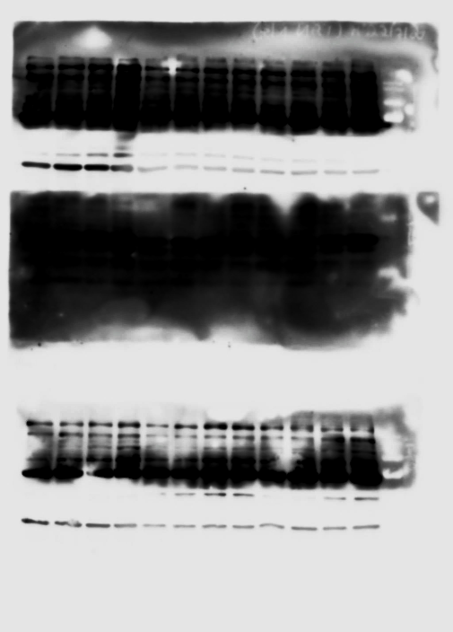

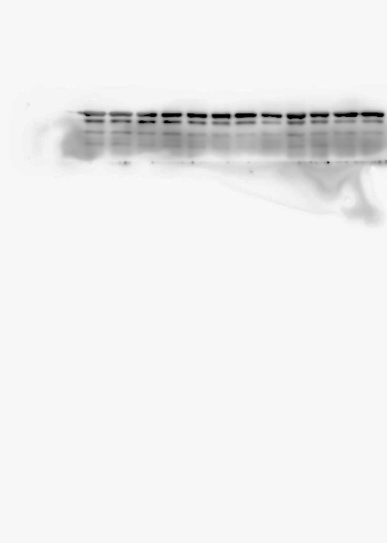
Figure 4A
OCI-LY19
IB: P(S65)-4E-BP1
IB: GAPDH
IB: 4E-BP1
IB: GAPDH
Lordello, L. et al.

Slide 12





Figure 4A
MD-901
IB: P(Thr389)-p70S6K
IB: β-actin
IB: β-actin
IB: S6K
IB: β-actin
IB: P(S65)-4E-BP1
IB: β-actin
IB: 4E-BP1
Lordello, L. et al.

Slide 13

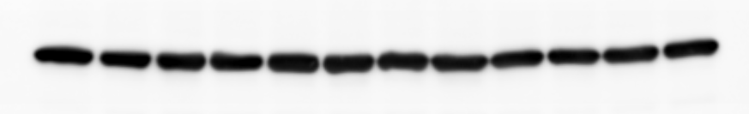
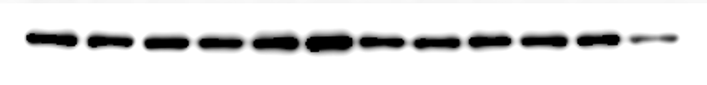
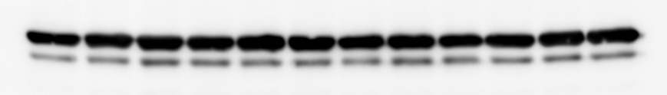


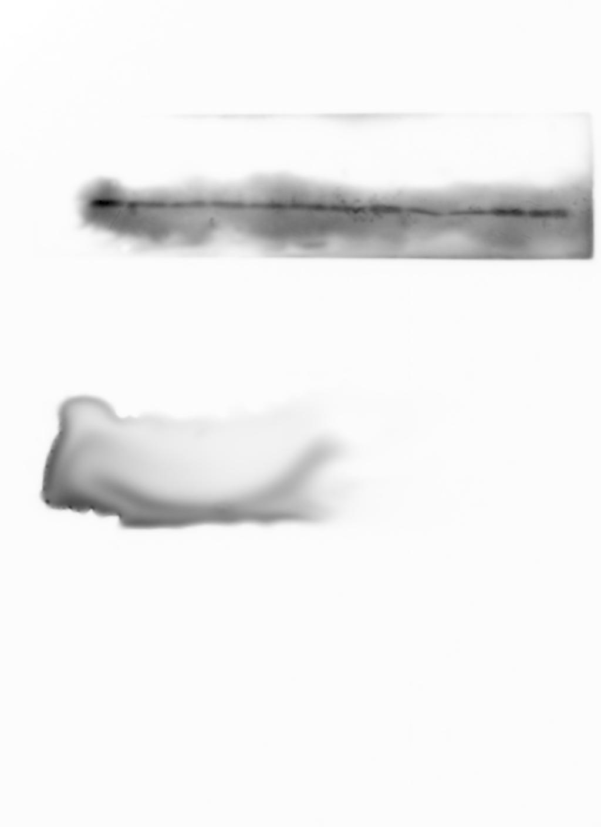
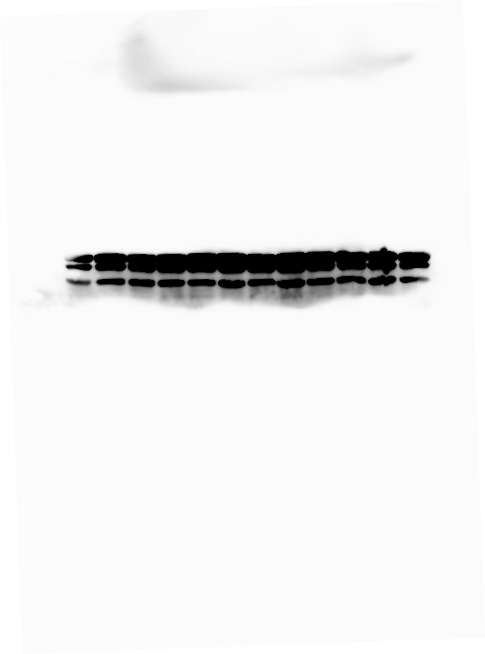
Figure 4A
SU-DHL4
IB: β-actin
IB: P(Thr389)-p70S6K
IB: β-actin
IB: S6K
IB: β-actin
IB: P(S65)-4E-BP1
IB: 4E-BP1
IB: GAPDH
Lordello, L. et al.

Slide 14
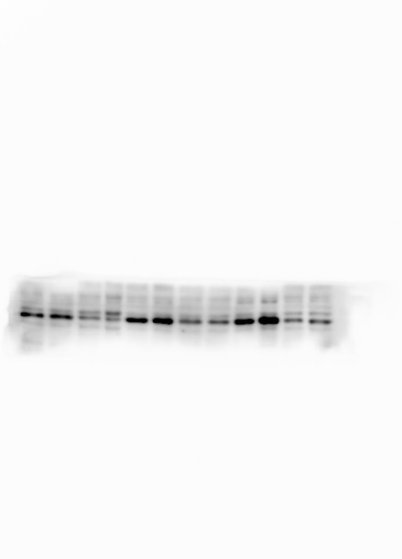
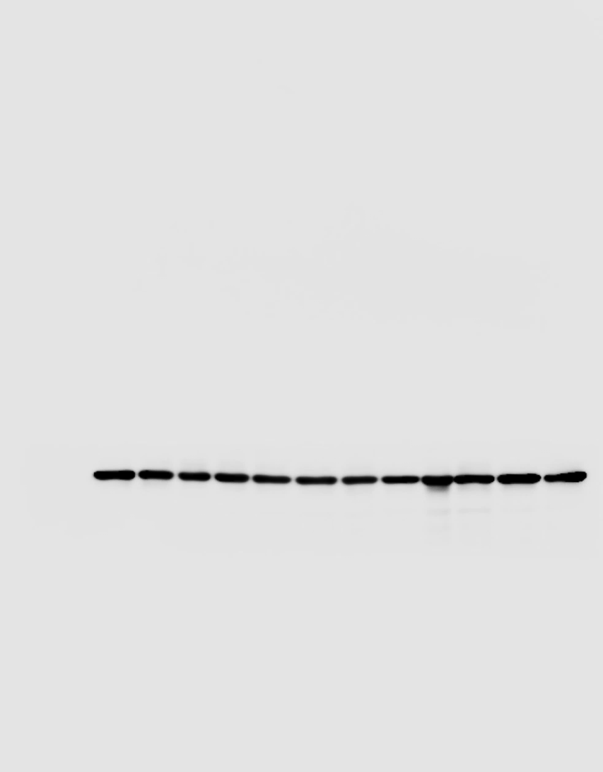
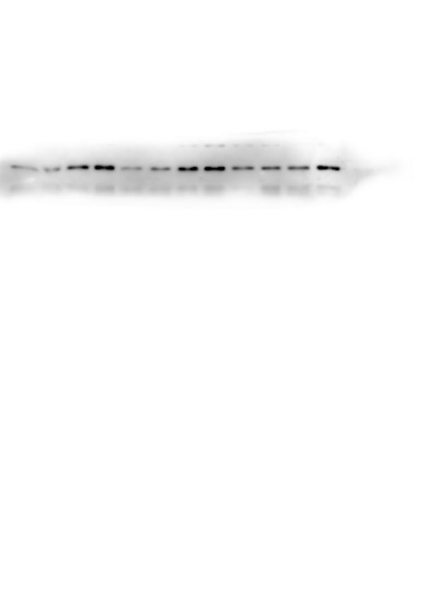

Figure 4B
OCI-LY19
IB: P(Thr180/Tyr182)-p38
IB: β-actin
IB: β-actin
IB: p38
Lordello, L. et al.

Slide 15
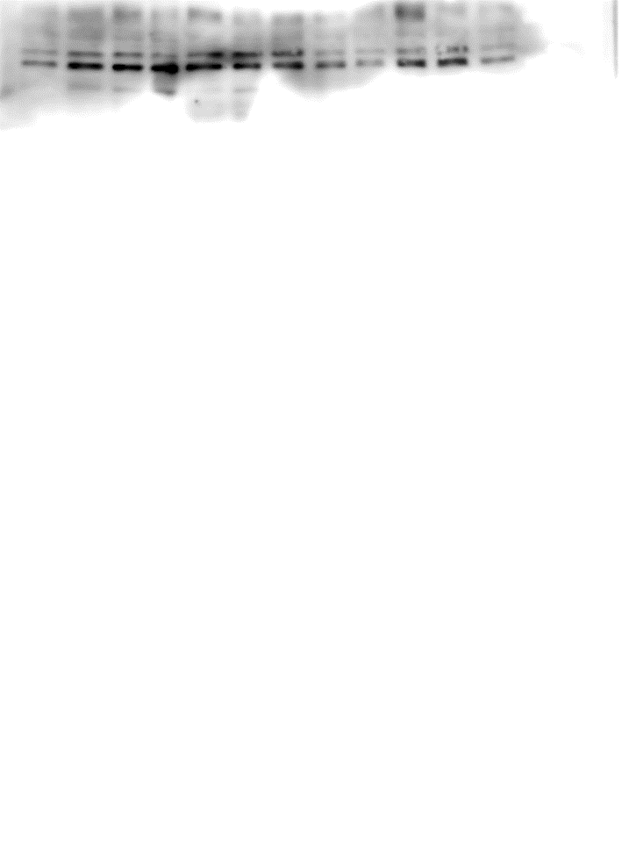
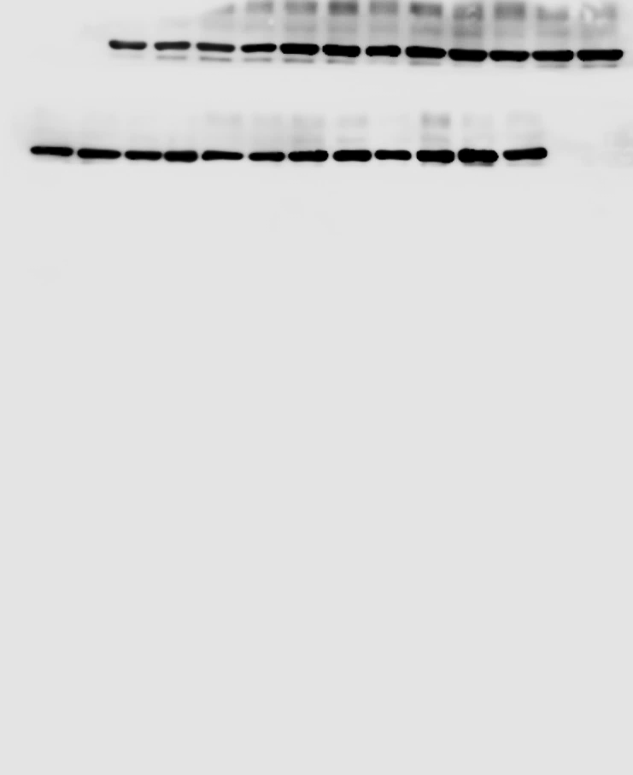
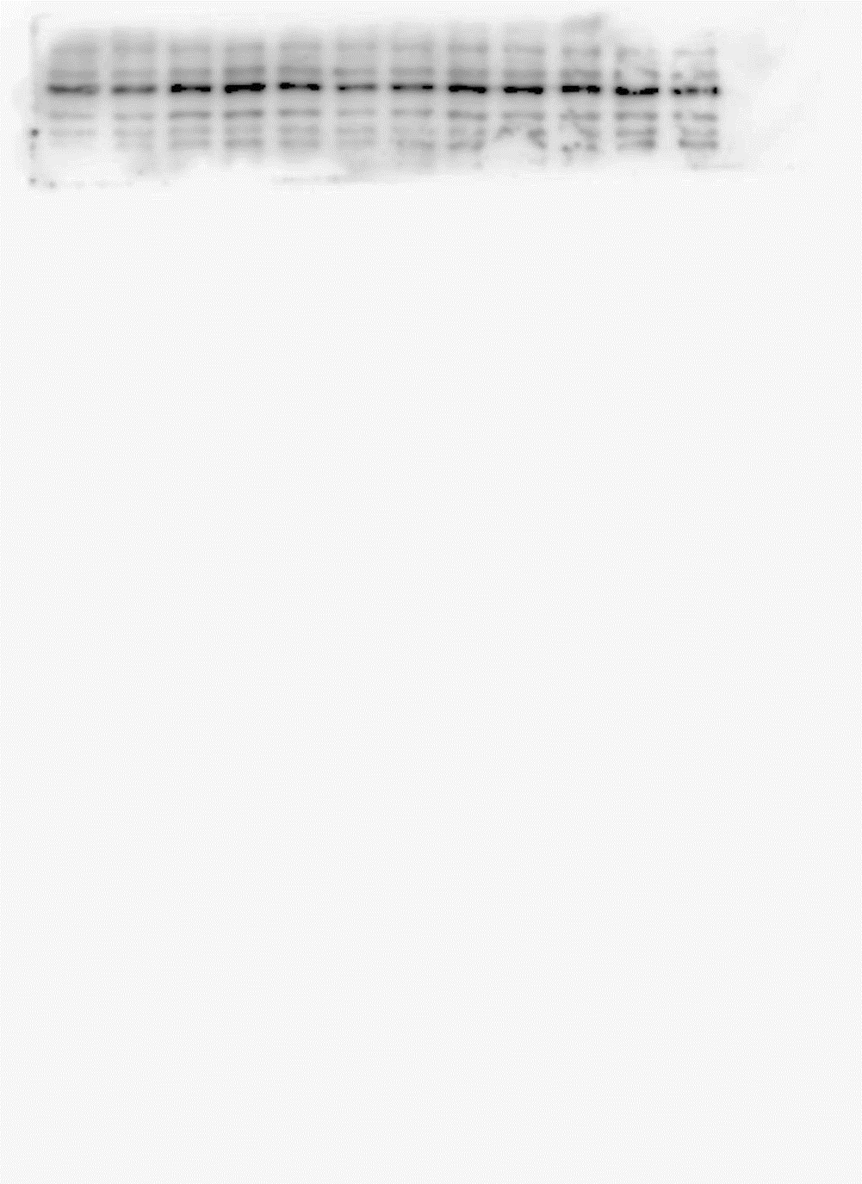
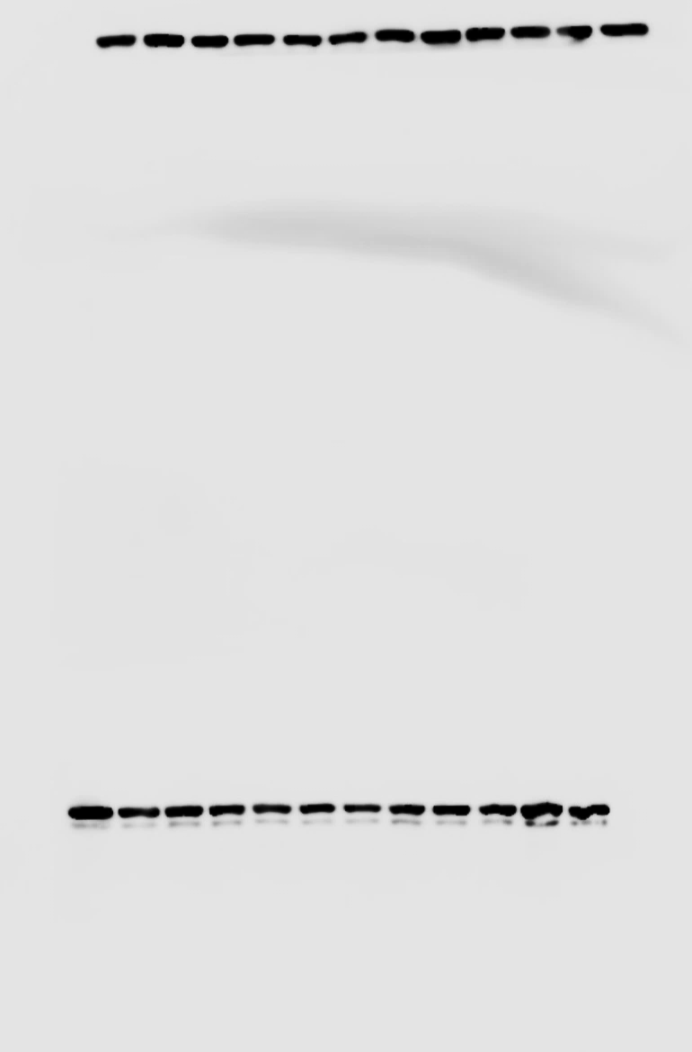
Figure 4B
OCI-LY19
IB: P(Thr202/Tyr204)-Erk1/2
IB: β-actin
IB: Erk1/2
IB: β-actin
Lordello, L. et al.

Slide 16
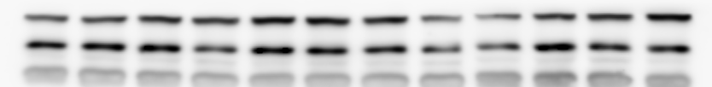

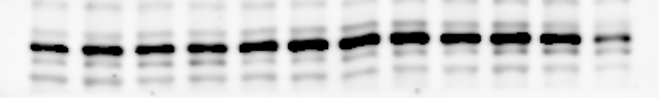
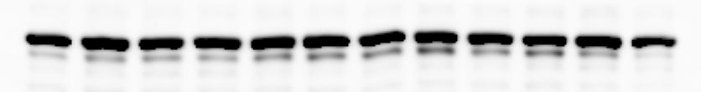
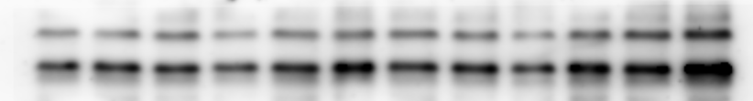
Figure 4B
MD-901
IB: β-actin
IB: P(Thr180/Tyr182)-p38
IB: β-actin
IB: p38
IB: β-actin
IB: P(Thr202/Tyr204)-Erk1/2
IB: β-actin
IB: Erk1/2
Lordello, L. et al.

Slide 17


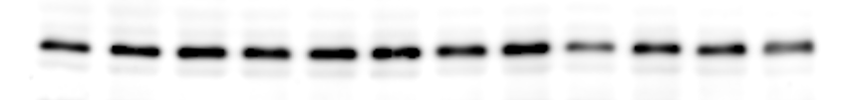
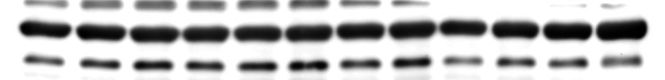

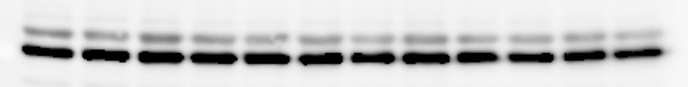
Figure 4B
SU-DHL4
IB: β-actin
IB: P(Thr180/Tyr182)-p38
IB: p38
IB: β-actin
IB: β-actin
IB: P(Thr202/Tyr204)-Erk1/2
IB: β-actin
IB: Erk1/2
Lordello, L. et al.

